Slide 1

SG Update – ScotWind
Practical Measures to Enable Rollout

Slide 2
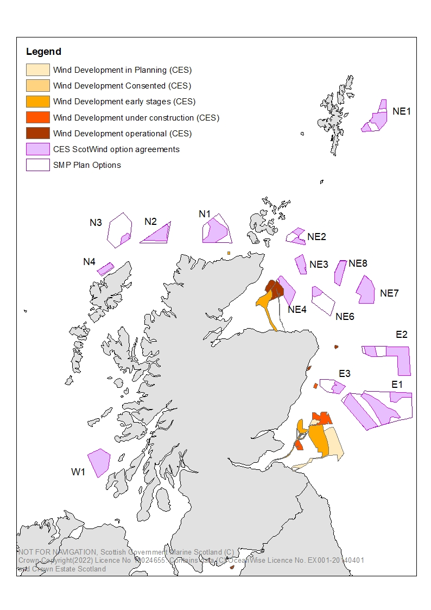
SCOTWIND – PRACTICAL MEASURES TO ENABLE ROLLOUT
What is ScotWind?

Slide 3
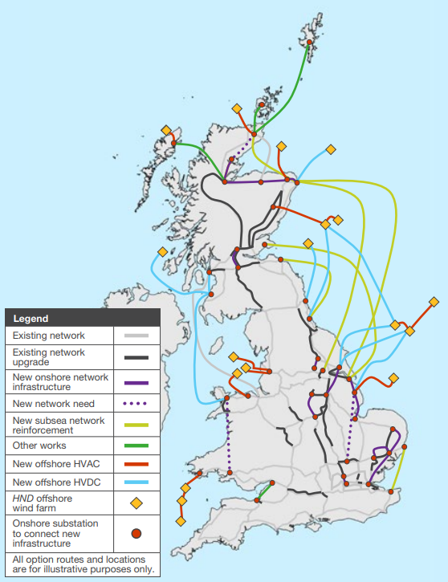
SCOTWIND – PRACTICAL MEASURES TO ENABLE ROLLOUT
The Offshore Wind Policy Statement (2020) sets Scotland’s ambition to achieve 8-11GW of off-shore wind in Scottish Waters by 2030 – the required changes to the grid infrastructure are detailed here
This is illustrative and more detailed work is underway to show specific locations and designs.
A follow-up process is also being undertaken to bring ScotWind projects not already included within the HND into scope.
National Grid ESO, Pathway to 2030 (July 2022)

Slide 4
SCOTWIND – PRACTICAL MEASURES TO ENABLE ROLLOUT
Resourcing / streamlining processes
Consult on changes to expand PDR for electricity sub-stations - PDR Review Phase 3
Work with HOPS as they develop a model voluntary agreement to provide income towards Planning Authorities’ resources spent as statutory consultees in respect of marine licence applications for offshore renewables
Building capacity
Work with the Improvement Service and HOPS to develop and deliver a programme of knowledge and information sharing to upskill the planning workforce and decision-makers (including elected members)
    Hydrogen workshop delivered October 2022
    Hydrogen production planning advice – draft in progress
    Grid consenting delivered March 2023
To facilitate and support regular information and knowledge sharing between SG (PARD, MS, and ECU as relevant) and HoPS.
SG tracking system (including inputs from PAs) to identify and monitor key development proposals necessary to support Scotwind.

Slide 5
SCOTWIND – PRACTICAL MEASURES TO ENABLE ROLLOUT
Thank you
Keith Willcock
Keith.Willcock@gov.scot

