Slide 1


Reflections on Scotland’s
Best Places
Stephen Tucker
Royal Town Planning Institute

Slide 2
December 2013: public call for suggestions
February 2014: 55 places nominated
February 2014: Expert Panel meets
March 2014: shortlist announced
March 2014: public vote
7 May: deadline
June: announcement

Slide 3

SCOTLAND’S BEST PLACES
built, enhanced or protected by planners and the planning system within Scotland since 1914 and that they:
have had a significant positive and sustainable impact socially, environmentally and economically
are best practice in planning
have benefitted from the important role played by planners and the planning system
are nationally significant and important to Scotland

Slide 4
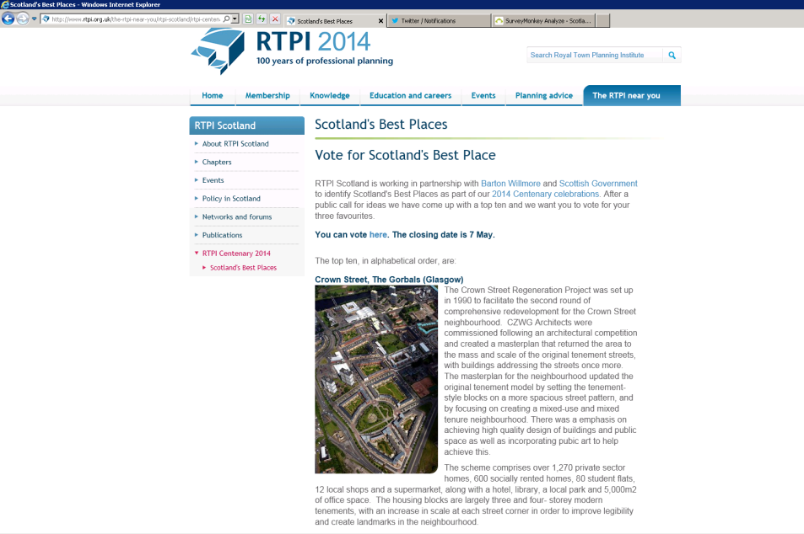
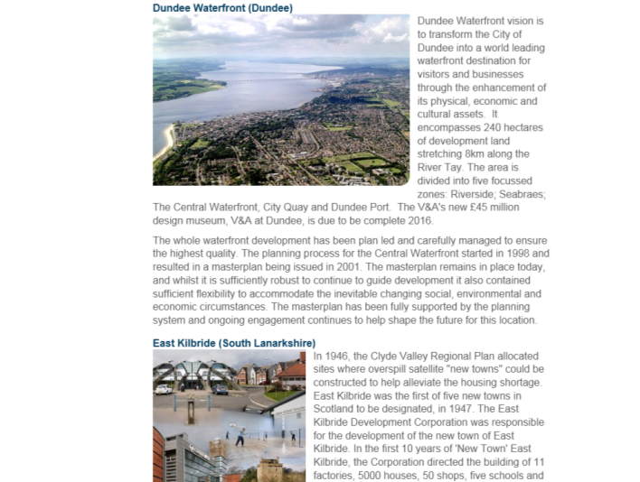

Slide 5
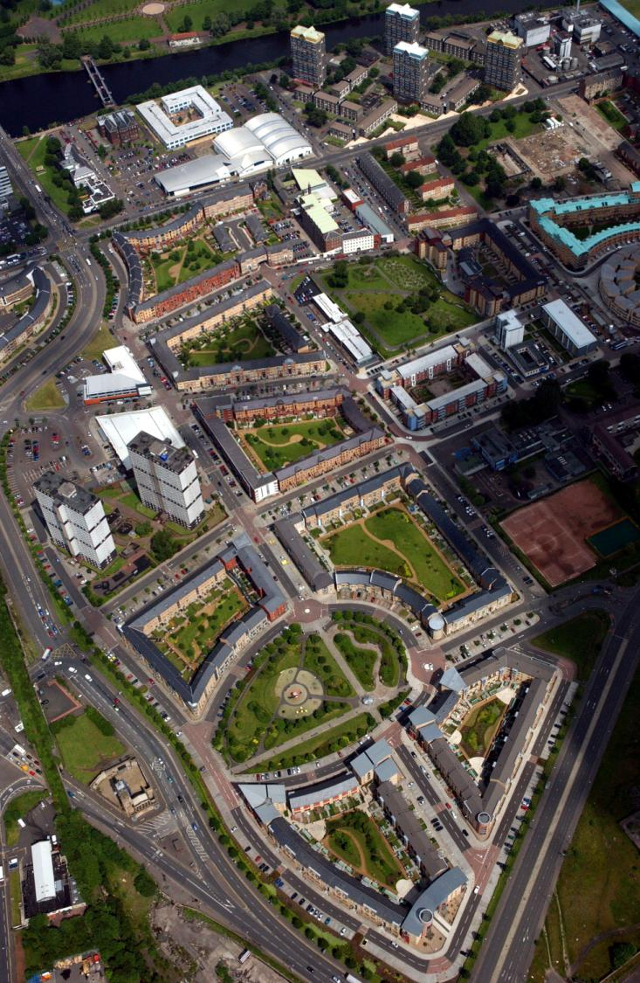
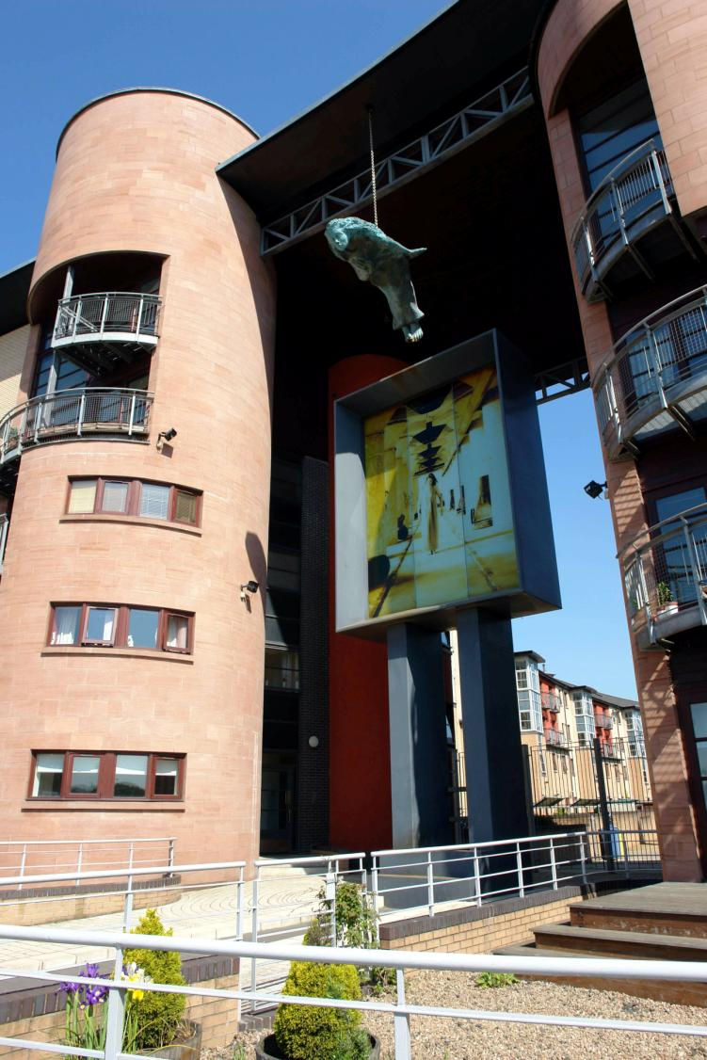

Slide 6
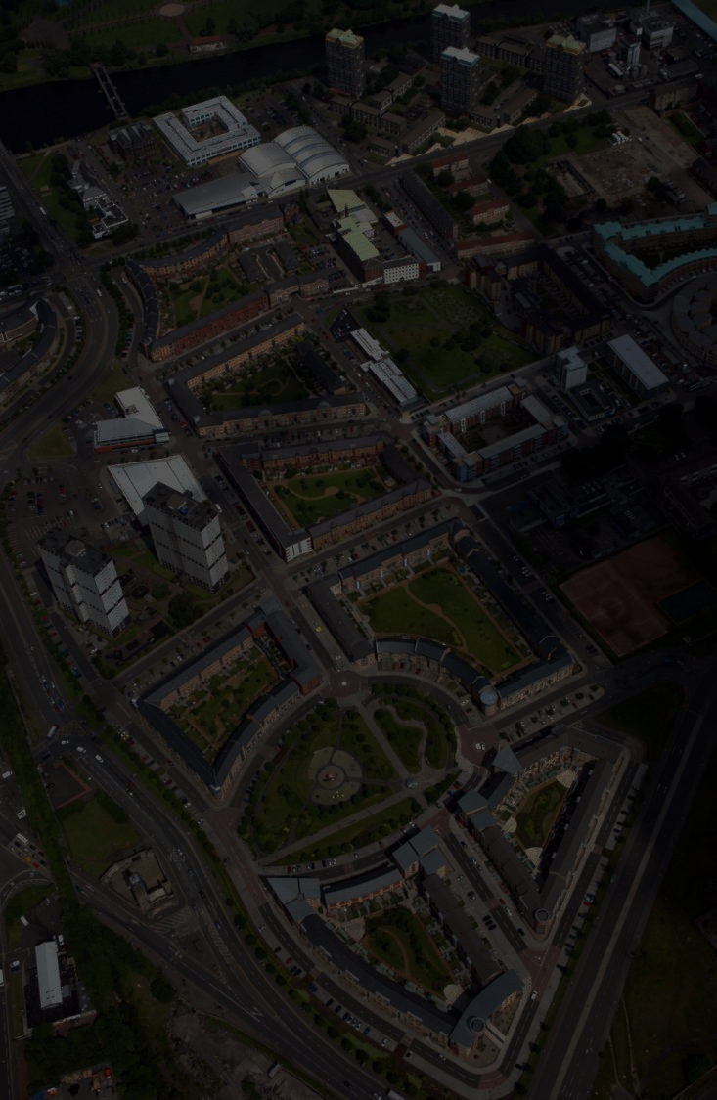
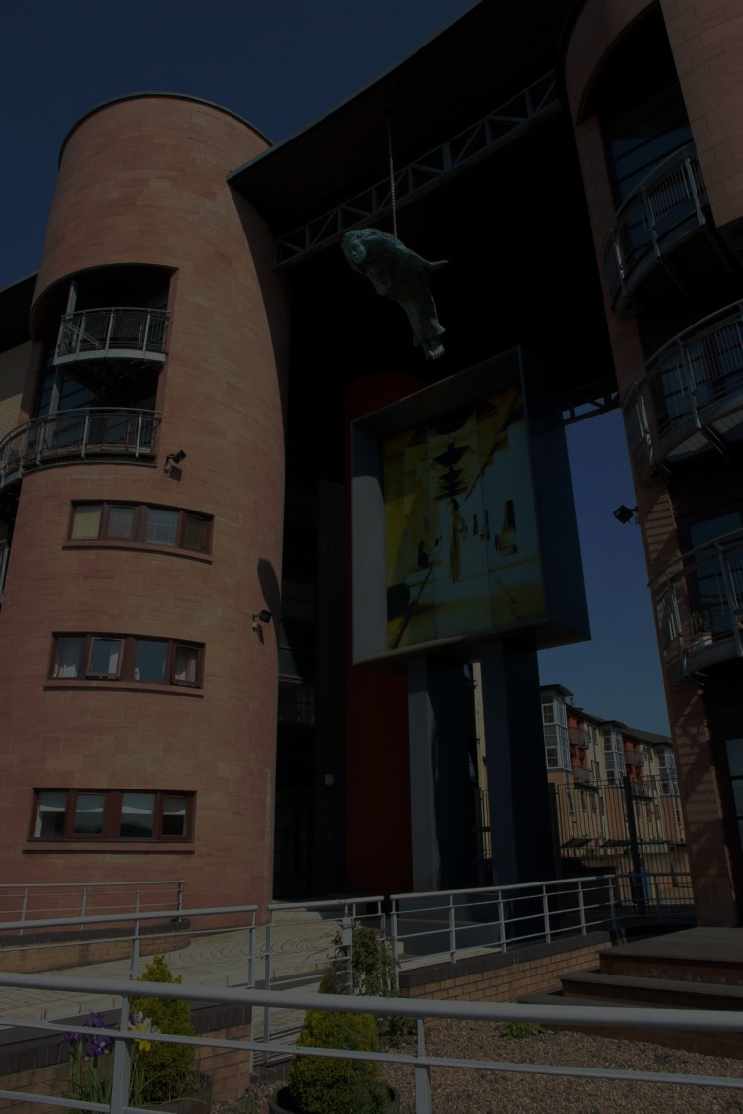
Crown Street, The Gorbals, Glasgow
Regeneration
Masterplan
Mixed Use
2000 homes

Slide 7
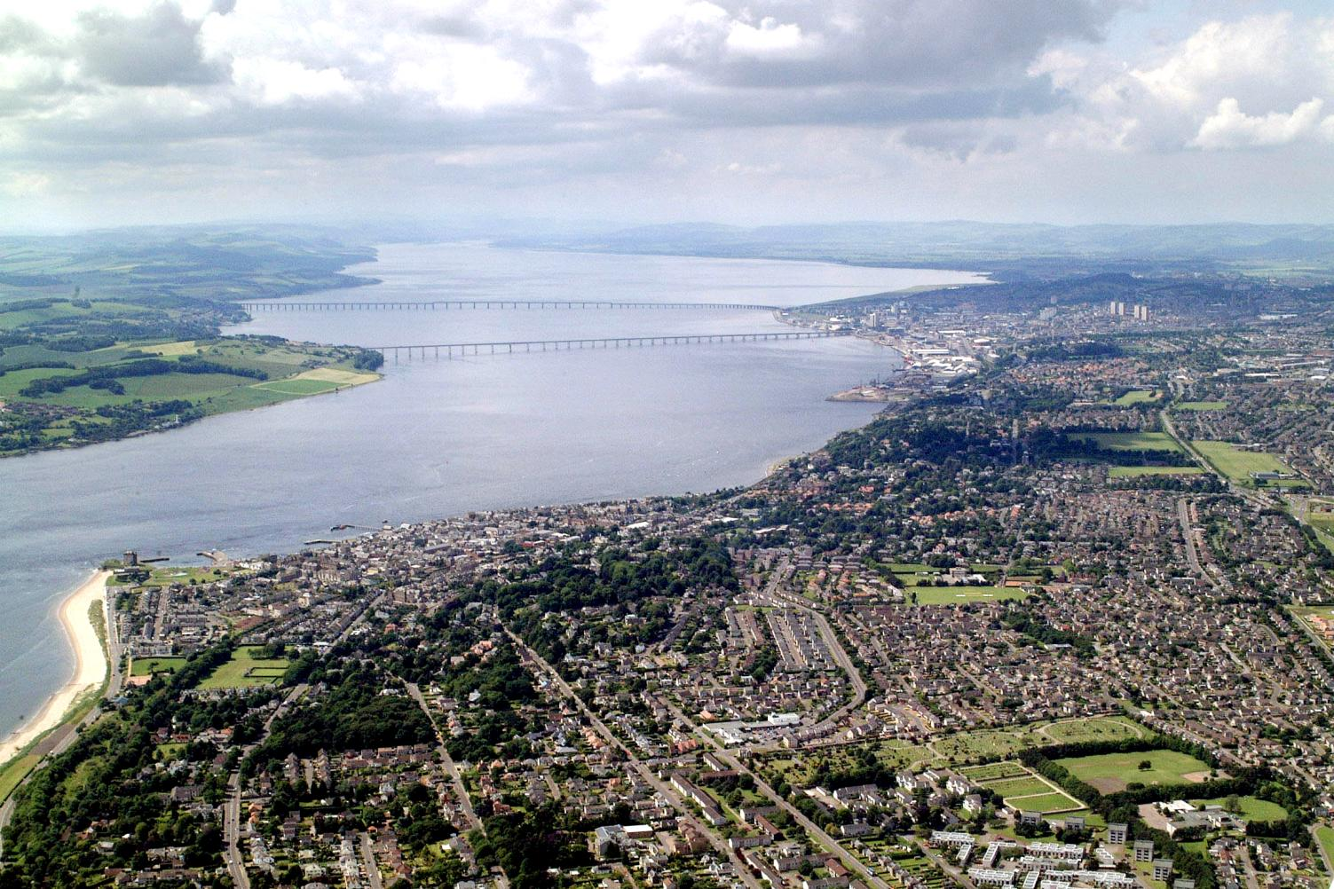

Slide 8
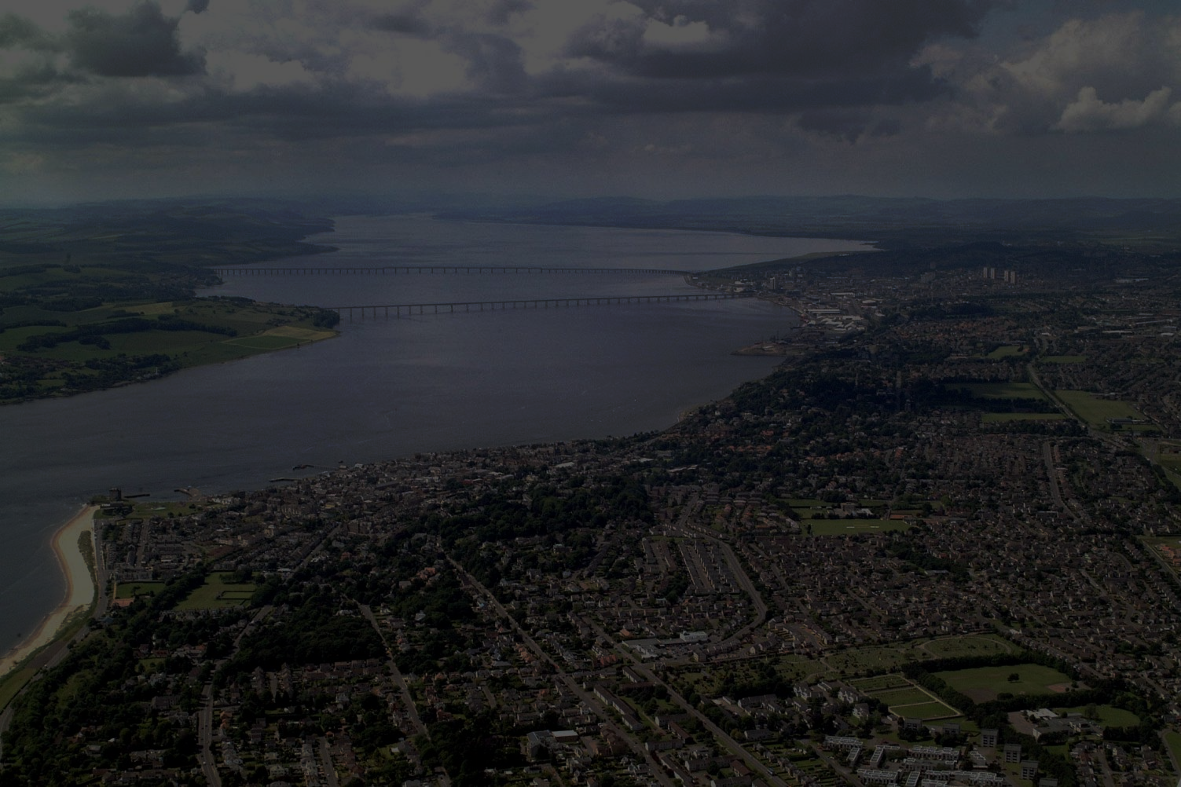
Dundee Waterfront
Regeneration
240 ha
8km
Five focussed areas
Ongoing

Slide 9
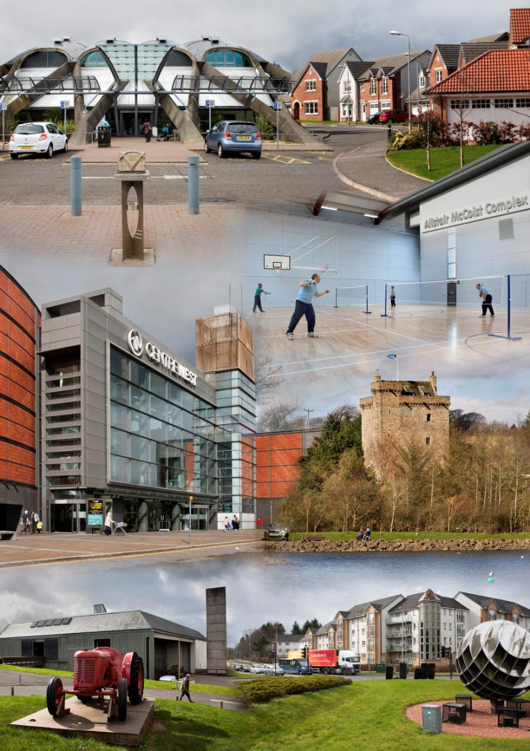

Slide 10
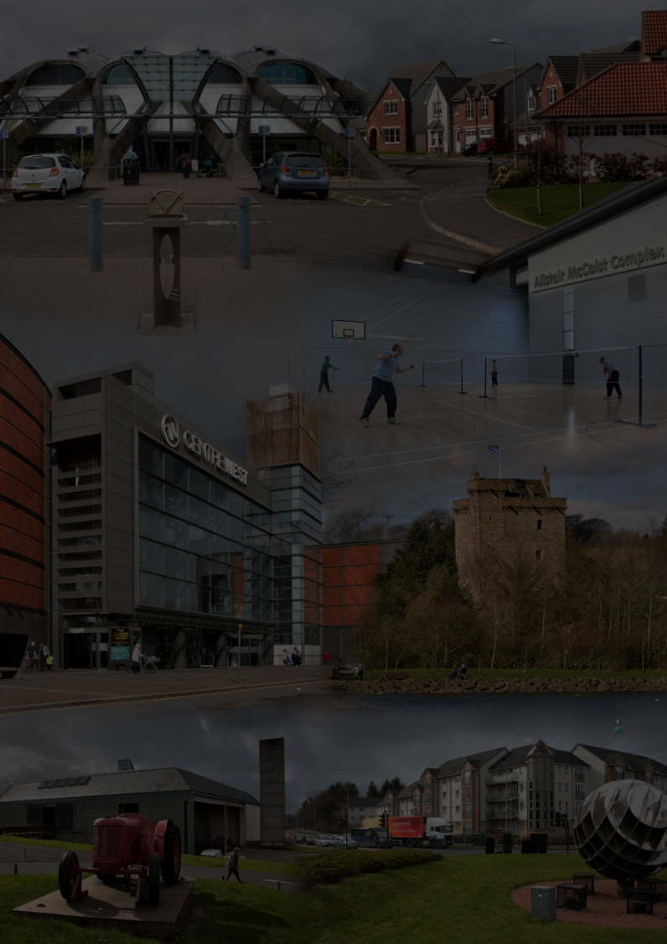
East Kilbride
South Lanarkshire
New Town
Regional Plan
Master Plan
Development Corp.
70,000

Slide 11
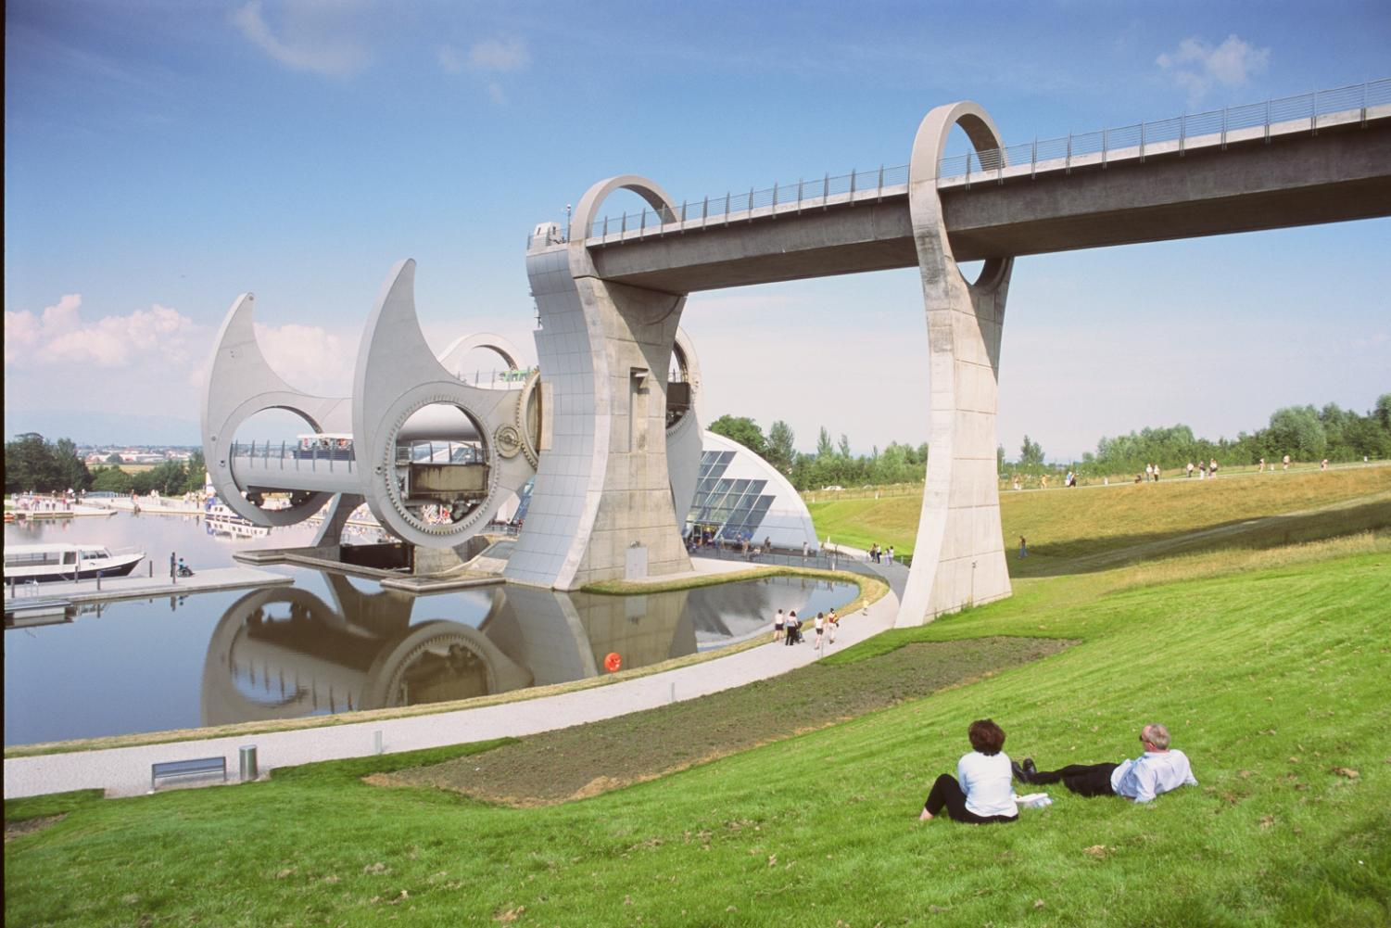

Slide 12
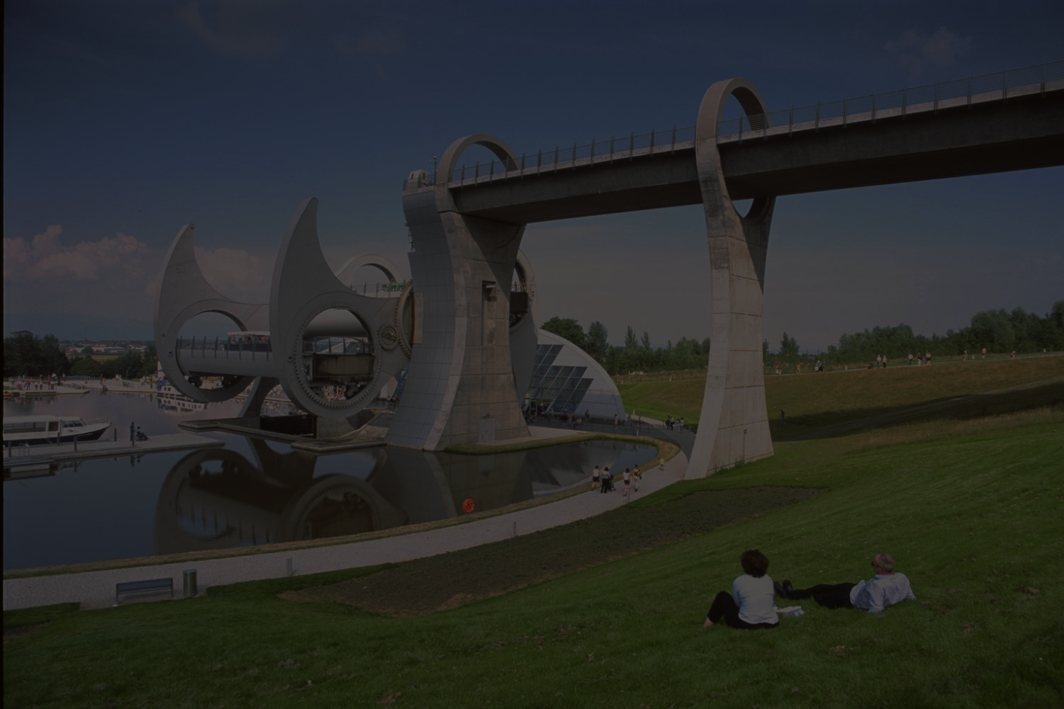
Forth and Clyde Canal
Multi authority
Subject Local Plan
Canal corridor refurbishment
Millennium Link
Falkirk Wheel

Slide 13
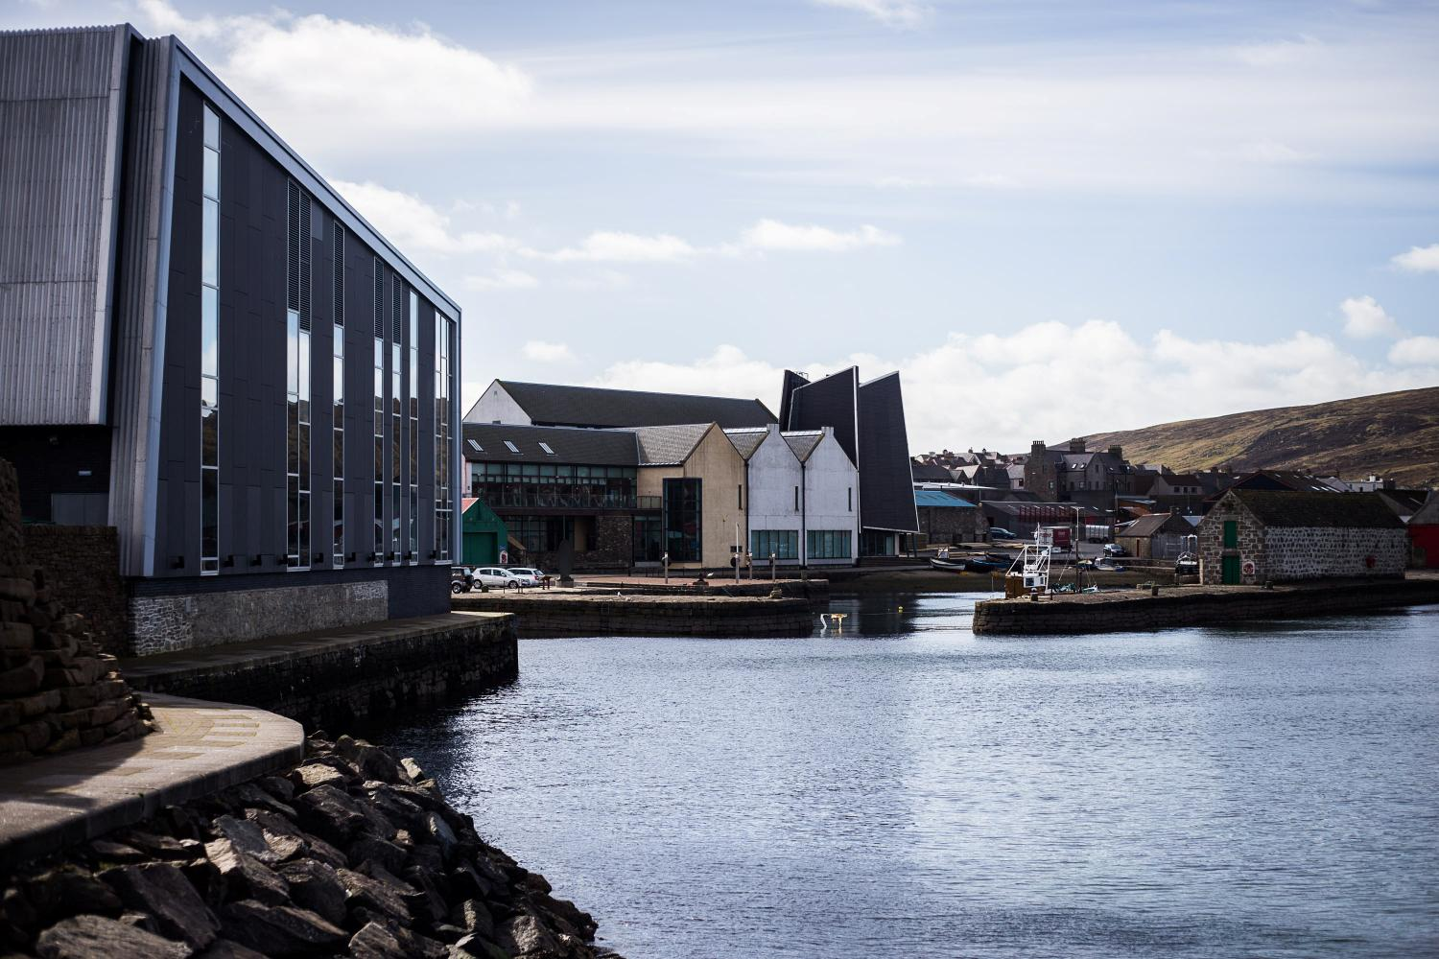

Slide 14
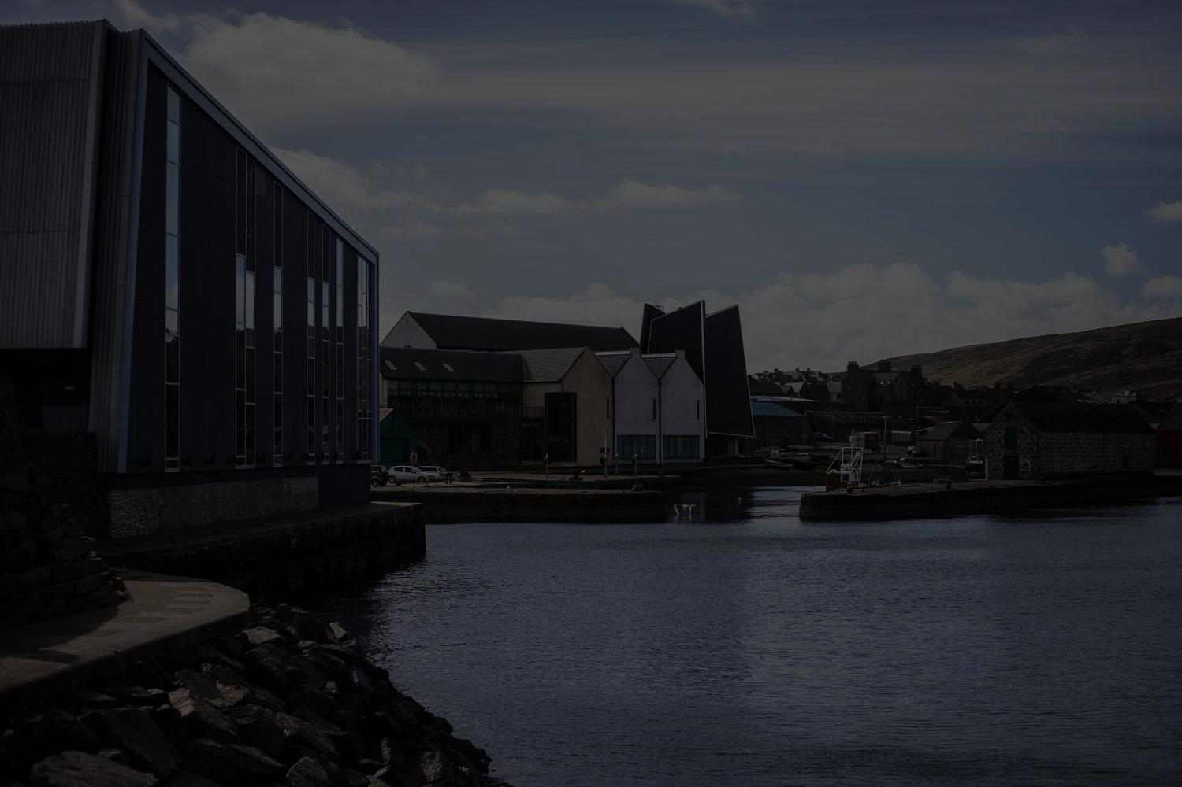
Lerwick Waterfront, Shetland
Vision for neglected area
Implementation strategy
Masterplan
Link to Town Centre
Culture
Historic builidngs

Slide 15
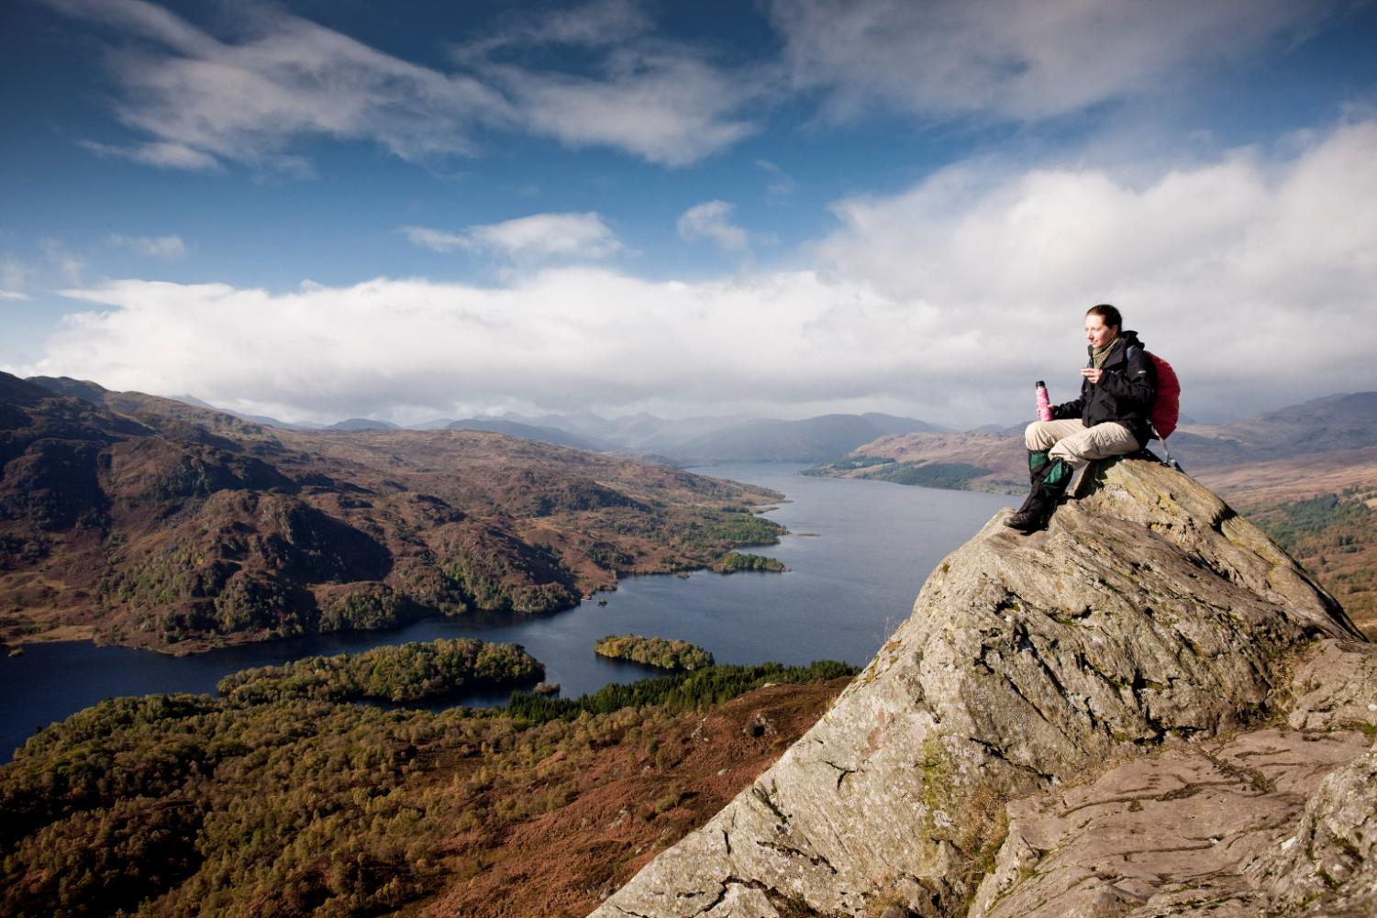

Slide 16
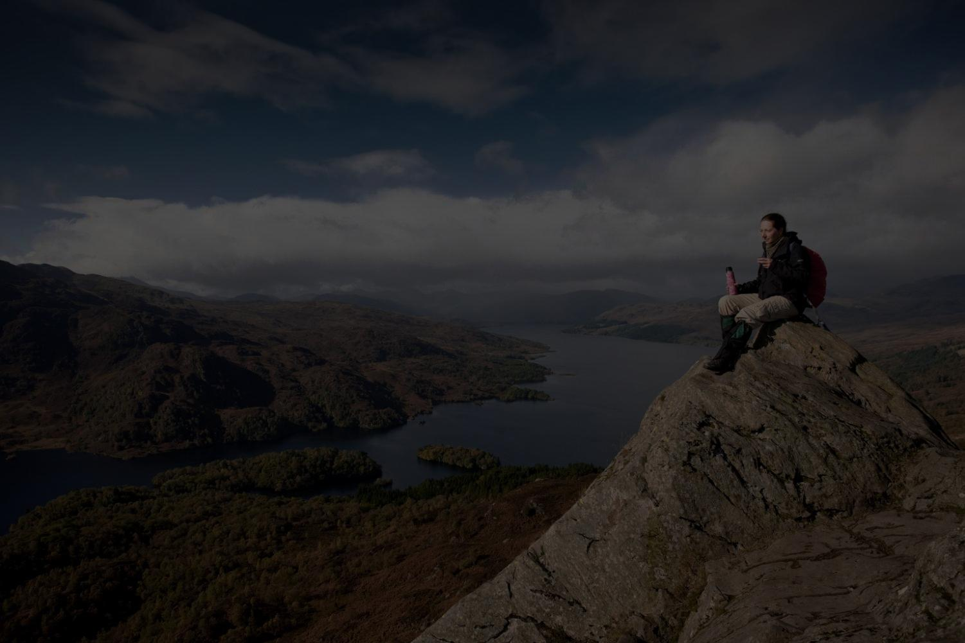
Loch Lomond and The Trossachs National Park
720 sq miles
Local plan
Protect
Enhance
Economic growth

Slide 17
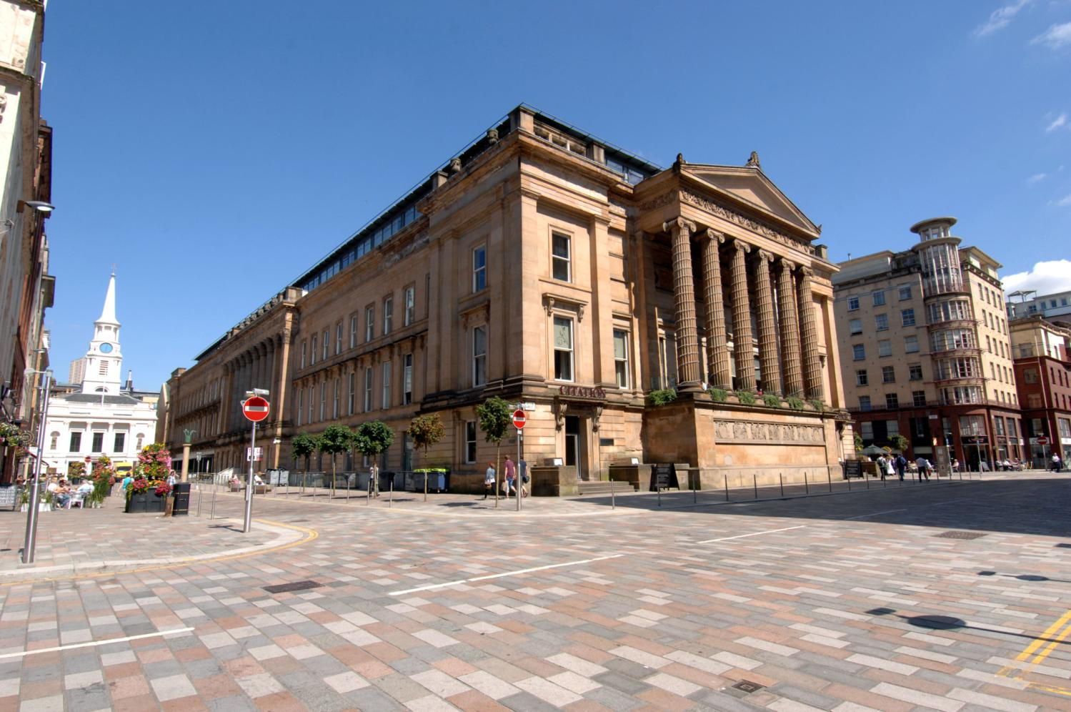

Slide 18
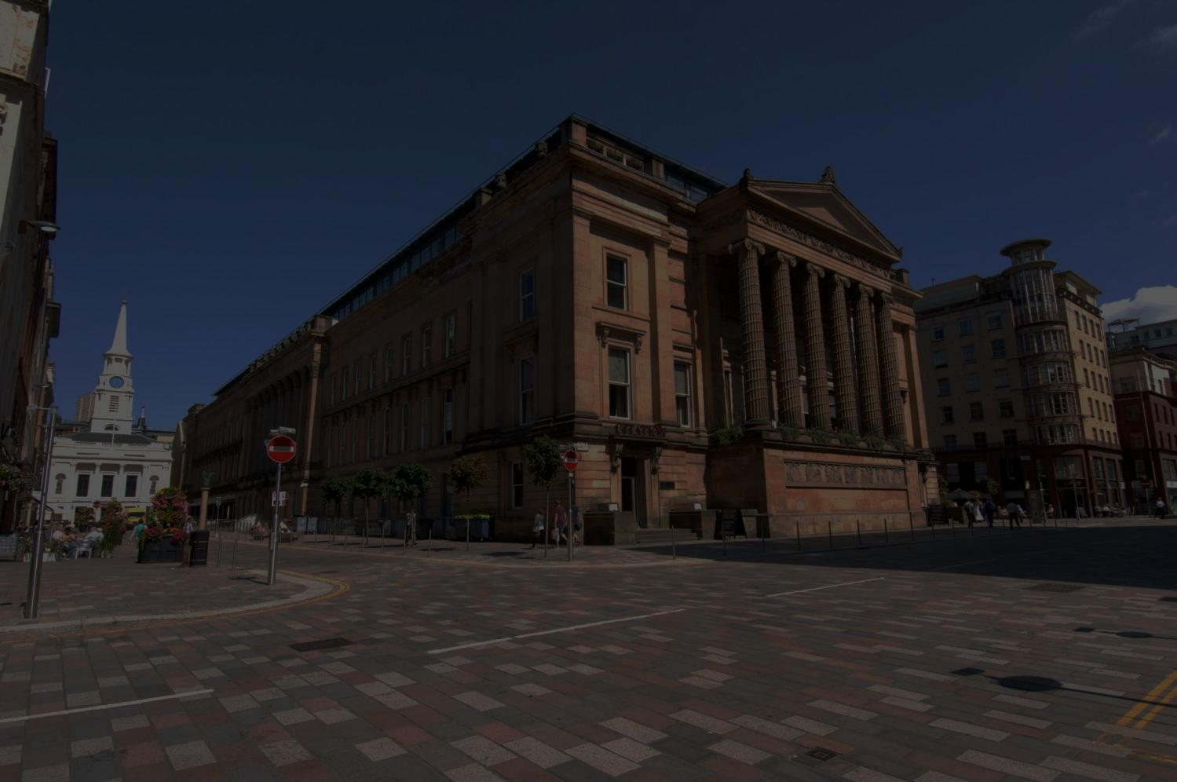
Merchant City, Glasgow
Regeneration
Branding and Confidence
Investment
Merchant City Initiative
Culture
Historic Townscape Initiative

Slide 19
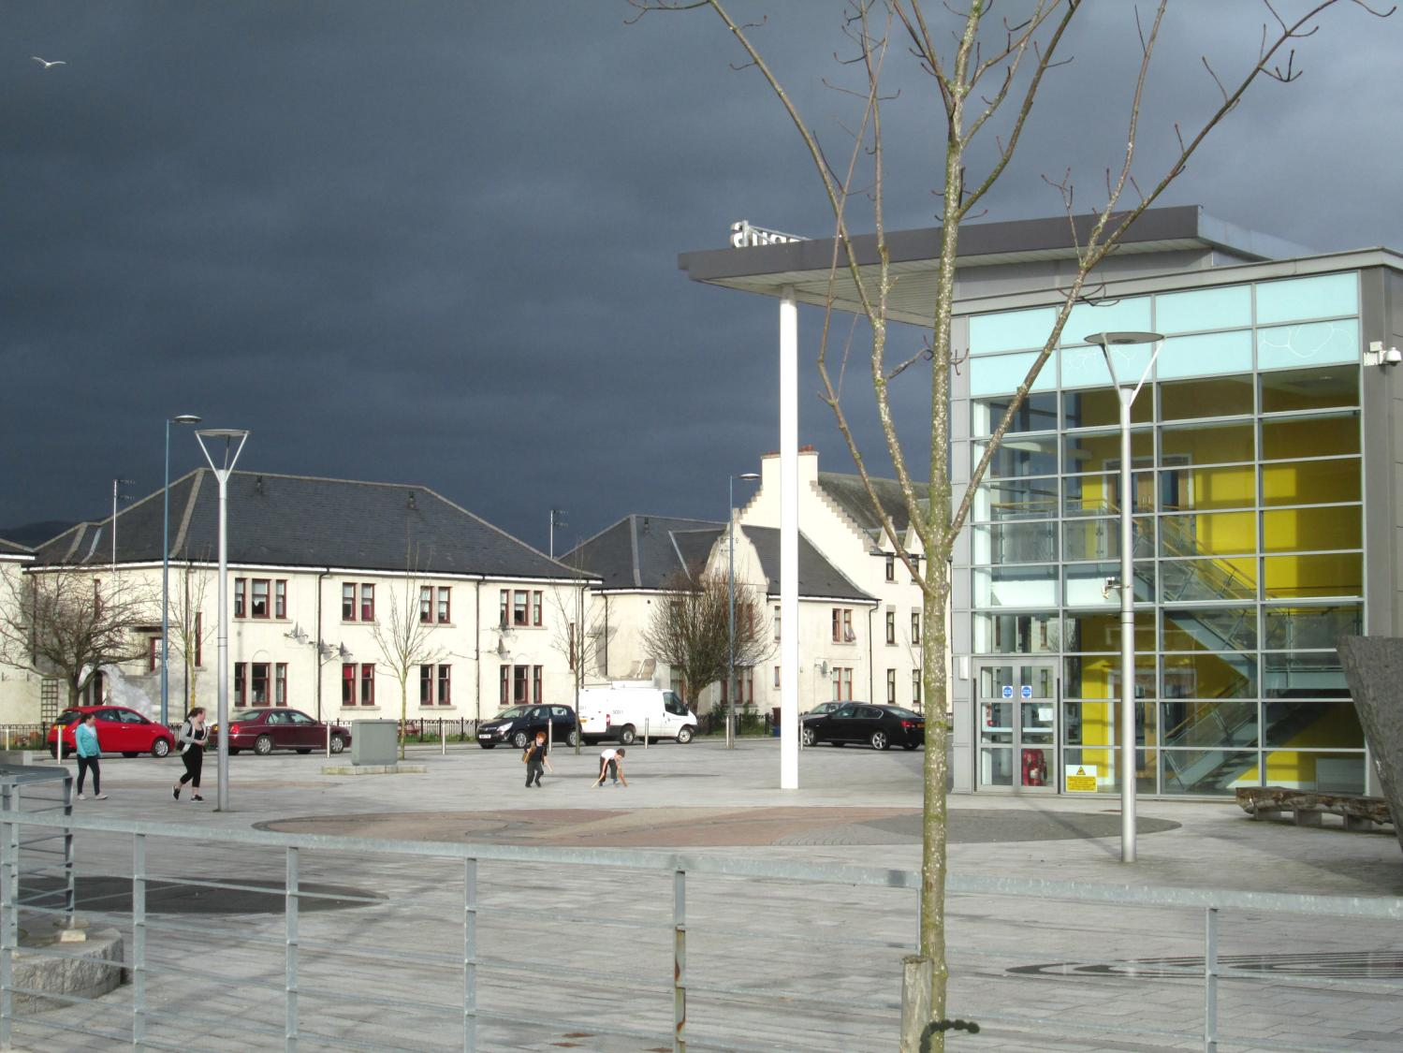

Slide 20
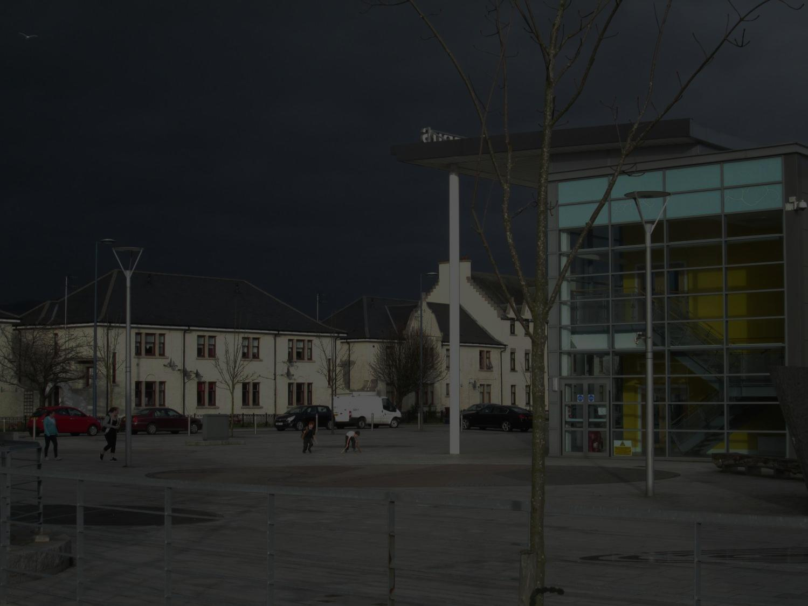
Raploch, Stirling
Masterplan
Community
Regeneration
Mixed Use
Distinctiveness
Education Campus
900 homes

Slide 21
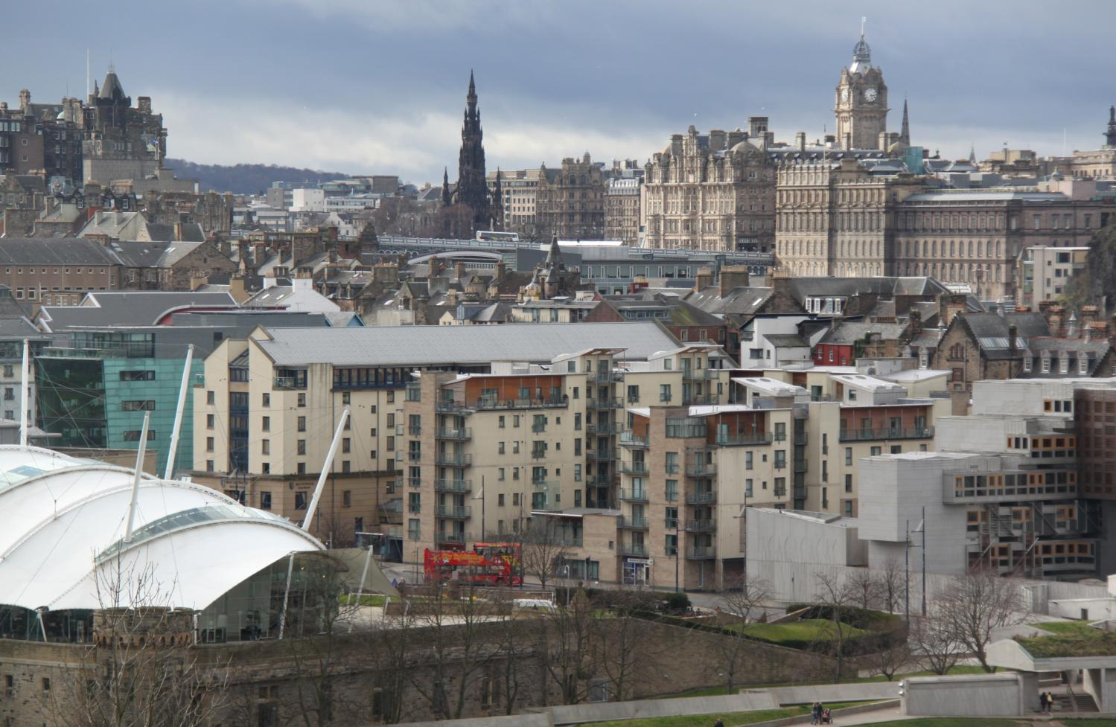

Slide 22
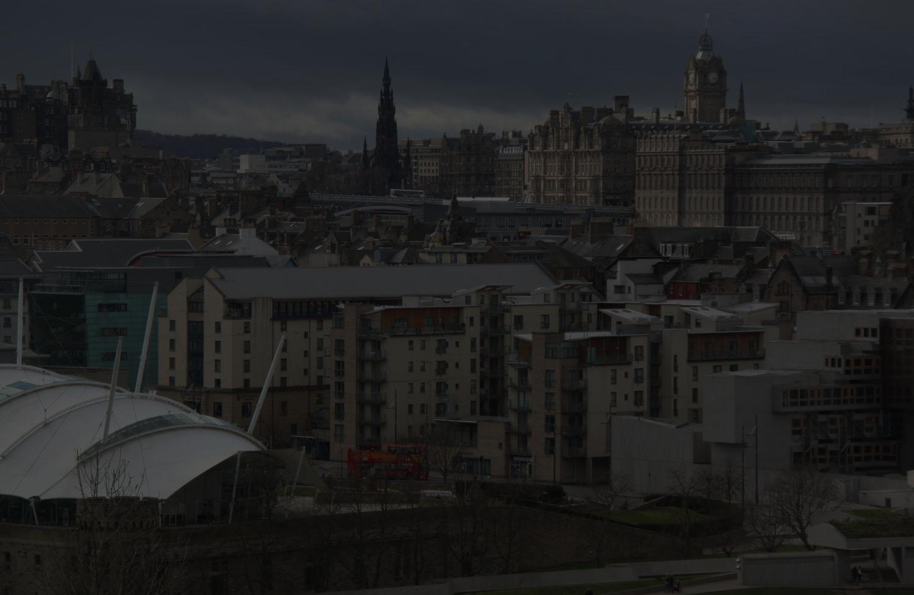
Royal Mile and Holyrood North, Edinburgh
Conservation
New build integration
Quality and design
Regeneration
Development strategy

Slide 23
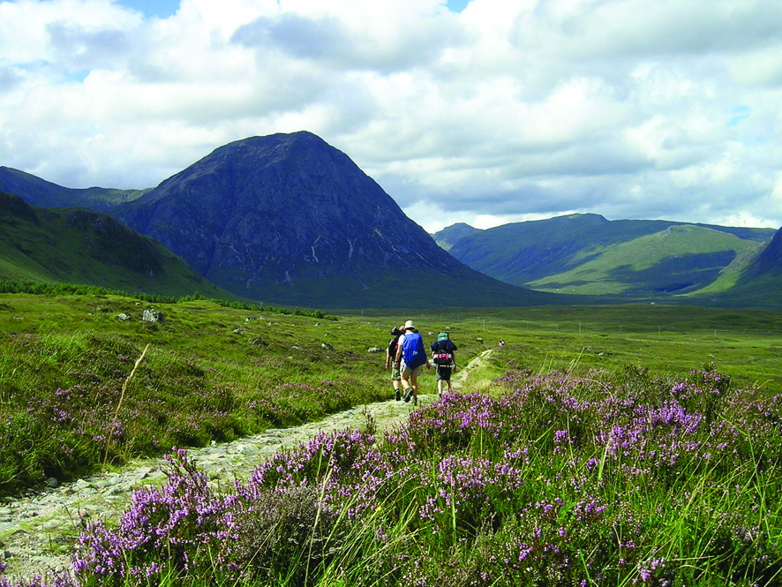

Slide 24
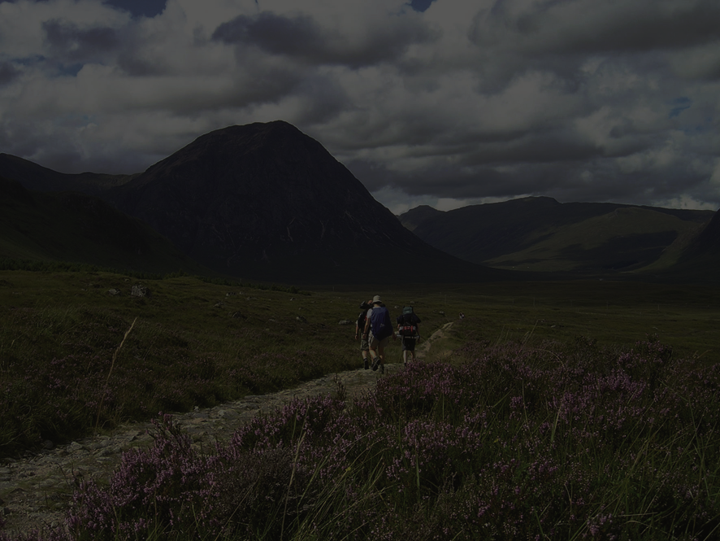
West Highland Way
96 miles
Protected through Structure Plan
Joint working
Improve
Protect
Develop

Slide 25
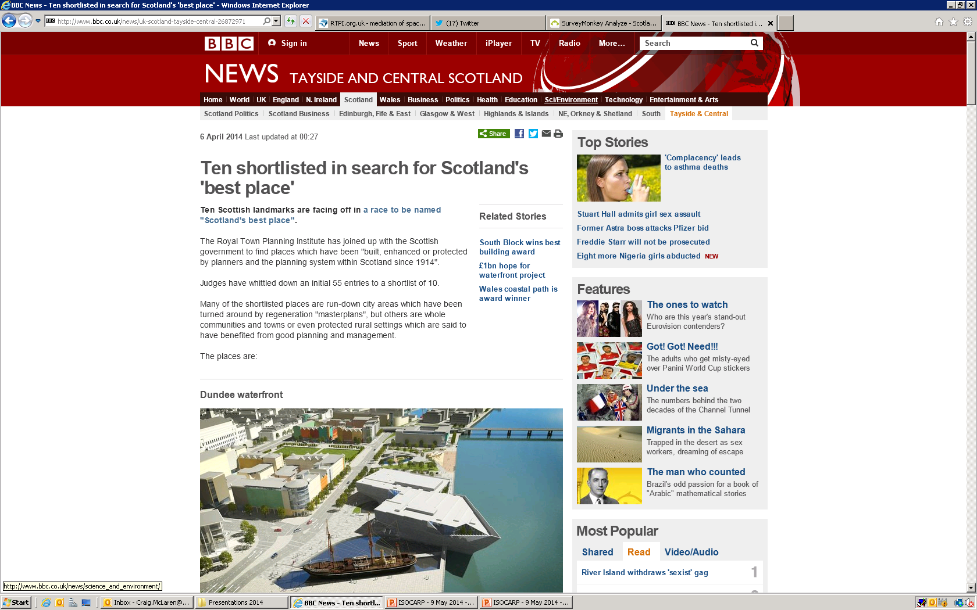

Slide 26
3,742 votes cast
Debate and discussion
Positive planning
Outcomes, not process
Great places for people
Media
June: announcement of Top 3

Slide 27

“We wanted to show how planners, planning and the planning system helped to develop, enhance or protect places across the length and breadth of Scotland.”
Alastair MacDonald

Slide 28
“…but what about the next 100 years?”

Slide 29
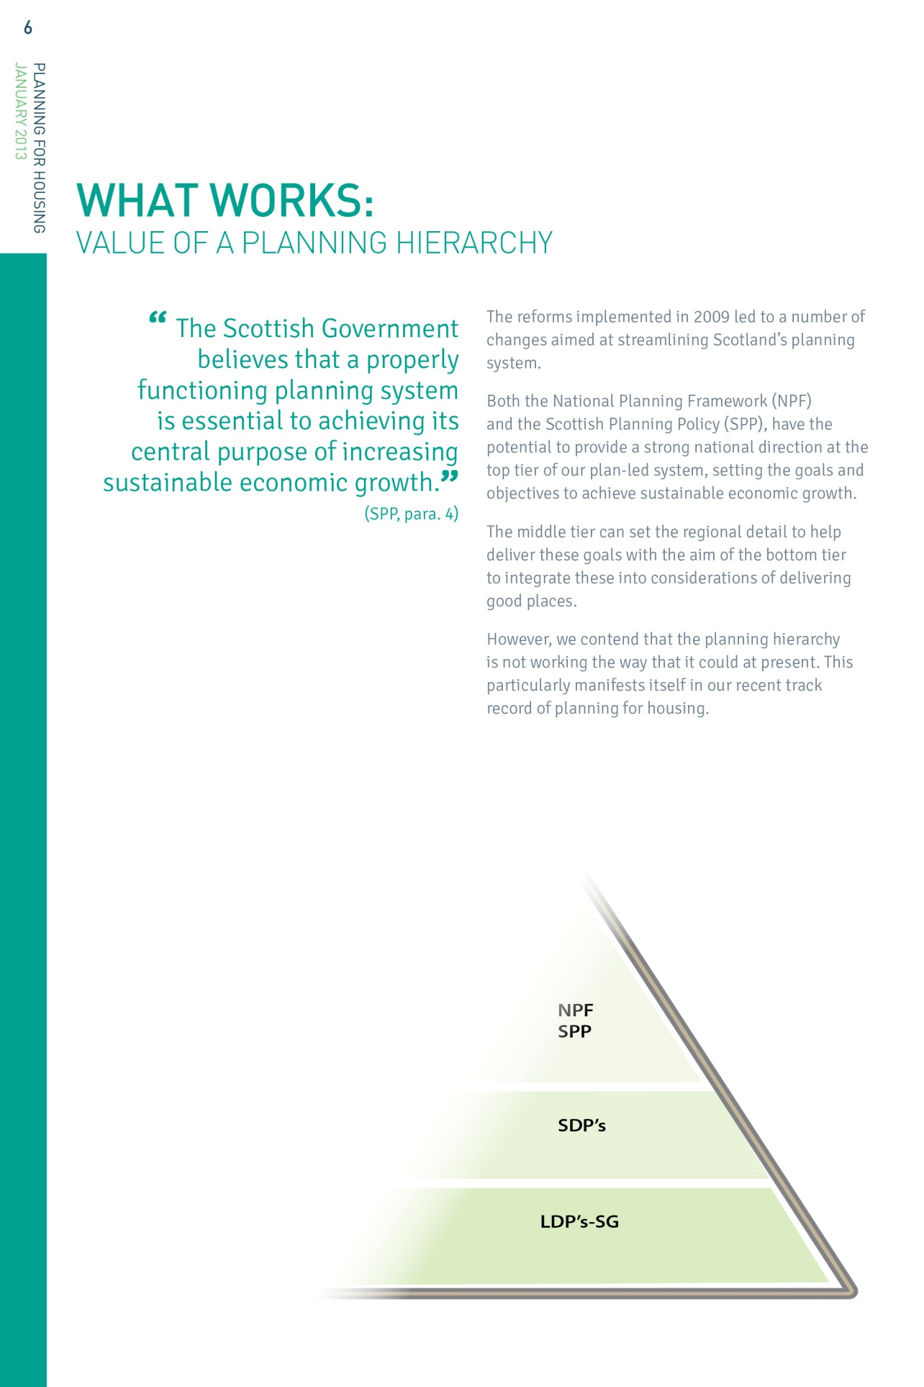
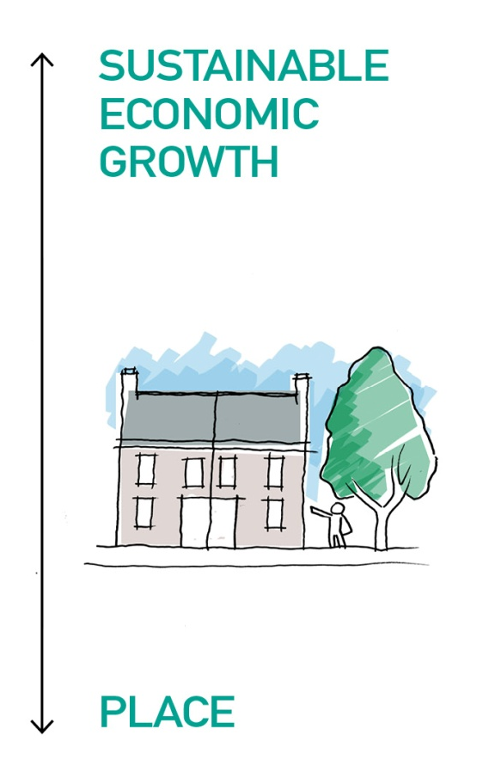

Slide 30
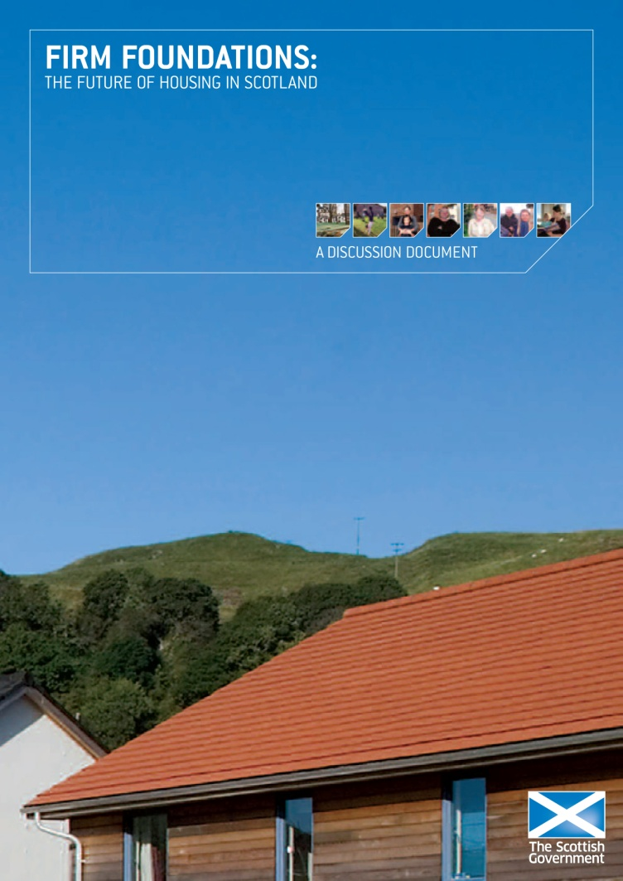
“ The worst housing crisis since the Second World War ” Philip Hogg, Chief Executive, Homes for Scotland
The Scottish Government in 2007- 35,000 new homes per year by 2015
New housing at lowest level since 1947
Planning for housing is too locally focused - National and strategic tiers could play a far greater role?
Do we plan to accommodate or stimulate growth?
Do we fully consider the economic benefits of housing?
Do we plan long term?
Do we work together to make sites effective?

Slide 31
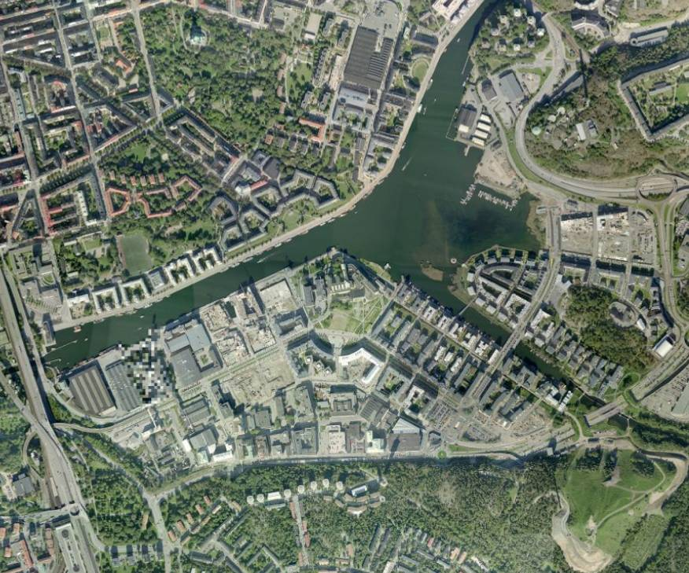
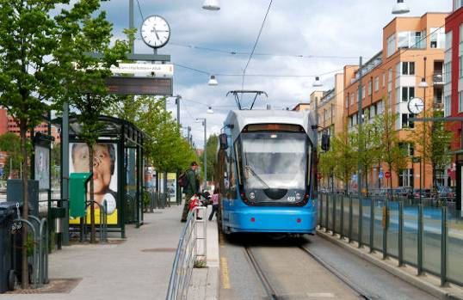
Trams / Buses

Slide 32
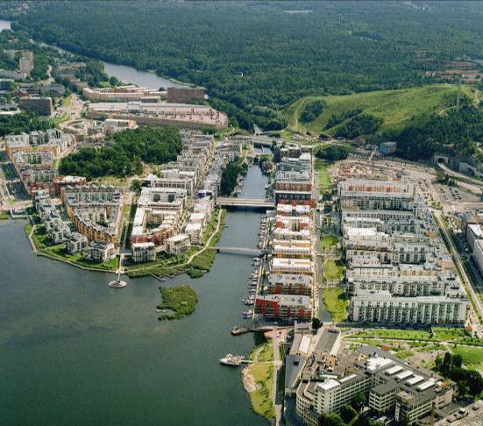

Slide 33
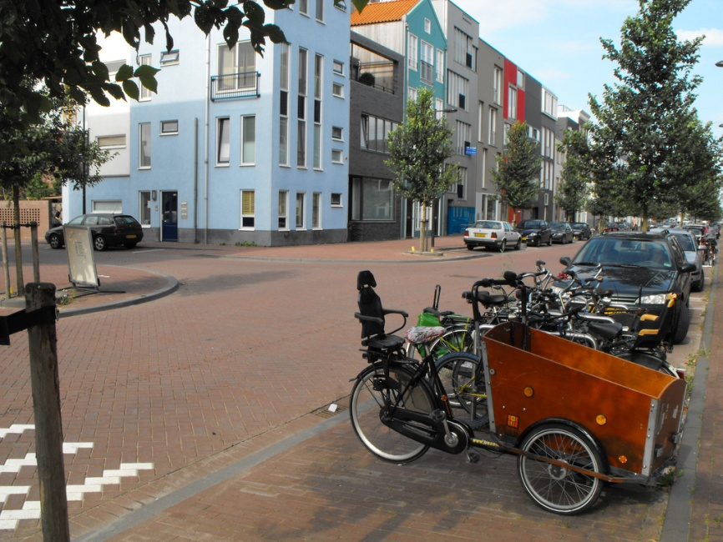
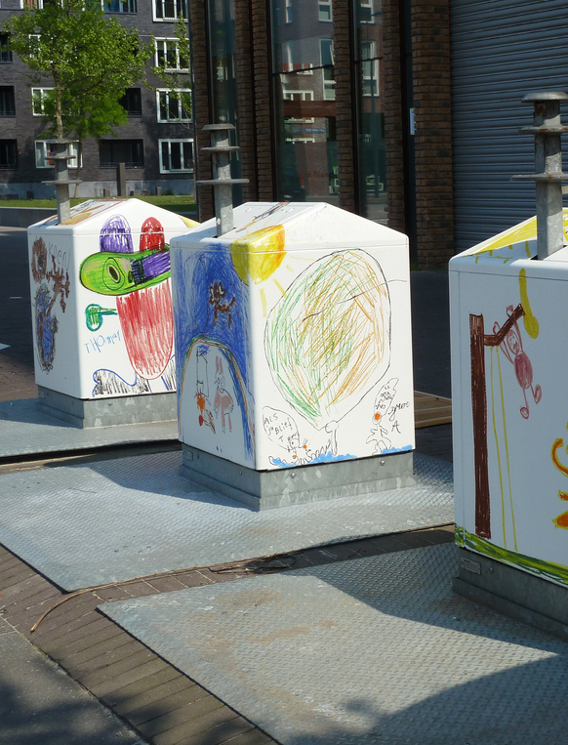
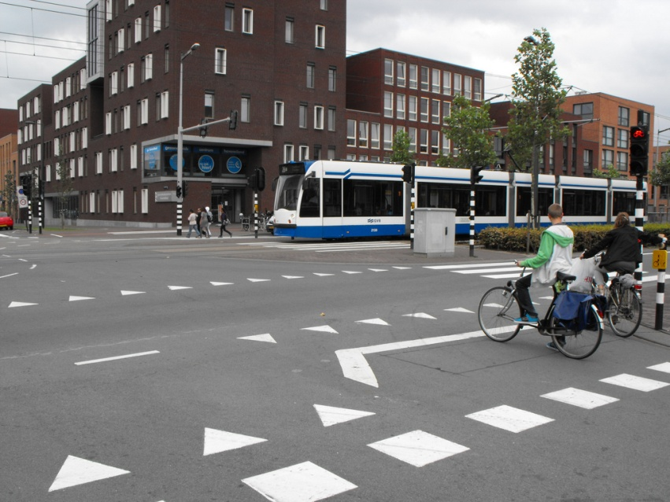
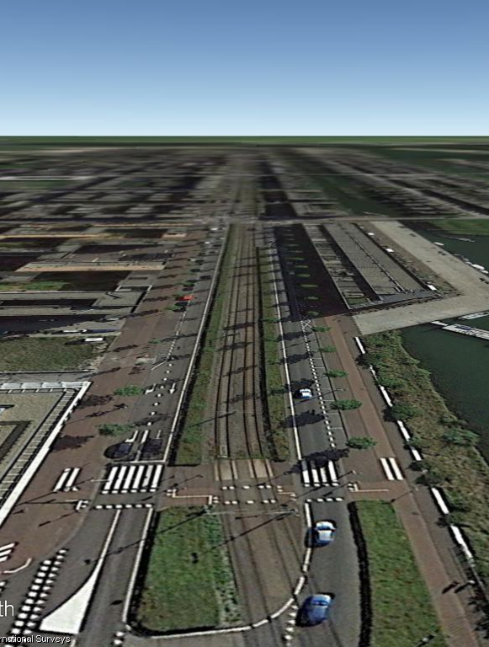
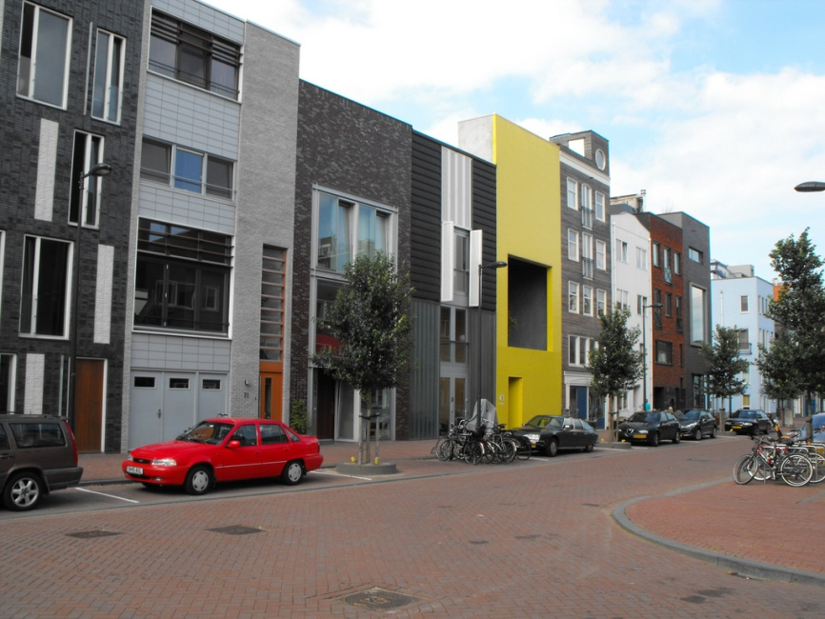
IJburg, Netherlands

Slide 34
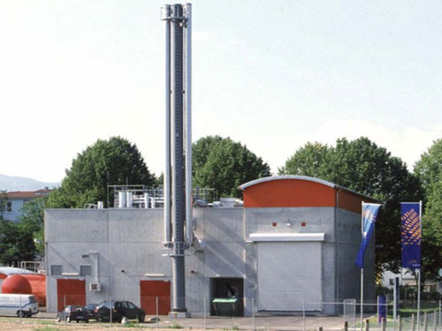
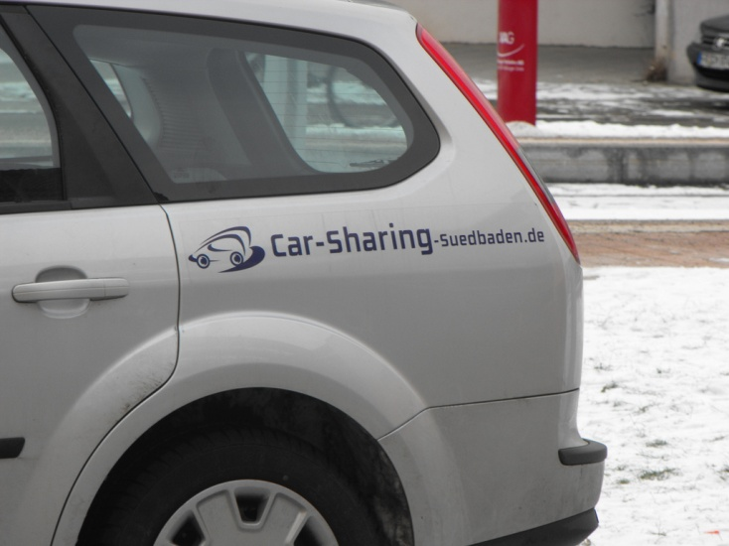
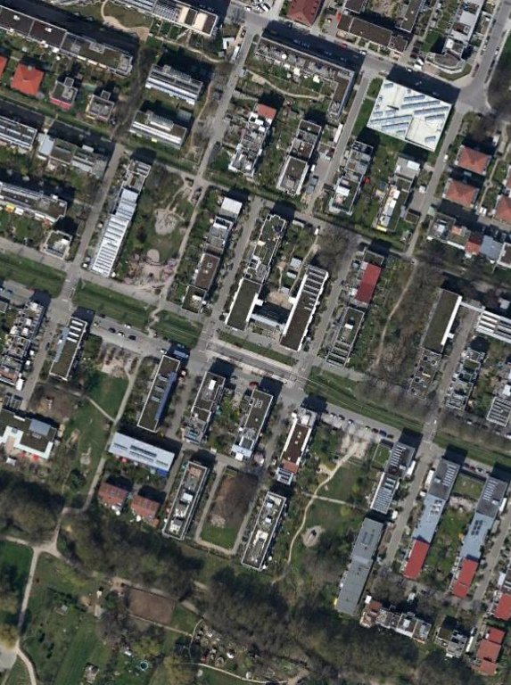
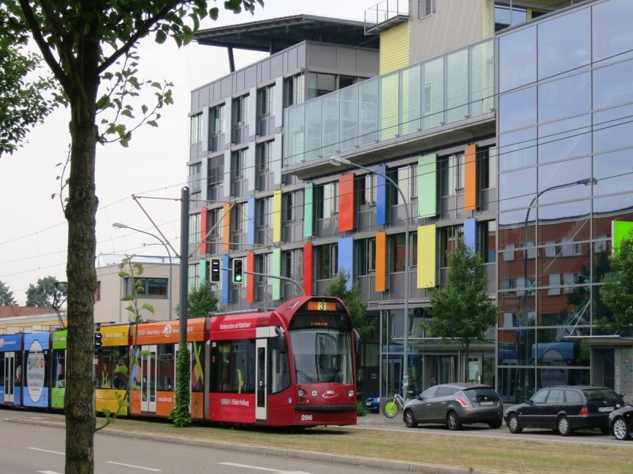
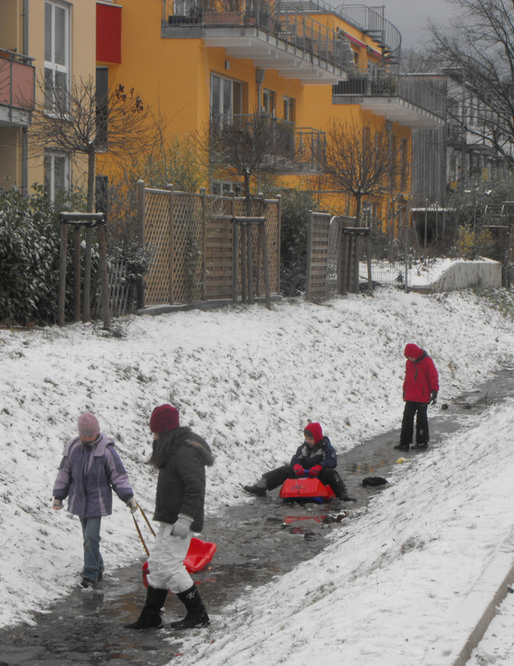
Freiburg, Germany
CHP
Waste

Slide 35
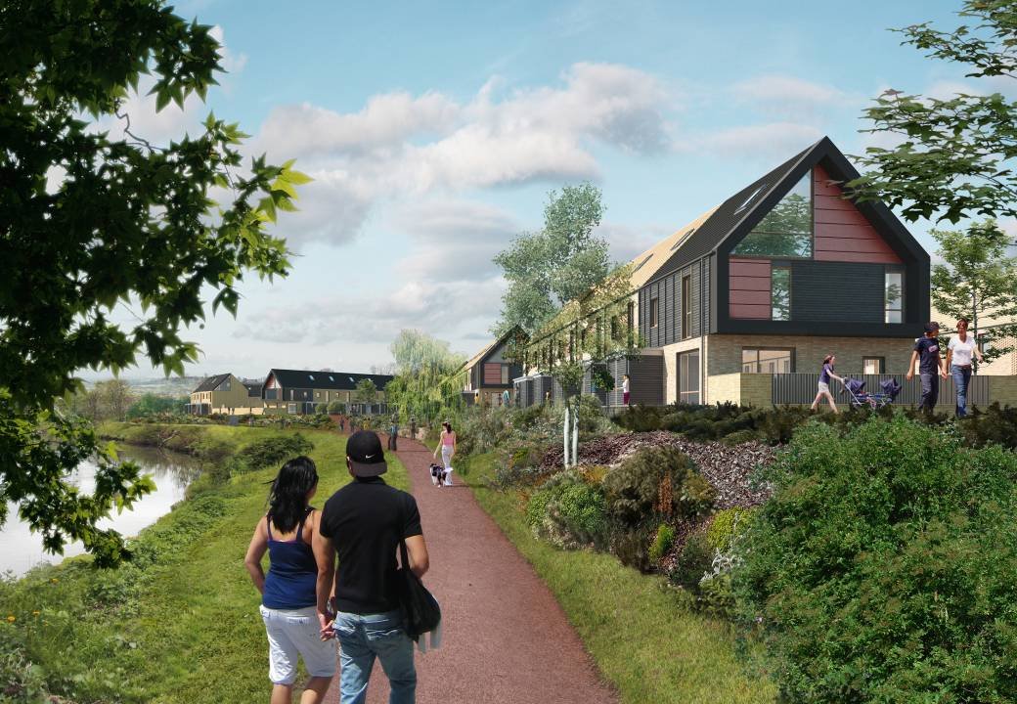
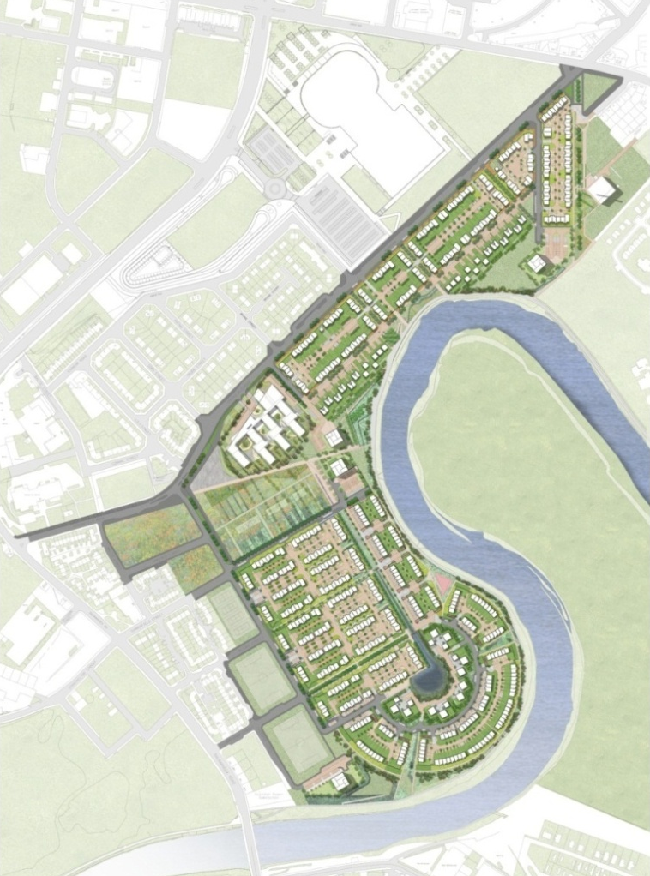
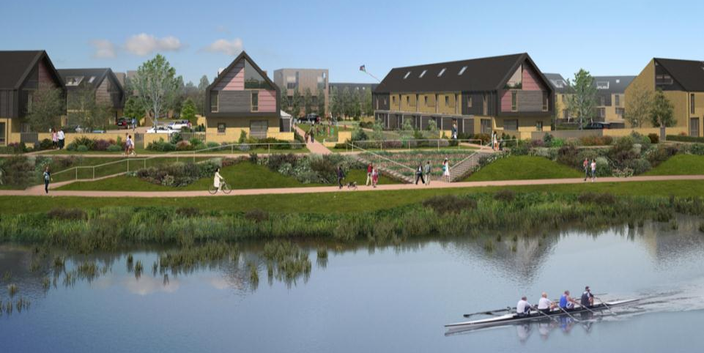
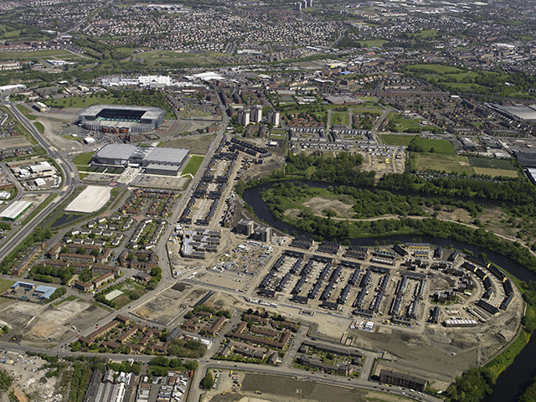

Slide 36
A simple recognition of cities (and their capacity for dense economic activity), as the key driver in achieving sustainable development;
A willingness to plan ambitiously for the long term (30yrs plus) with national and regional targets;
A recognition that long term planning of new transport infrastructure and new development go hand in hand to deliver sustainable growth;
A partnership approach to delivery and effectiveness; and,
An open, honest and sometimes brave approach to engaging local communities.

Slide 37
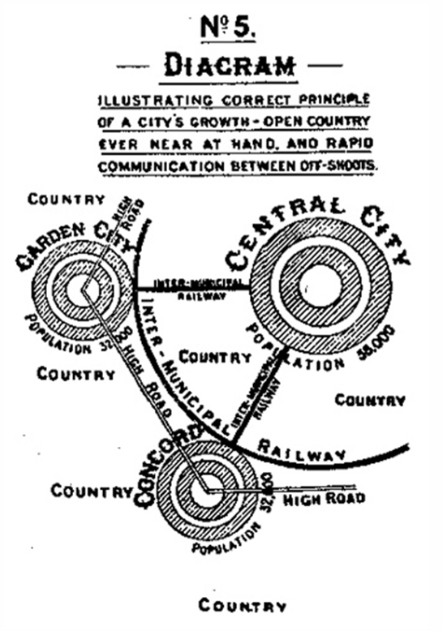
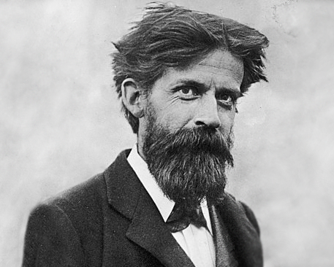


Slide 38
…the continuing "absolutely shocking" shortage of new housing supply was due to the attitude of "bods with the bums on the seat in the nice warm offices who put the words on the paper and the lines on the plans". Sandy Adam, Chair, Homes for Scotland (Sunday Herald)

Slide 39
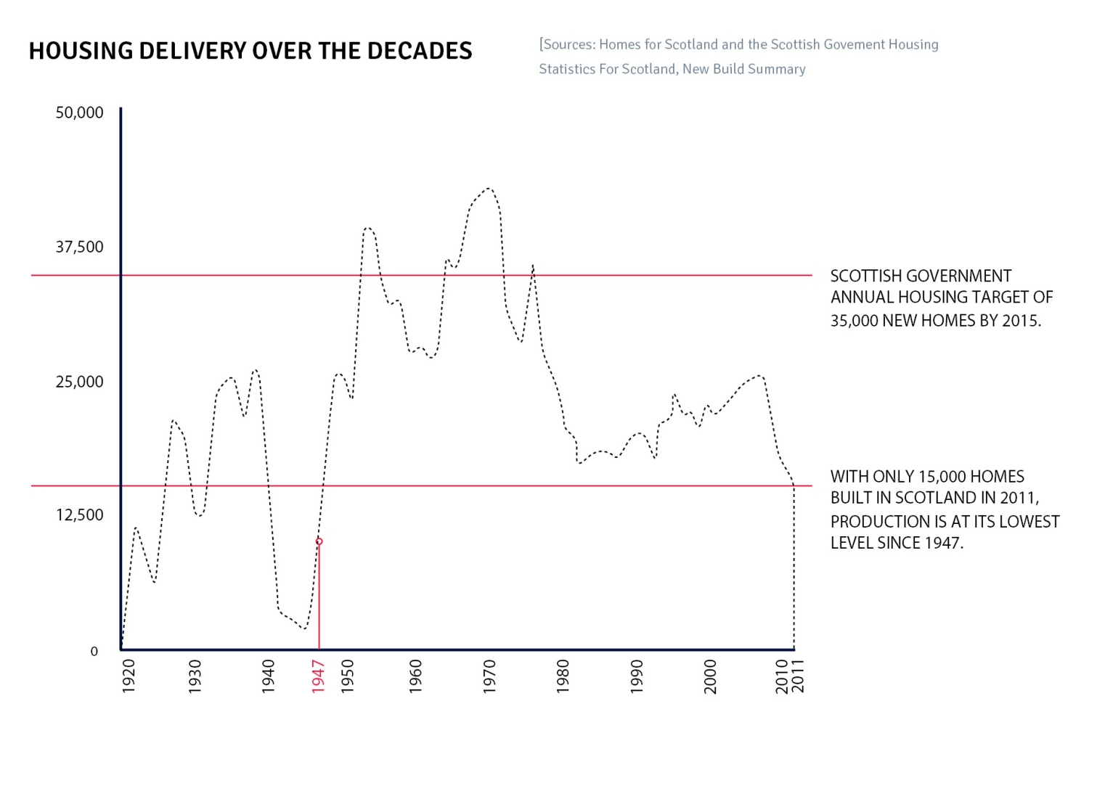
1960’s
1970’s
1980’s
The ‘Golden Age’- leadership of planning
Planning through plans
Development plan led growth
42,000 homes built per year in Scotland
Planning application Route – reduction in new housing delivery

Slide 40
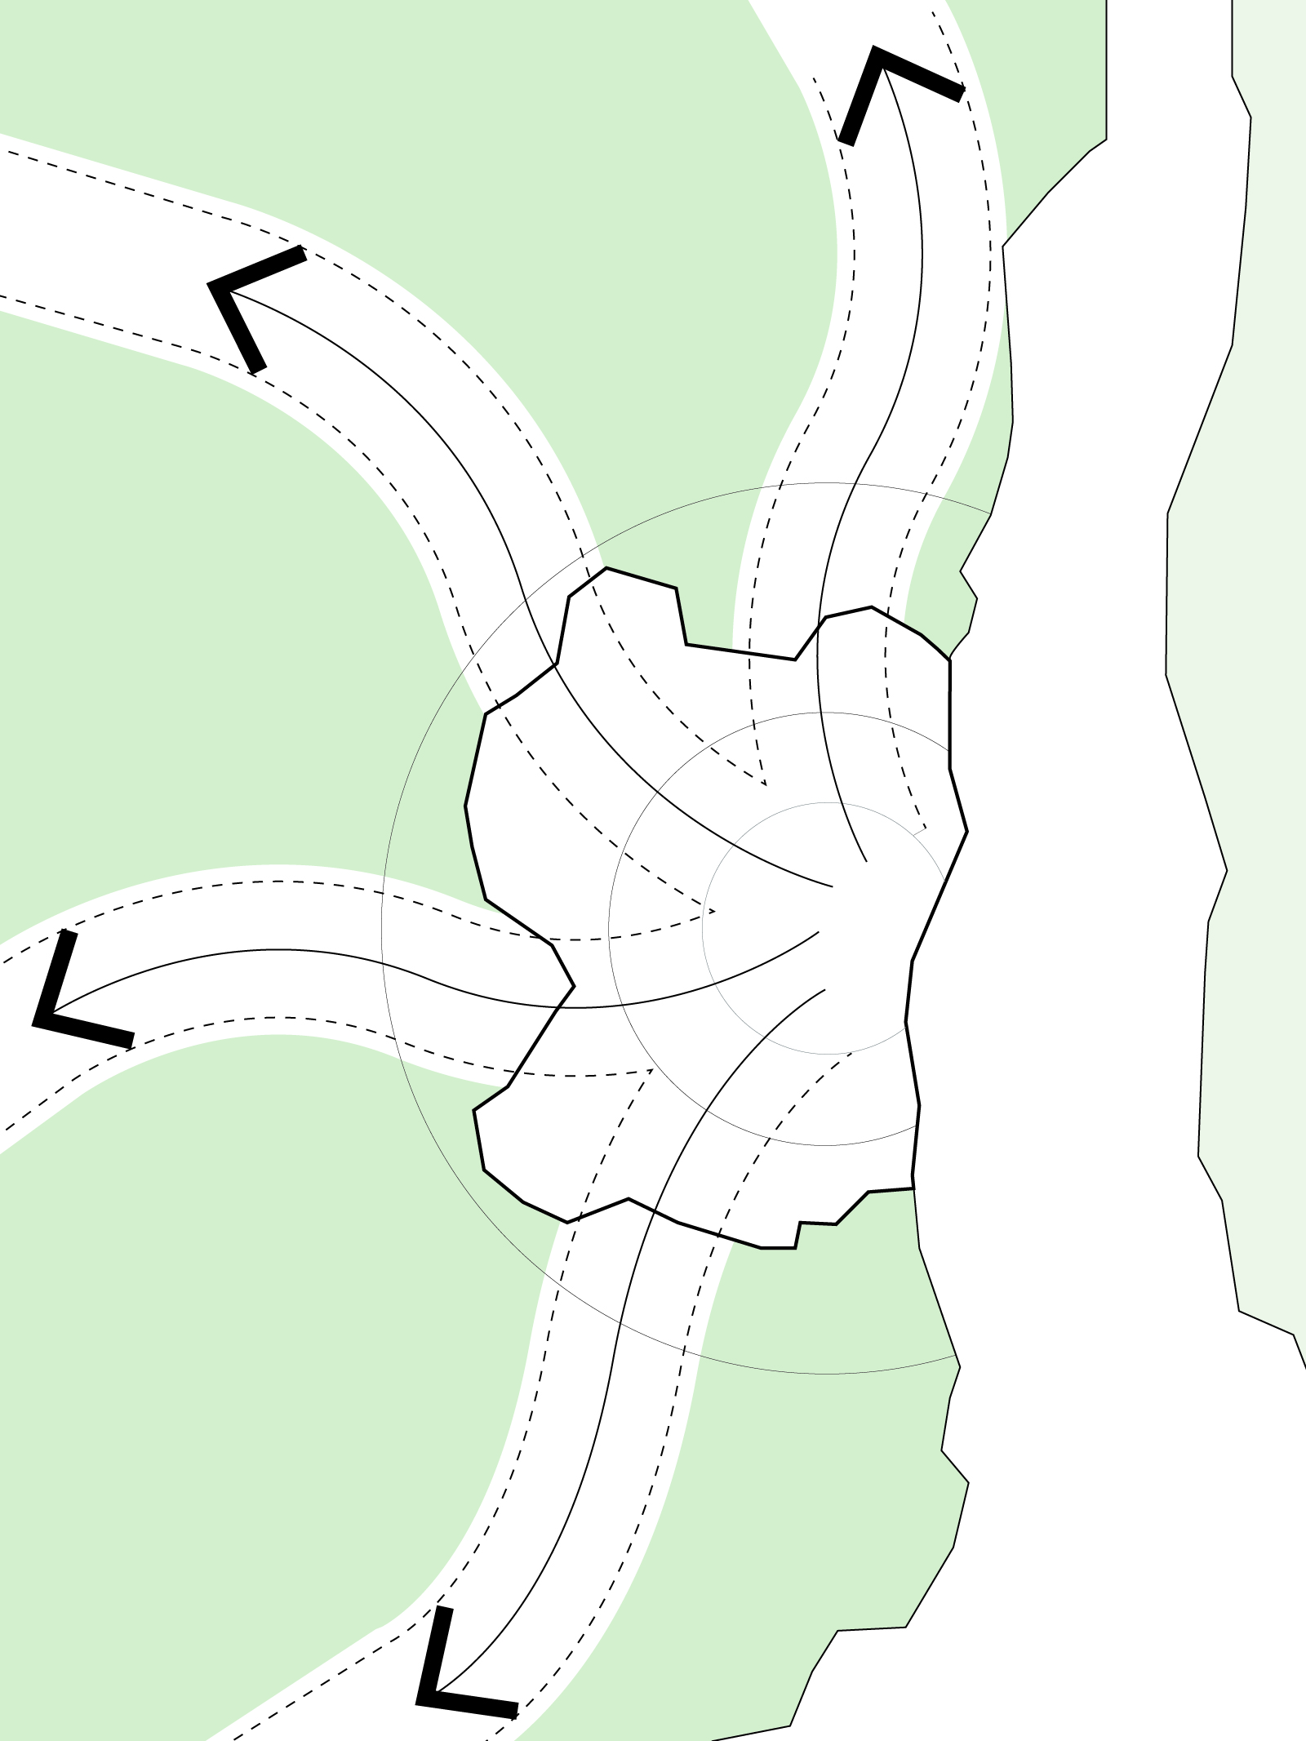
Plan for everyone - Access to regular and affordable public transport is inextricably linked to the aim of achieving more sustainable lifestyles. ”
(Back to Basics, Barton Willmore 2013).

Slide 41
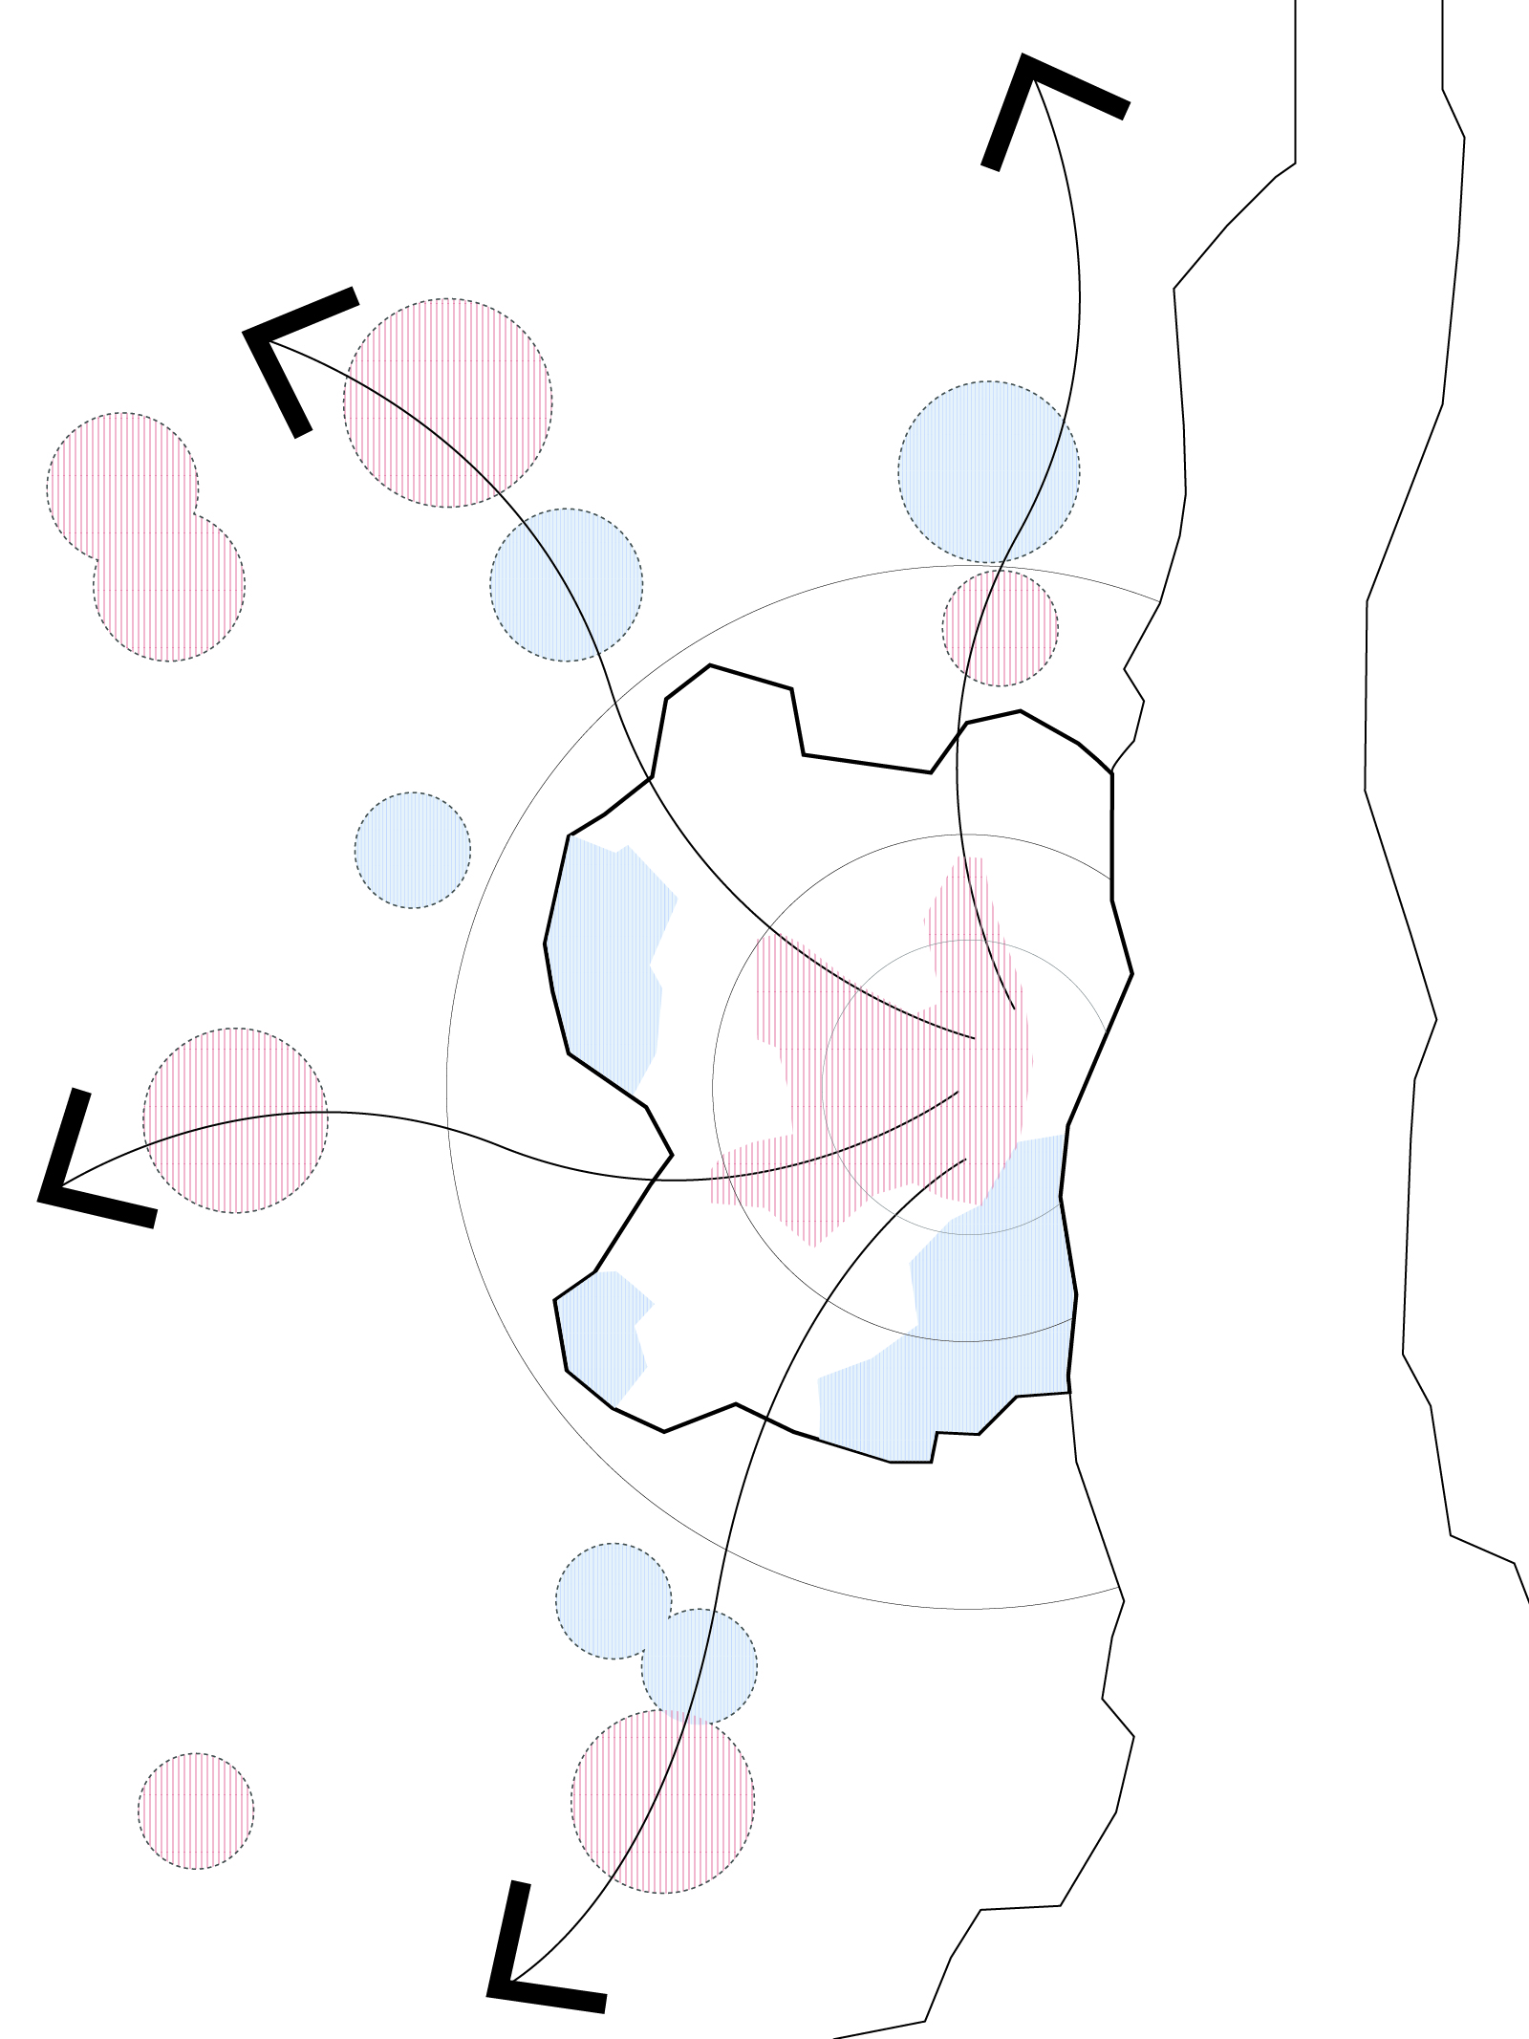
People want to live close to good transport infrastructure i.e. suburban rail stations, good quality schooling and community facilities as well as access to open spaces / countryside ”
(Back to Basics, Barton Willmore 2013).

Slide 42

Brownfield development will remain a central component of achieving more sustainable growth. ” (Back to Basics, Barton Willmore 2013).

Slide 43

Greenbelt remains sacrosanct… instead it should be considered a component of sustainable growth.”
(Back to Basics, Barton Willmore 2013).

Slide 44

Planning should be simple...
Prioritise sites where infrastructure exists and where there is clear market demand. ”
(Back to Basics, Barton Willmore 2013).

Slide 45

Sustainable development is about achieving a balance. This does not mean allowing any development, anywhere, at any cost... .”
(Back to Basics, Barton Willmore 2013).

Slide 46

We need to think longer term and more strategically about the growth of our cities and towns.”
(Back to Basics, Barton Willmore 2013).

Slide 47

Aren’t we all trying to achieve the same things?
A revitalised inner core
A great lifestyle for new and existing residents in sustainable cities and towns
Highly accessible green wedges that can be protected over time… ”
(Back to Basics, Barton Willmore 2013).

Slide 48

“Cities have the capability of providing something for everybody, only because, and
only when, they are created by everybody“.
BW Shortlisted Entry to The Wolfson Prize for Economics

Slide 49
Hierarchy and Plan led system capable of planning effectively for sustainable growth
National and Regional Level could help drive and shape housing growth
New housing is only part of the solution
Long term ambitious planning for land and transport is the key…
What could we achieve if we release 30 years worth of opportunity then work together to deliver the quality on the ground?
That’s our opportunity!
The wellbeing of our individuals and families “depends heavily on our ability to find a house” (Firm Foundations, The Future of Housing in Scotland,
Scottish Government 2007).

