Slide 1
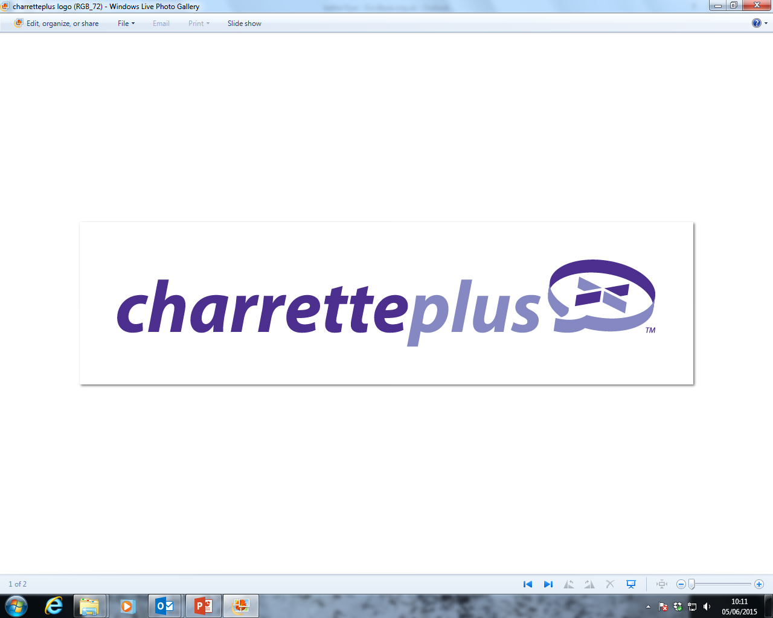
“Something is happening…
  Heads of Planning Scotland
  Annual Conference
  Perth
  12 June 2015
community collaborative place making
Petra Biberbach
PAS | Chief Executive

Slide 2
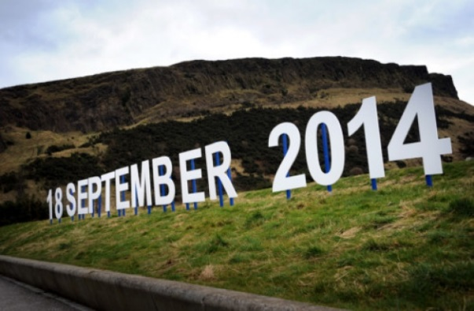
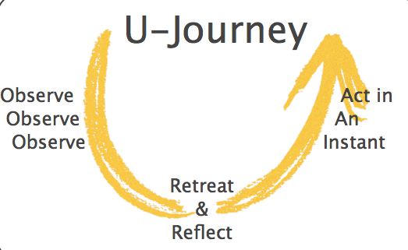
“Something is happening…
  cottish Government
  Participation Week
  12 June 2015
What kind of self and society do we want to be?
inequality
time
Petra Biberbach
PAS | Chief Executive

Slide 3
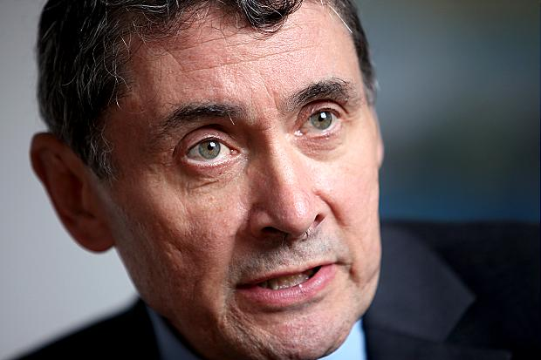
“Something is happening…
  cottish Government
  Participation Week
  12 June 2015
Work with public to find new solutions…
comprehensible, manageable and meaningful
The biology is very clear:
Chaotic, difficult circumstances lead to an increased risk of physical and mental ill health
… lets not spend a fortune trying to find drugs to fix that; lets change the chaotic and difficult circumstances!
Petra Biberbach
PAS | Chief Executive

Slide 4

Spatial Planning
Community Empowerment
Community Planning
“Something is happening…
  cottish Government
  Participation Week
  12 June 2015

Slide 5
Spatial Planning
Community Empowerment
Community Planning
participative place making

Slide 6

Spatial Planning
Community Empowerment
Community Planning

Slide 7
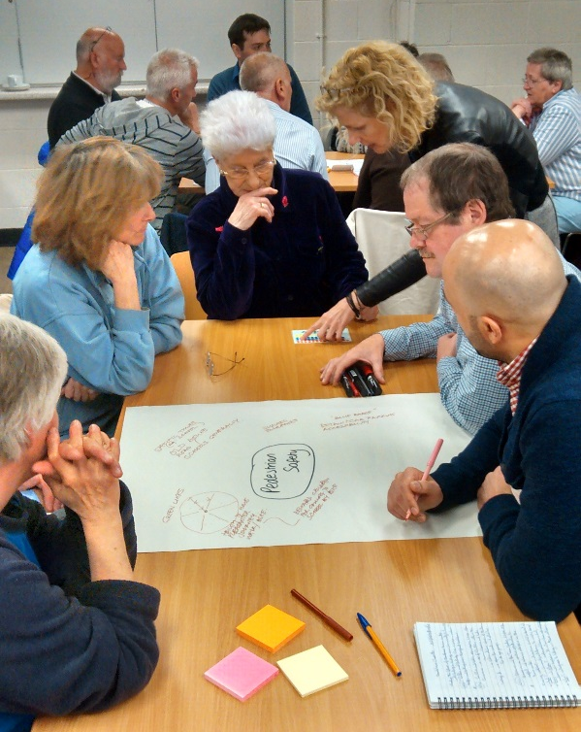
“Building Active Citizenship…
Independent, impartial and universal
Charity operating on Social Enterprise principles, acting in the interest of the long term public good
Volunteer led – building social capital
Supports public sector aims by engaging citizens in thinking about their place and the co-design of public services
Ethos: Asset based approach; Partnership working; Co-production

Slide 8

INCLUSIVE PLACEMAKING:
Meaningfully engaging communities in participative decision making processes
Charretteplus retains the essential characteristics of a Charrette: involving communities in an intense collaborative engagement event, with design and iterative testing …
plus …
  links spatial and community planning to assist visioning of service delivery
  collaborates with local authorities to build capacity for local delivery of charrettes (upskilling of LA staff) making it more cost effective and sustainable
  through the PAS network of professional volunteers, associates and staff it delivers more, to a greater number of audiences, more efficiently
  takes forward charrette outcomes - in the form of a committed Action Plan
  Charretteplus builds momentum and generates a legacy
  supported by the Scottish Government, COSLA and SOLACE

Slide 9
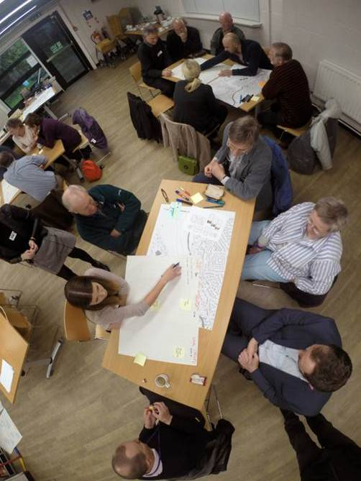
INCLUSIVE PLACEMAKING:
Bringing people into decision making processes in meaningful participative ways
Youth engagement
Seldom heard communities
SP=EED
Community led initiatives
Charretteplus

Slide 10
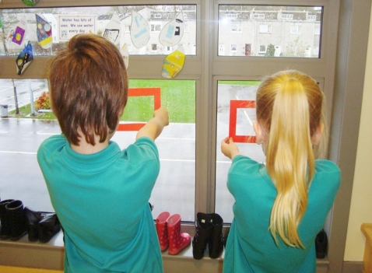
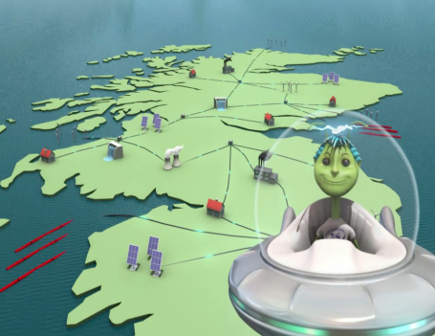
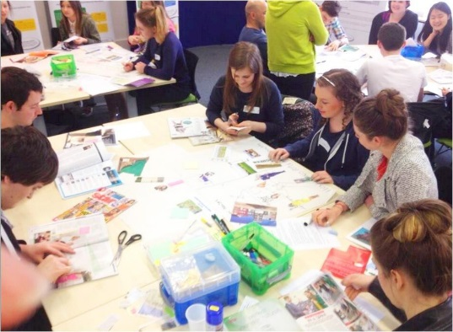
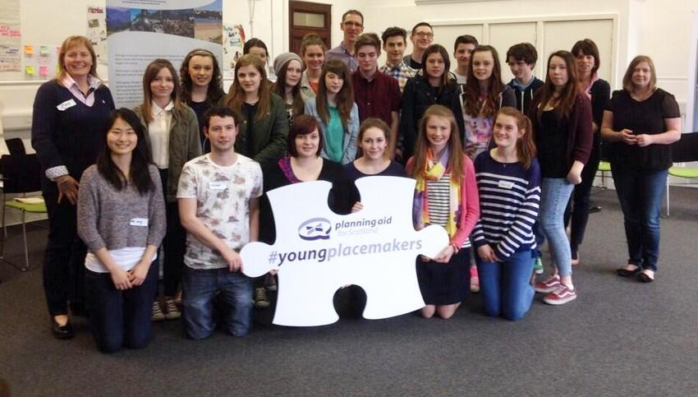
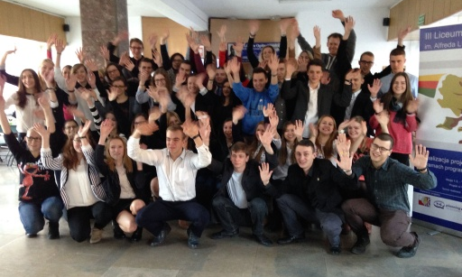
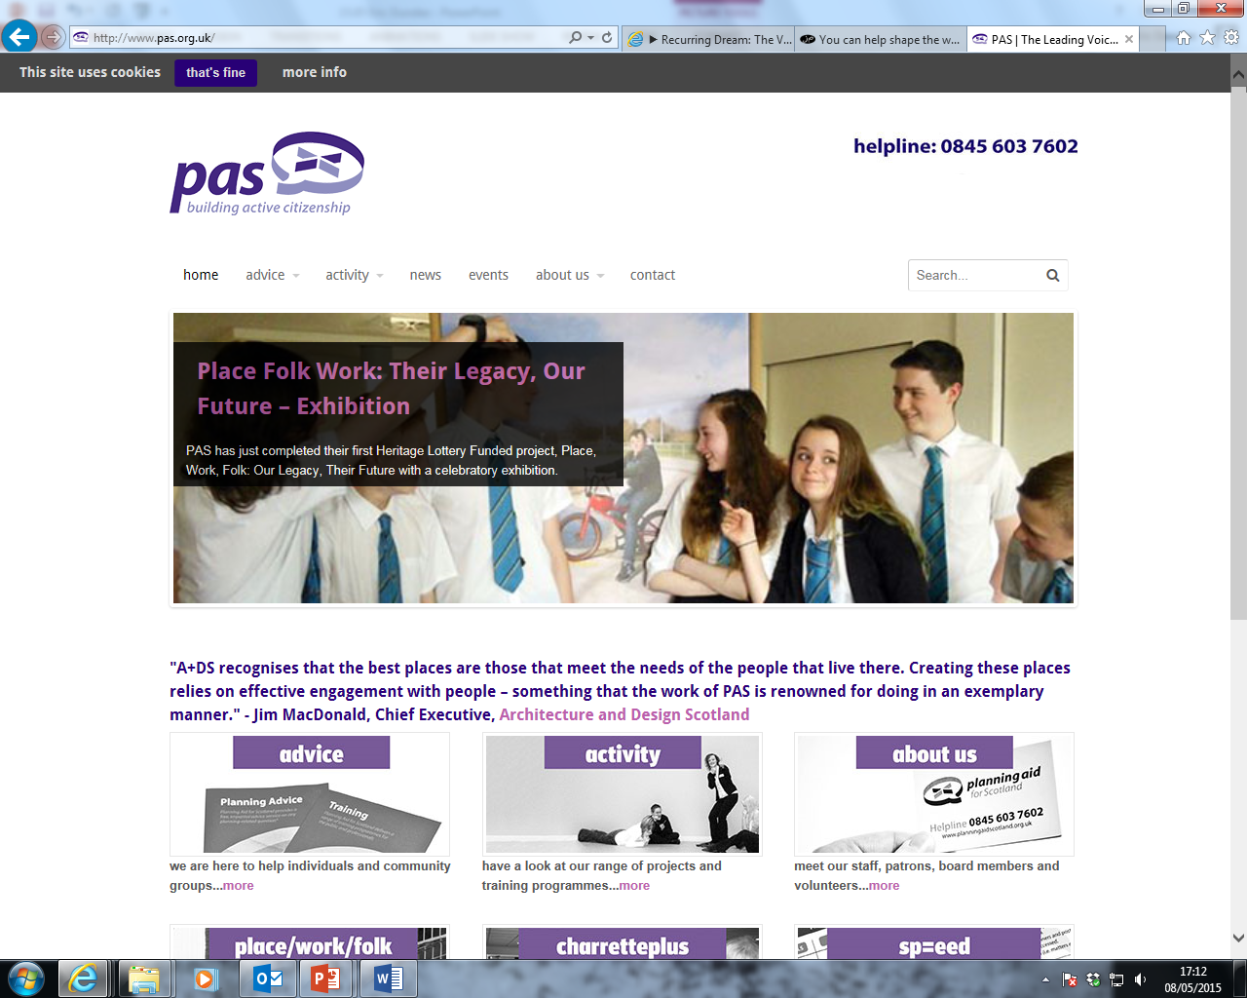
INCLUSIVE PLACEMAKING: youth engagement
Bringing young people into the decision making process in meaningful ways
IMBY
In My Back Yard
YEP!
Youth Engagement in Planning
Young Placemakers
European Youth Exchanges
Place Work Folk

Slide 11
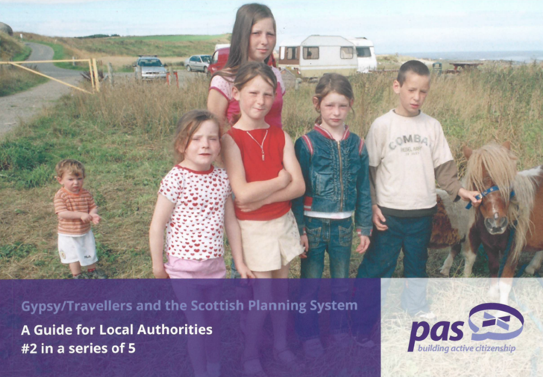
INCLUSIVE PLACEMAKING: seldom heard voices
Meaningfully engaging seldom heard communities in decision making processes

Slide 12
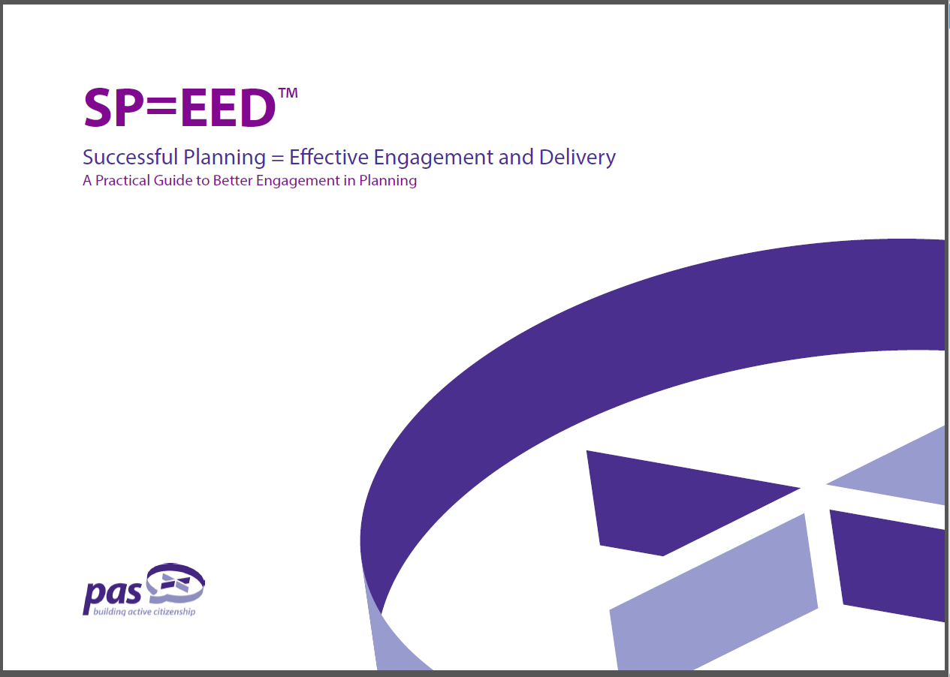
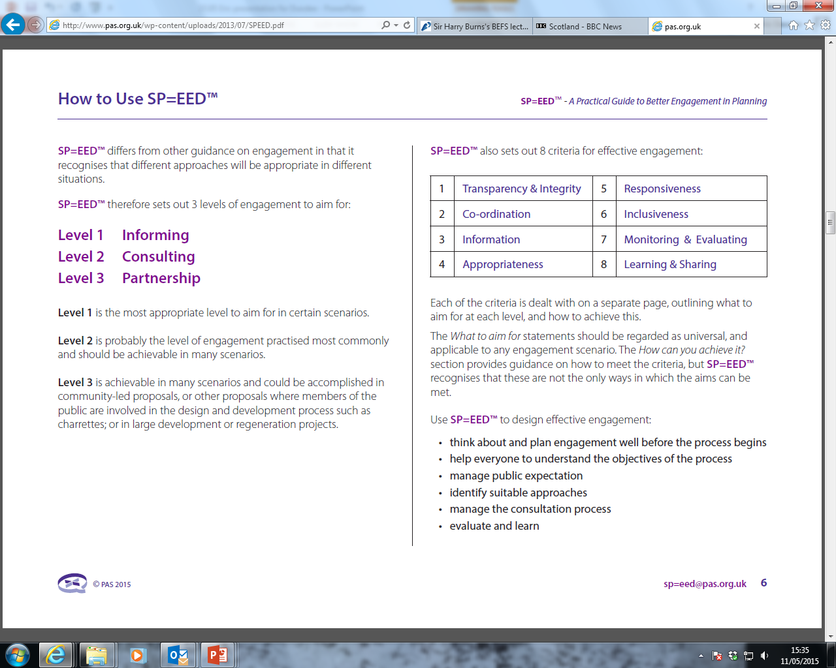
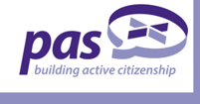
INCLUSIVE PLACEMAKING: SP=EED
Meaningfully engaging communities in decision making processes

Slide 13
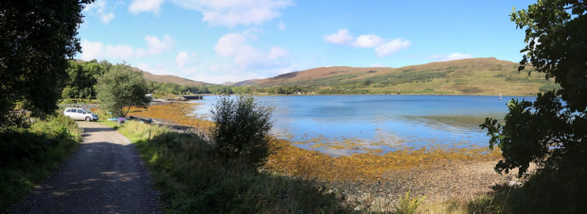
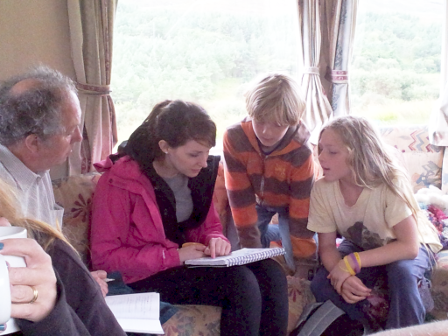
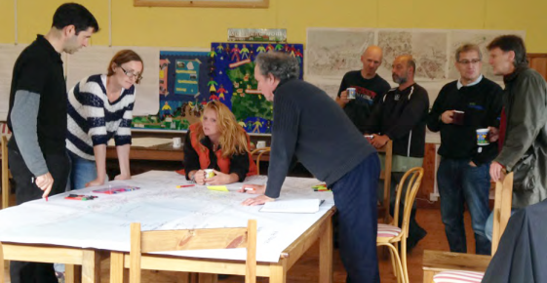
INCLUSIVE PLACEMAKING: community led
Isle of Rum
Meaningfully engaging communities in participative decision making processes

Slide 14
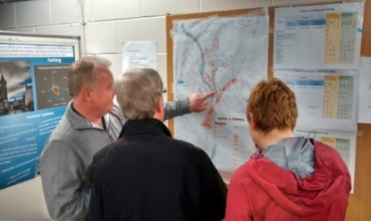
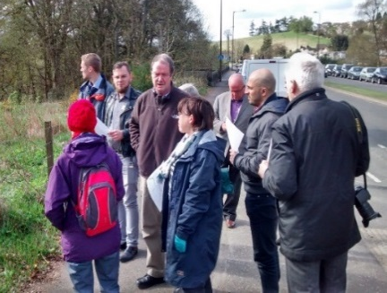

INCLUSIVE PLACEMAKING: Charretteplus
Meaningfully engaging communities in participative decision making processes
Levenmouth
Dunblane
Motherwell
    Cupar
    Galashiels
    Others …
[
]

Slide 15
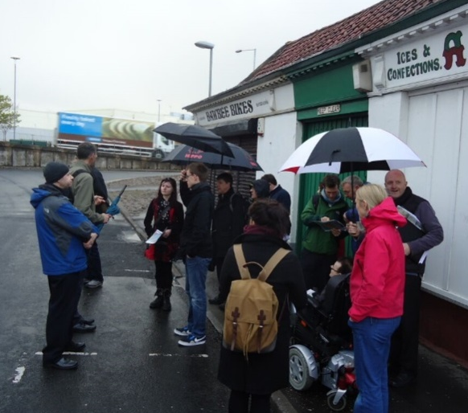
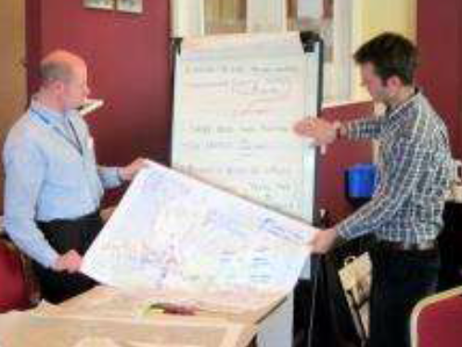
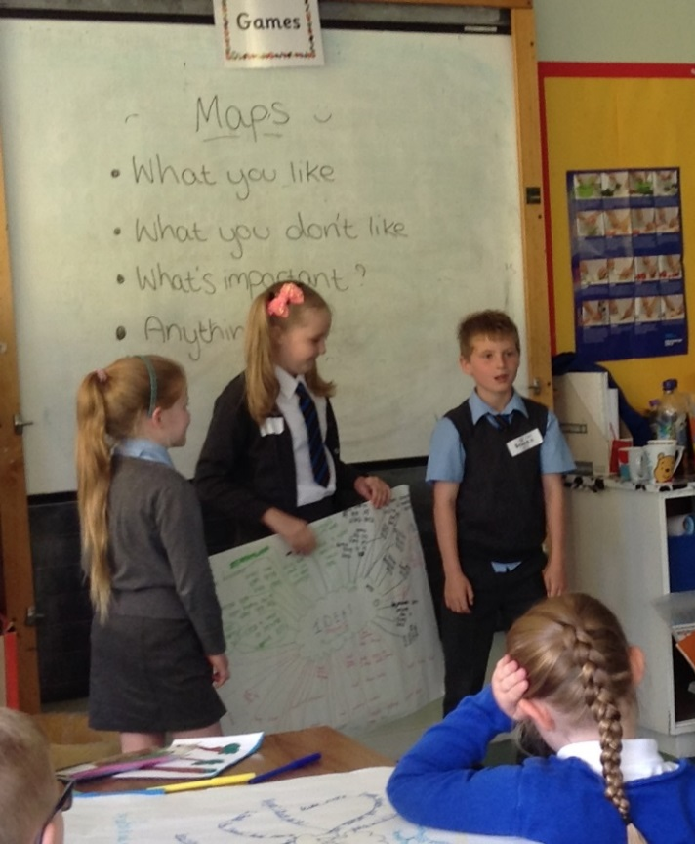
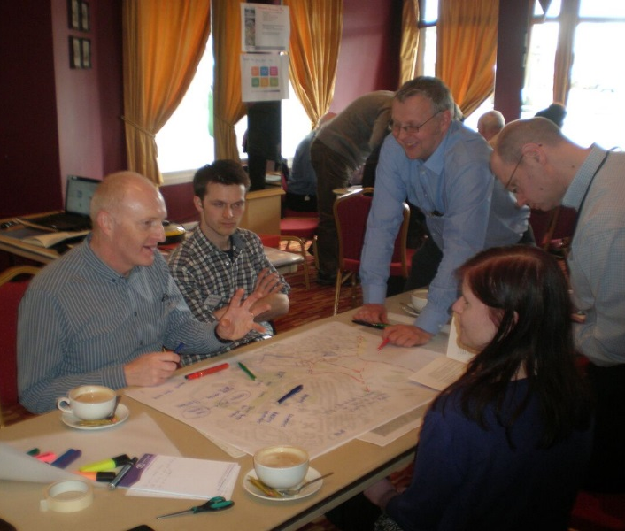
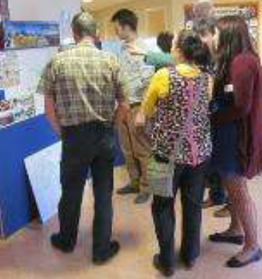
INCLUSIVE PLACEMAKING:
Meaningfully engaging communities in participative decision making processes
Levenmouth

Slide 16
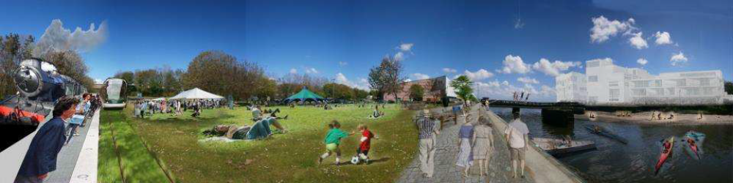
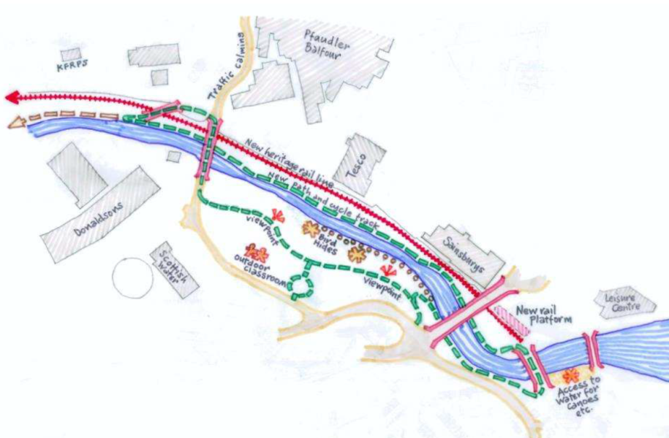
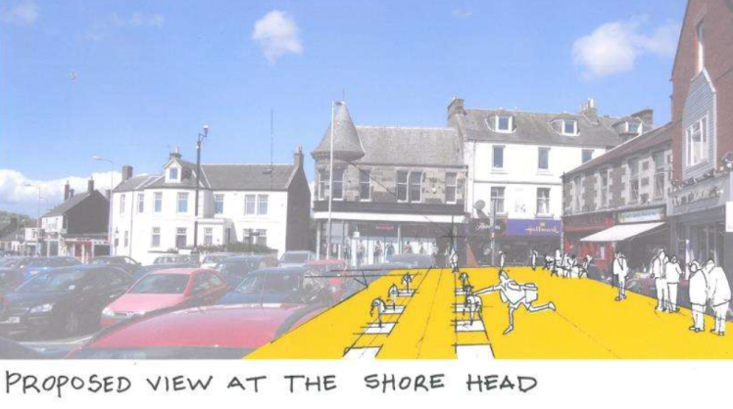
INCLUSIVE PLACEMAKING:
Meaningfully engaging communities in participative decision making processes
Levenmouth

Slide 17
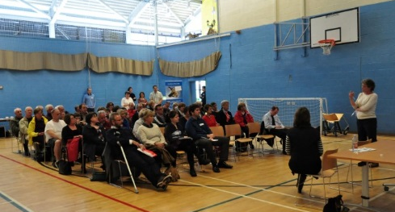
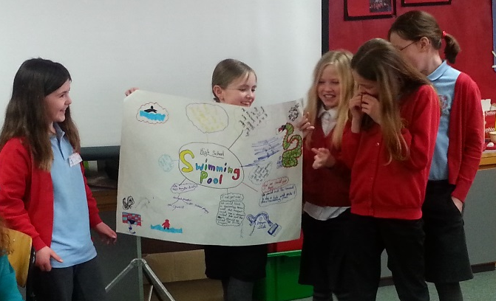
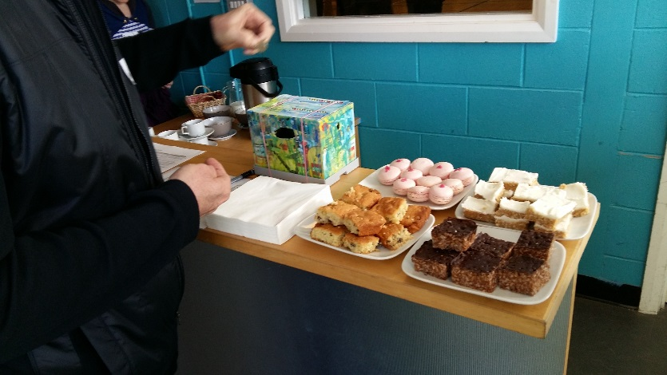
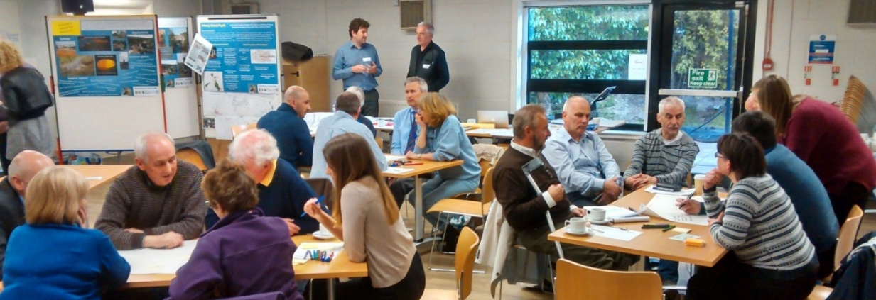
INCLUSIVE PLACEMAKING:
Meaningfully engaging communities in participative decision making processes
Dunblane

Slide 18
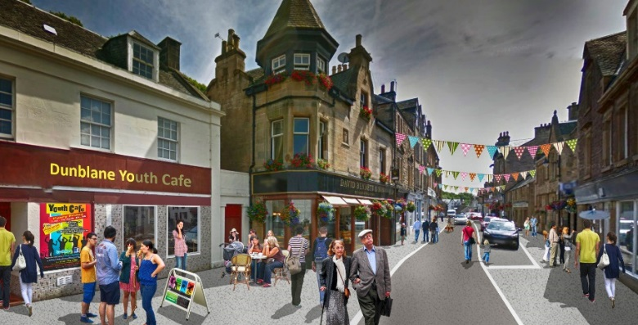
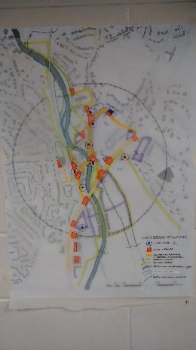
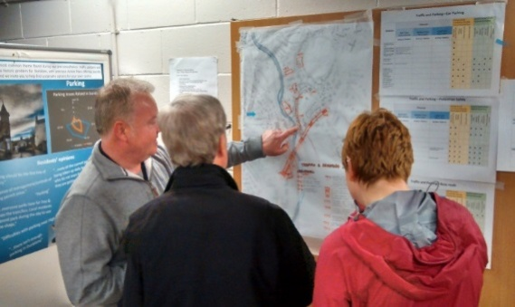
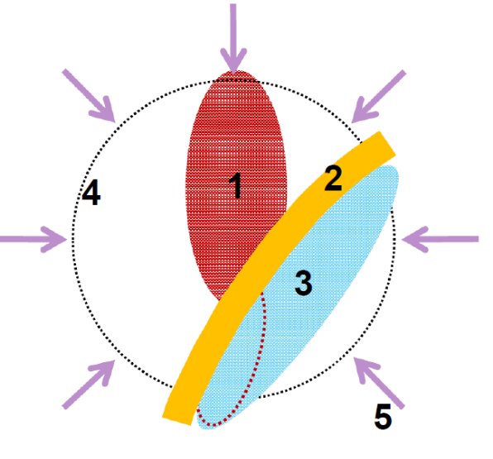
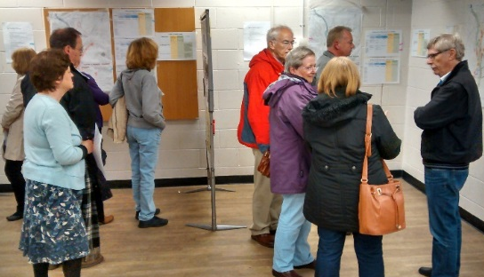
INCLUSIVE PLACEMAKING:
Meaningfully engaging communities in participative decision making processes
Dunblane

Slide 19
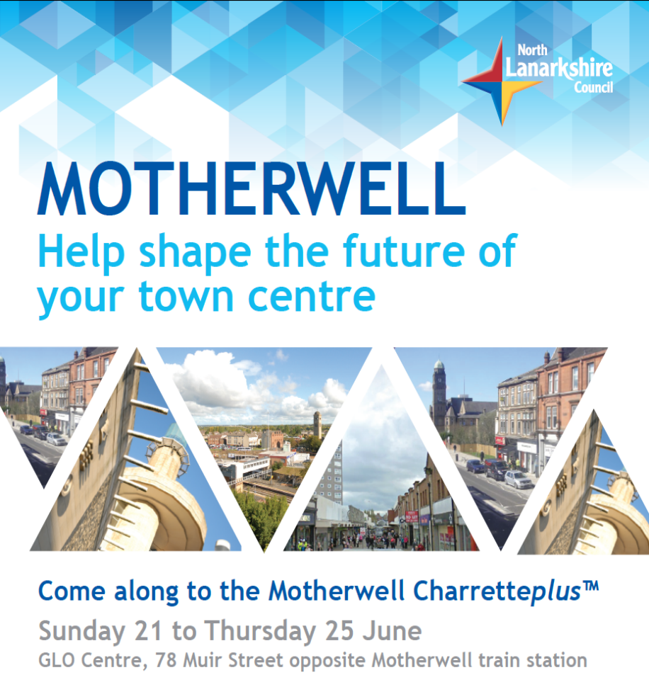
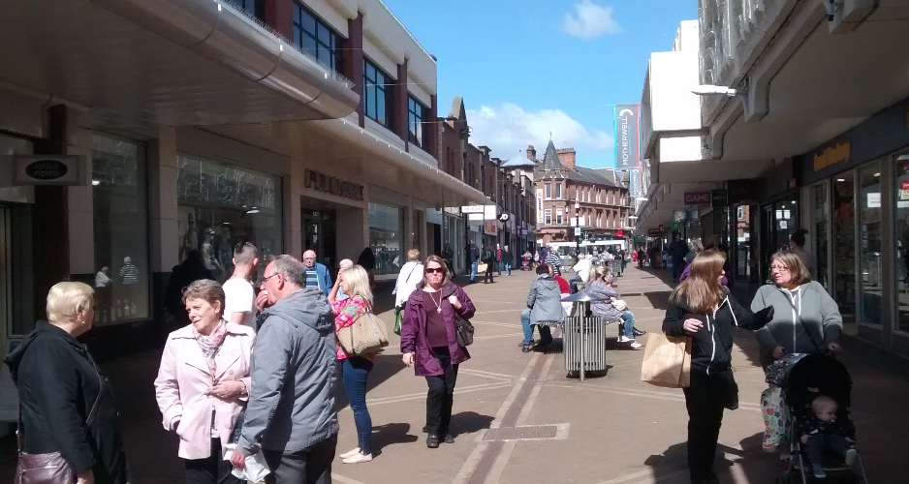
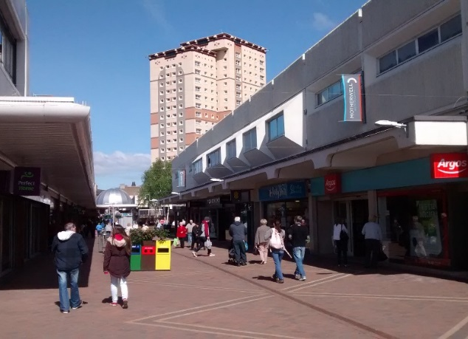
INCLUSIVE PLACEMAKING:
Meaningfully engaging communities in participative decision making processes

Slide 20
Explore Possibilities Link to service delivery | e.g. CLEAR local voluntary group promoting walking / cycling identified as a lead on behalf of community; bring different skill sets; liaise with Highways and Parks – advice / interaction; on ground co-operation and working with squads; design and install tree planting + verge maintenance
Seize Opportunity Positioning for action | e.g. work with Economic Regeneration a fully formed plan written in a way that helped push for a palette of projects as opportunities arose; allow incremental investment – a range of £30/50k projects to follow up; link action with policy initiatives; attract £1m from corporate body – able to present
Change Mindsets Big v small incremental | e.g. Housing Services Rather than a preference for edge of settlement green belt land release, now exploring potential of VDL; 14 houses being built; Wider impact – how to re-energise the high street – link with revitalise economic activity; + working with owners of derelict properties
Link With SOA Outcomes & assets | e.g. local partnering Teenage pregnancy v economic opportunity; Local promotion / employment advancement; discuss with local employers a need to promote educational chances
Measurable Benefits Tangible & In-tangible | e.g. Benchmarking a framework need to gather more data / evidence; collect info on footfall, vacancy rates; economic activity increases at certain times – aligns with events; general satisfaction – voice concern; positive supportive press!
Raising Aspirations One voice; raise profile | e.g. LMRC – rail campaign: take on a campaign manager e.g. a framework to co-ordinate lots of fragmented action (and ambition) under one strategic wrapper; Previously seen as disparate bits – now accessed in one single point with a coherent approach
Make It Real Quick wins; belief | e.g. Bowling Club Down to 18 members; Became a business for organisation that did community transport; Bus in elderly people for lunch clubs; Found new use and purpose; local action; reflect reality; engage at right level
Different Approach Language to discuss | e.g. play parks Massive resistance to loss of parks; “ we will put in new £ … but this will mean … “; Mental health charity took over a park - Help people back into work; links to wider objectives: H+W; greenspace
Capitalise Why re-invent? | e.g. Link with community education engagement of communities the norm; link with what already exists! Don’t re-invent / join-up! want to do the best for services for communities

Slide 21
Explore Possibilities Link to service delivery | e.g. CLEAR local voluntary group promoting walking / cycling identified as a lead on behalf of community; bring different skill sets; liaise with Highways and Parks – advice / interaction; on ground co-operation and working with squads; design and install tree planting + verge maintenance
Seize Opportunity Positioning for action | e.g. work with Economic Regeneration a fully formed plan written in a way that helped push for a palette of projects as opportunities arose; allow incremental investment – a range of £30/50k projects to follow up; link action with policy initiatives; attract £1m from corporate body – able to present
Change Mindsets Big v small incremental | e.g. Housing Services Rather than a preference for edge of settlement green belt land release, now exploring potential of VDL; 14 houses being built; Wider impact – how to re-energise the high street – link with revitalise economic activity; + working with owners of derelict properties
Link With SOA Outcomes & assets | e.g. local partnering Teenage pregnancy v economic opportunity; Local promotion / employment advancement; discuss with local employers a need to promote educational chances
Measurable Benefits Tangible & In-tangible | e.g. Benchmarking a framework need to gather more data / evidence; collect info on footfall, vacancy rates; economic activity increases at certain times – aligns with events; general satisfaction – voice concern; positive supportive press!
Raising Aspirations One voice; raise profile | e.g. LMRC – rail campaign: take on a campaign manager e.g. a framework to co-ordinate lots of fragmented action (and ambition) under one strategic wrapper; Previously seen as disparate bits – now accessed in one single point with a coherent approach
Make It Real Quick wins; belief | e.g. Bowling Club Down to 18 members; Became a business for organisation that did community transport; Bus in elderly people for lunch clubs; Found new use and purpose; local action; reflect reality; engage at right level
Different Approach Language to discuss | e.g. play parks Massive resistance to loss of parks; “ we will put in new £ … but this will mean … “; Mental health charity took over a park - Help people back into work; links to wider objectives: H+W; greenspace
Capitalise Why re-invent? | e.g. Link with community education engagement of communities the norm; link with what already exists! Don’t re-invent / join-up! want to do the best for services for communities
“Something is happening
“Something is happening

Slide 22
TYPICAL CHARRETTE MODEL |  | plus / value added
What is a charrette? | Impartial and independent; Participate; credibility | CPP mandate at highest level – able to make it happen!
Process driven… | Do things differently / locally; buy-in | Keep it simple! When everything is a priority = 0!
Big production item… | Make it relevant: scale up small; impacts infrast invest | Compact; honed down
Team come / go… | Continuity; build legacy; held to account (engaged press!) | Set a ‘new norm’
Consultancy led / expensive… | Partnership approach; build capacity; elected member | Not dependency! Bank knowledge & experience
Targets ’answers’… | Seeks to understand Qs; seeks solutions to problems | Sometimes ‘non-physical’ / ‘non-tangible’ is best!
Time focussed… | Builds social capital; chance encounters | Not time limited

Slide 23

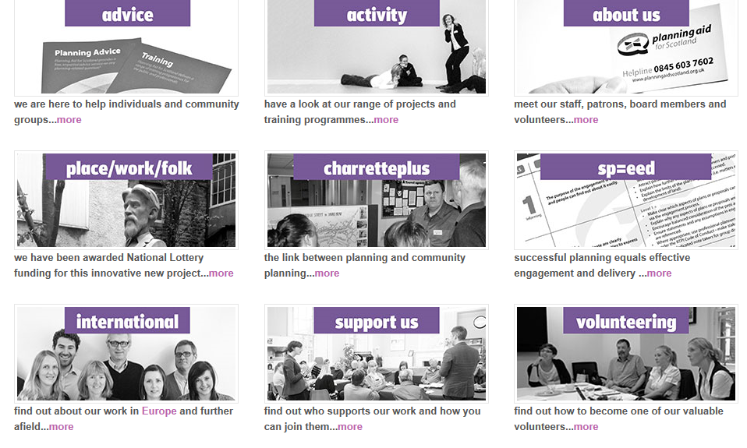
www.pas.org.uk
Online information sheets
Weekly news bulletin
Telephone and online helpline
Follow us on Twitter @PAS_tweets
Petra@PAS.ORG.UK
Petra Biberbach
PAS | Chief Executive

