Slide 1
Heads of Planning
People, Place and Planning
Planning with Communities
Colin Mair, CEO, Improvement Service

Slide 2
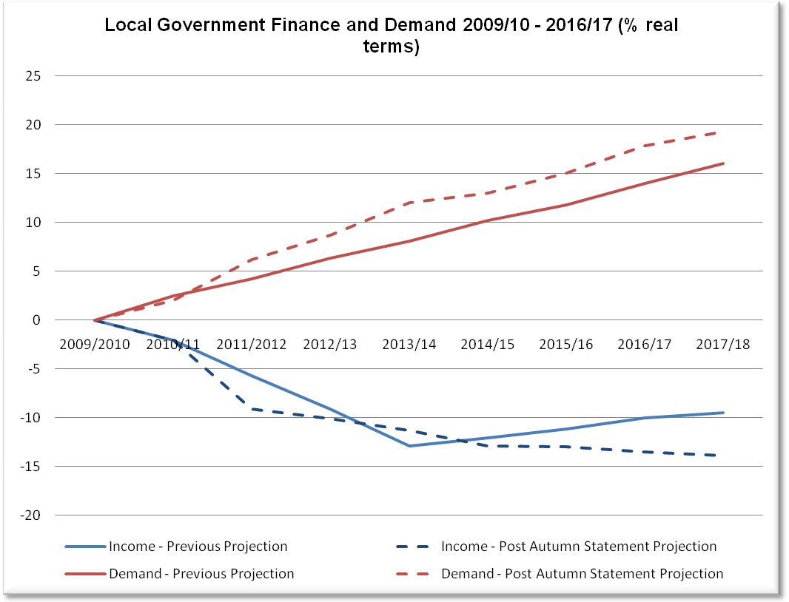
Post budget 2013

Slide 3
Outcomes for Most and Least Income Deprived : 2012/13
 | 20% most income deprived | 20% least income deprived
 | Average | Average
S4: Average tariff score: all pupils | 116.44 | 212.36
Emergency admission – both sexes – all ages – rate/100,000 | 14633.68 | 6878.47
No. SIMD crimes per 10,000 | 928.92 | 242.90
Percentage of total population who are income deprived | 33.85 | 4.15

Slide 4
Outcomes for Most and Least Deprived Areas: 2012/13
 | Average for 100 most deprived areas | Average for 100 least deprived areas
S4 Tariff | 84 | 295
Emergency Admissions per 100,000 | 28,200 | 4,015
Crimes per 10,000 | 1,673 | 216
% income deprived | 57 | 2

Slide 5
Inter Relationships
Live outcomes strongly interrelated at community level: positively and negatively
Very strong relationship with economic factors
Most strategic initiatives (health equality, GIRFEC, etc.) would be focussed on the same communities
Community outcomes not service outcomes

Slide 6
The Ambition for Community Planning
‘Public services must improve outcomes, and reduce the outcome gaps within populations and between areas’
‘Total resources will be targeted to deliver priorities’
‘Promoting prevention and early intervention’
Delivering demonstrable improvements in peoples lives’

Slide 7
Community Empowerment Bill
Duty on partners to work together to improve outcomes
“Outcome improvement plan” and annual reporting against it
Probable duty to have integrated local planning for communities experiencing severe inequality
Participation requests: letting community bodies into outcome improvement (appeal)
Potentially community control of assets and services

Slide 8
A Wee Bit of History
The history of improving life outcomes and reducing inequalities in Scotland:
Economic growth and development
Development of collective infrastructure
Regulation….Public Health ; Housing ; Safety at work etc
Planning : creating liveable places
…….All before the “welfare state” and universal public services

Slide 9
An Integrated Model of Intervention
Economic capacity and opportunities
Planning regulation and infrastructure
Community capacity, culture and behaviour
Customised and accessible public services

Slide 10
Working for Community Benefit
Getting it right for communities
Getting it right with communities
“Getting connected”

Slide 11
Connections
“Main Issues” Report and LDP ←→ “Outcome Improvement plan” and SOA
Space , place , opportunity and access
Link between very local , regional and national planning and development
Community engagement and capacity building eg Charette

Slide 12
Some Areas for Experiment & Development
Integrated team engagement with communities: spatial, outcome and service planning together
Improving engagement: visualisation and virtual design
“Embedding planning”: building planning into “thematic” partnerships, e.g. Health and Care or Girfec or Leisure and Culture Strategy
Targeting and improving vulnerable areas and communities: re-imagining space, use and opportunity: place (re)making

Slide 13
End Points
Planning for community outcomes not “planning outcomes”
The “earliest intervention”: Getting the place right
“Demonstrable improvements in peoples lives”: assessing planning impact more holistically
A truly “universal” approach: making it better for communities we have failed to engage

Slide 14
A Couple of Quotes from Friere
“What the true planner (“educator”) does is to make it possible for people to become themselves”
“If the structure does not permit dialogue the structure must be changed”

