Slide 1

Perth Transport Futures
Delivering Perth’s Growth
A 30 year journey 1990 - 2020

Slide 2
Perth Transport Futures
First the warnings!

Slide 3
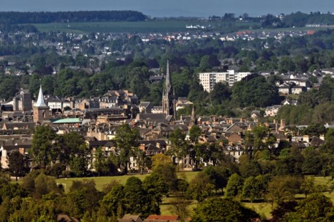
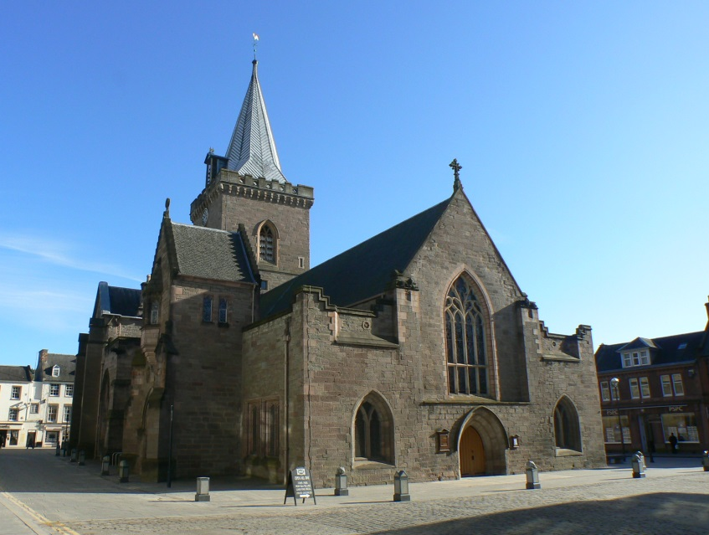
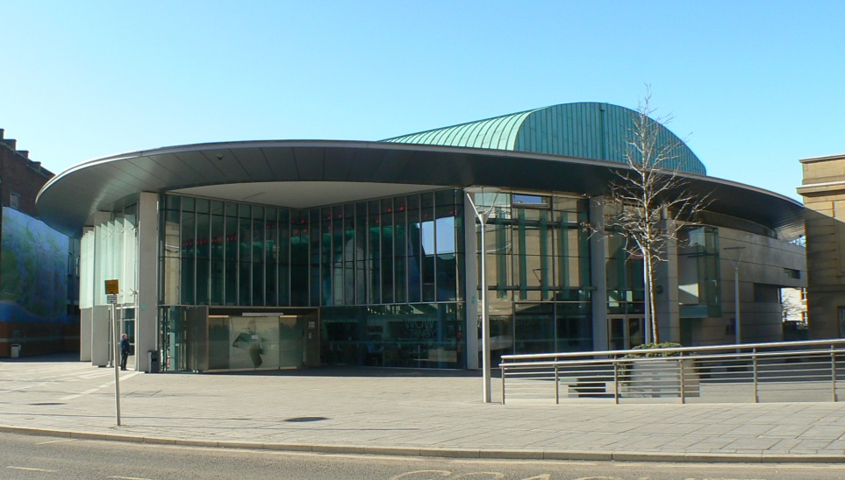
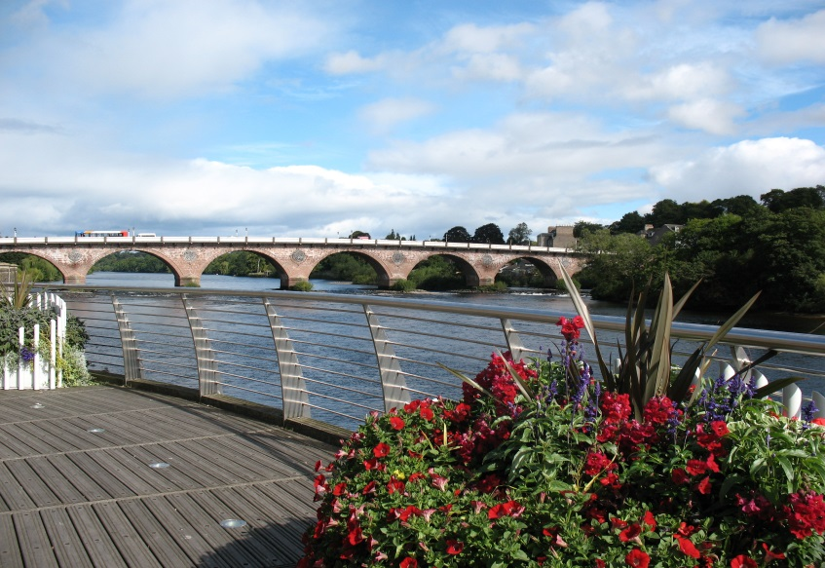
Perth Transport Futures - Problems

Slide 4
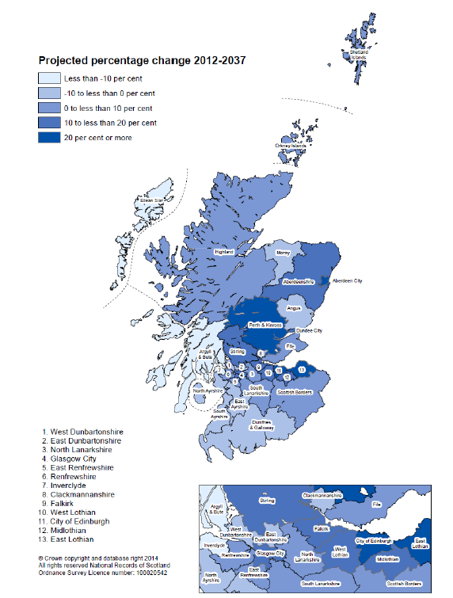
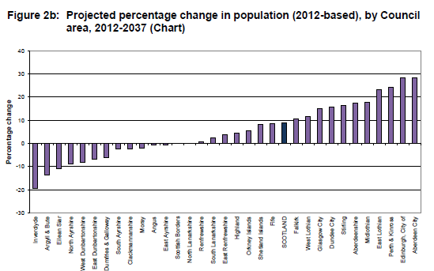
Perth Transport Futures - Problems
Population Projections 2012-37
Shift West to East
Perth & Kinross plus 24.2%

Slide 5
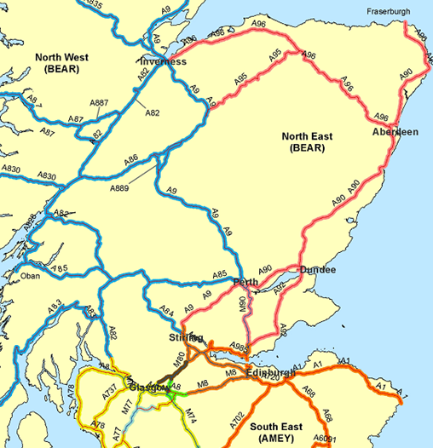
Perth Transport Futures - Problems
Majority of traffic to North and North East Scotland goes through or round Perth
Vulnerability of high level bridges at Dundee
& Friarton

Slide 6
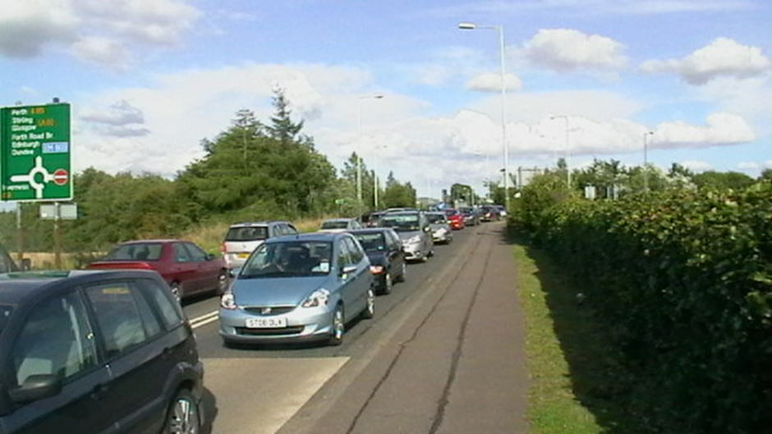
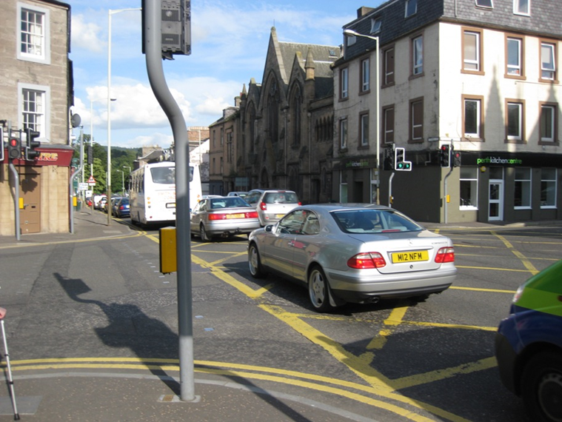
Perth Transport Futures - Problems
Early 1990s
Congestion becomes a local issue
Early 2000s
Congestion impacts on Trunk Road network and Air Quality becomes an issue

Slide 7
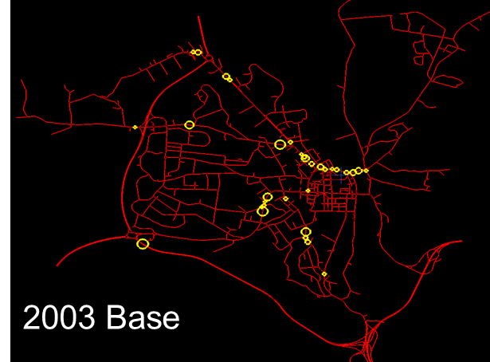
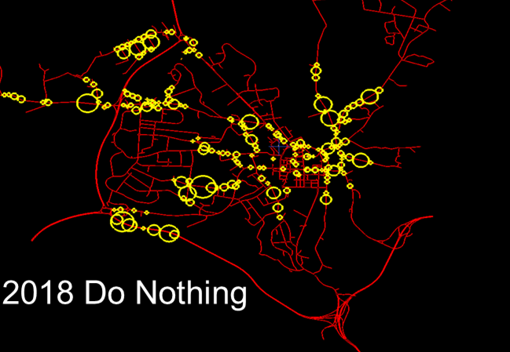
Perth Transport Futures
Impact of “Doing Nothing”

Slide 8
Perth Transport Futures
Impact of “Doing Nothing”
Air quality will continue to deteriorate with Atholl Street already identified as having one of the poorest air qualities in Scotland
  The sustainable economic growth of the Perth area will be constrained as the City is running out of employment land
  Congestion will increasingly impact on the wider Scottish economy and reduces the benefits in journey time to be delivered by the A9 upgrade (Estimated increase of 35min by 2033)

Slide 9
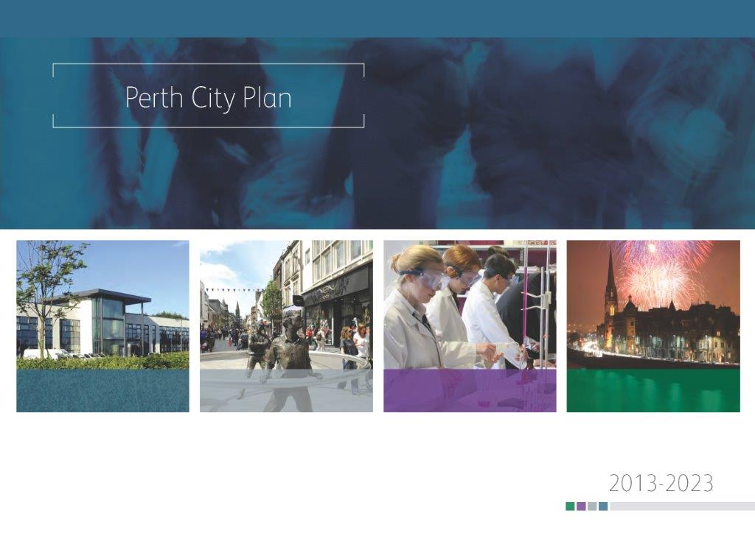
Perth Transport Futures
Strategic Rationale
Perth is Scotland’s third fastest growing area with an ambitious City Plan to deliver economic growth and increased prosperity
Perth is currently an AQMA as European Air Quality Standards are regularly breached and the Council has a statutory duty to address this issue
New development will also further increase congestion
Perth’s growth is constrained unless new roads infrastructure is put in place to mitigate the impact

Slide 10
Perth Transport Futures –
The solutions
Enter the world of
  STAG
  DMRB
  Key Agencies

Slide 11
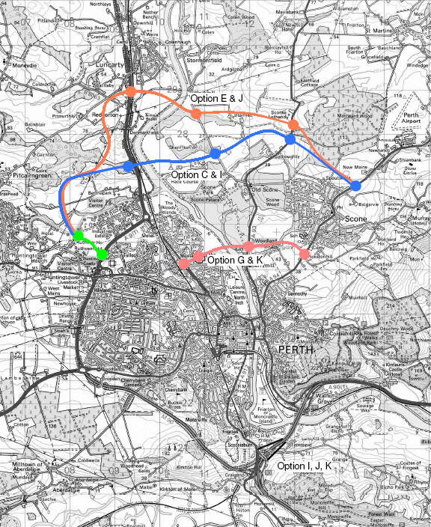
Perth Transport Futures
Internal traffic management solutions exhausted
Remove non essential traffic from City centre
Various options examined all required new bridge North of Perth

Slide 12
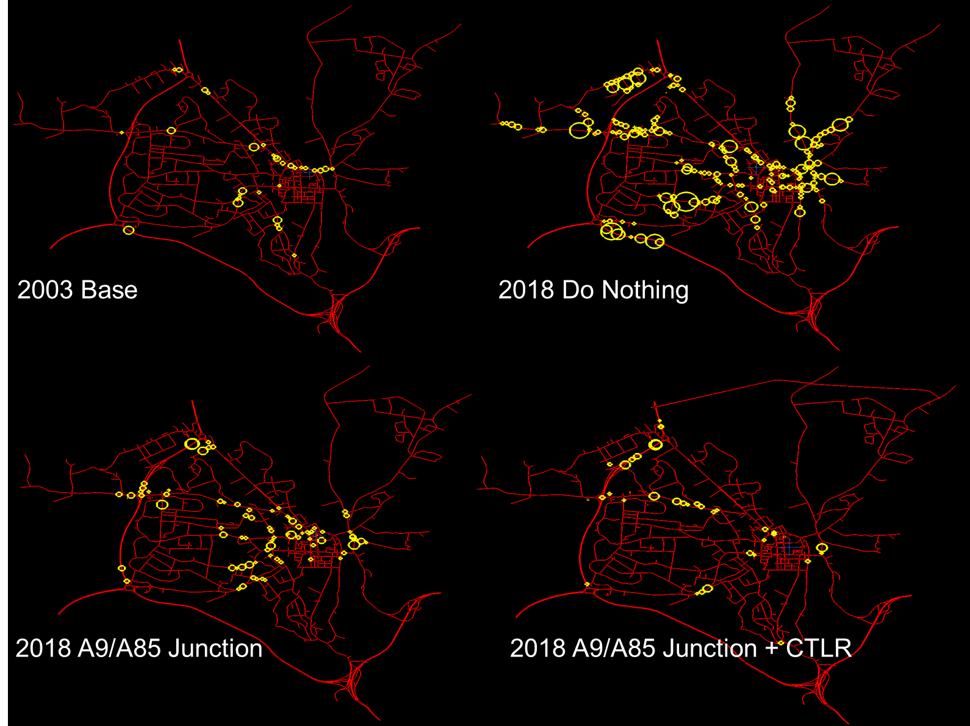
Perth Transport Futures

Slide 13
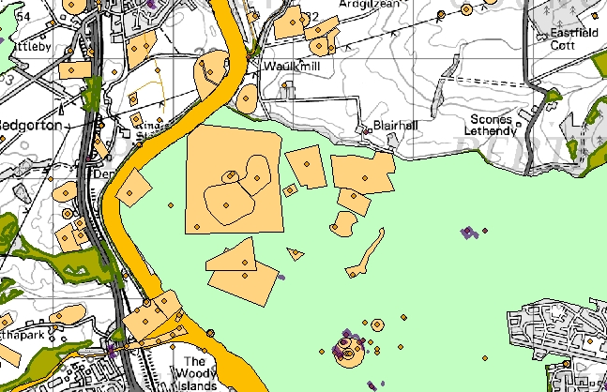
Perth Transport Futures
The Constraints
Ancient monuments
Listed Buildings
Unscheduled sites
Designed Landscapes
Flood plain
SAC
Ancient woodland
Junction Separation
CTLR

Slide 14
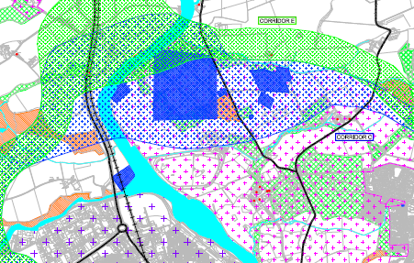
Perth Transport Futures
The Constraints
The answer - get the key agencies together

Slide 15
Perth Transport Futures Projects
The projects are an integrated series of measures (Including associated citywide improvements)
to address Perth’s long term transportation needs and ensure Perth’s growth does not compromise the national trunk road network.
Whilst many of the individual measures have merits in isolation only when all elements are in place does the optimum benefits accrue.

Slide 16
Perth Transport Futures Projects
The projects comprise 4 phases of works:
1a A9 / A85 junction
1b Cross Almond link to Bertha Park
2. Cross Tay link road
Berth Park link to A9
Associated citywide improvements
1-3 are listed in order of likely priority, the series of measures in package 4 can be implemented incrementally through the life of the project.

Slide 17
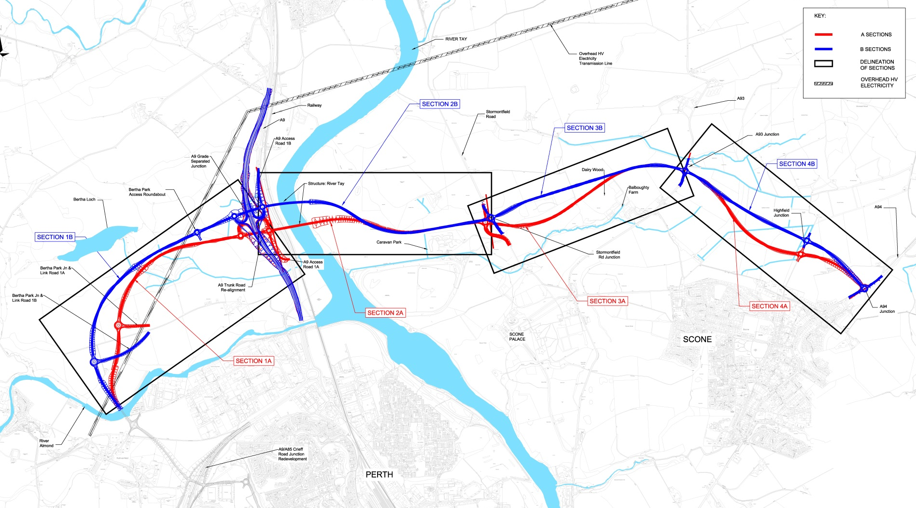
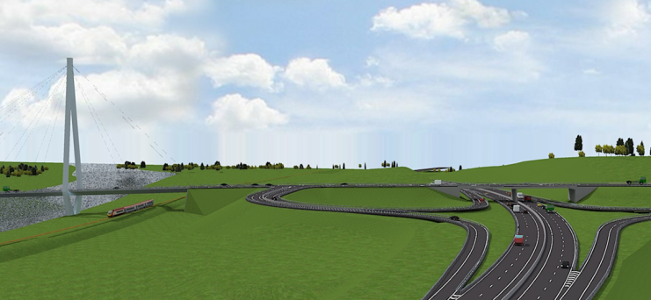
Perth Transport Futures - Projects

Slide 18
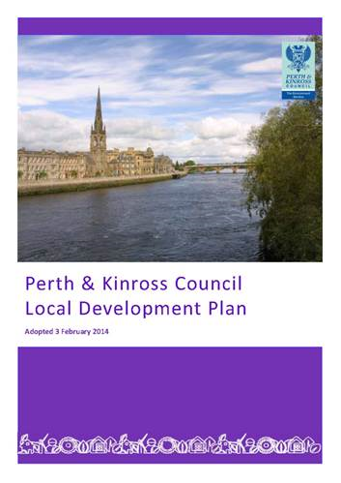
Local Development plan
The transport solution has been fully integrated into the Development Plan guiding the strategic growth of Perth and creating opportunities to maximise the potential for sustainable transport links to serve key strategic development sites

Slide 19
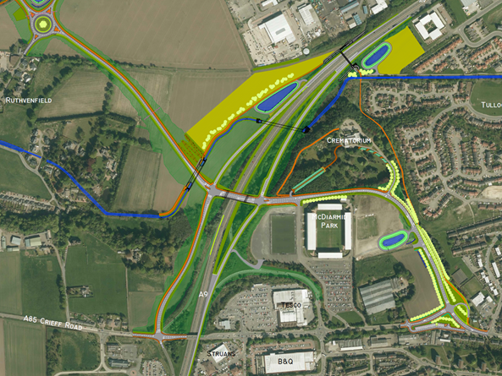
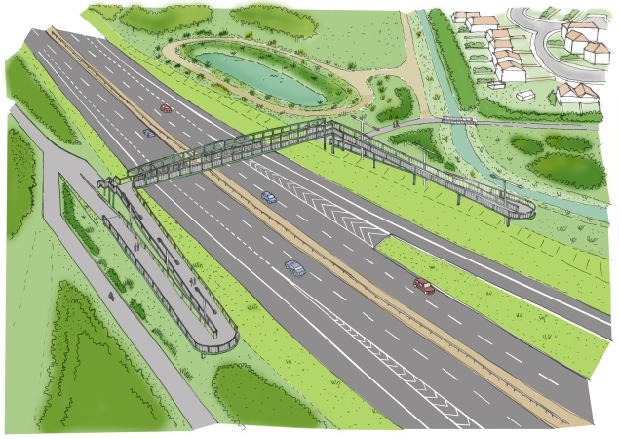

Phase 1a – A9/A85 Junction
Opening Up Perth’s Potential
25ha economic development land
Almond Valley -1,500 houses
New cycle / pedestrian bridge benefiting pedestrians crossing the A9
Improved access for
St Johnstone & Crematorium
New A9 overbridge making provision for Transport Scotland high load route
6ha opportunity site
Development along A85 Corridor
Relieves congestion & Improves air quality

Slide 20
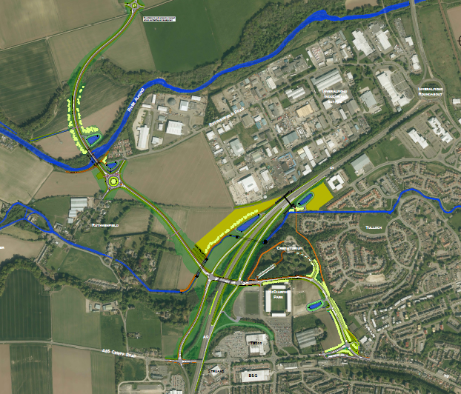
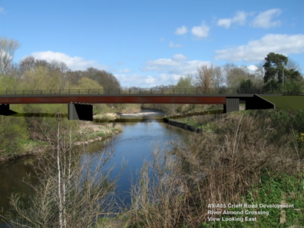
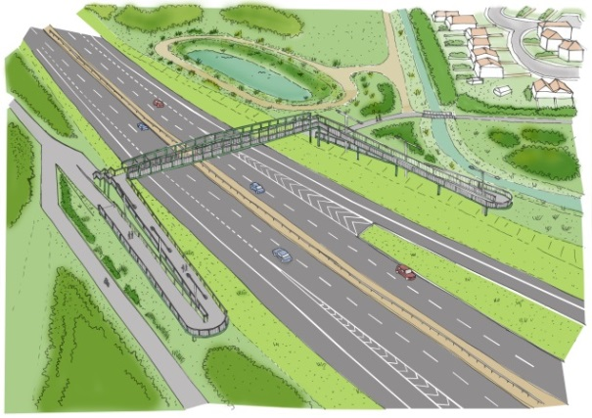
Phase 1 – A9/A85 Junction
Opening Up Perth’s Potential
25ha economic development land
Link Road to Bertha Park
3,000+ houses
25ha employment land
Secondary School
2 Primary Schools
Almond Valley -1,500 houses
New cycle / pedestrian bridge benefiting pedestrians crossing the A9
Improved access for
St Johnstone & Crematorium
25ha economic development land
New A9 overbridge making provision for Transport Scotland high load route
Almond Valley -1,500 houses
6ha opportunity site
6ha opportunity site
Perth West
3,000+ houses
25ha employment land
2 Primary Schools
Development along A85 Corridor
Relieves congestion & Improves air quality

Slide 21
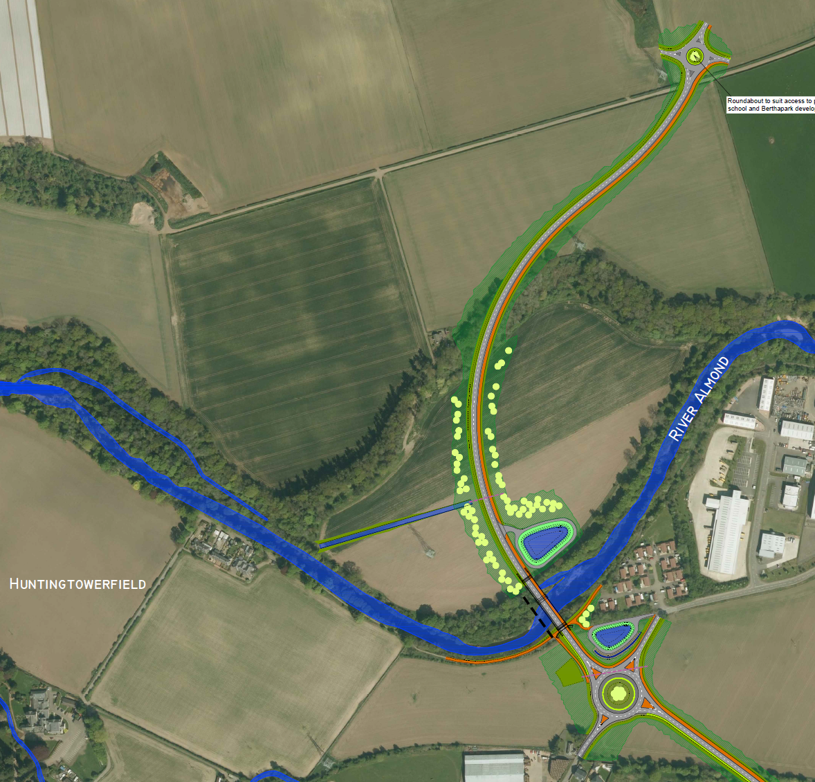

Phase 1a – A9/A85 Junction
Opening Up Perth’s Potential
Roundabout providing access to proposed school site
Bertha Park
Link Road to Bertha Park
3,000+ houses
25ha employment land
Secondary School
2 Primary Schools
New River Almond Bridge
New bridge over River Almond
Double Dykes Travellers Site
Roundabout providing easier access to Inverlamond Industrial Estate

Slide 22
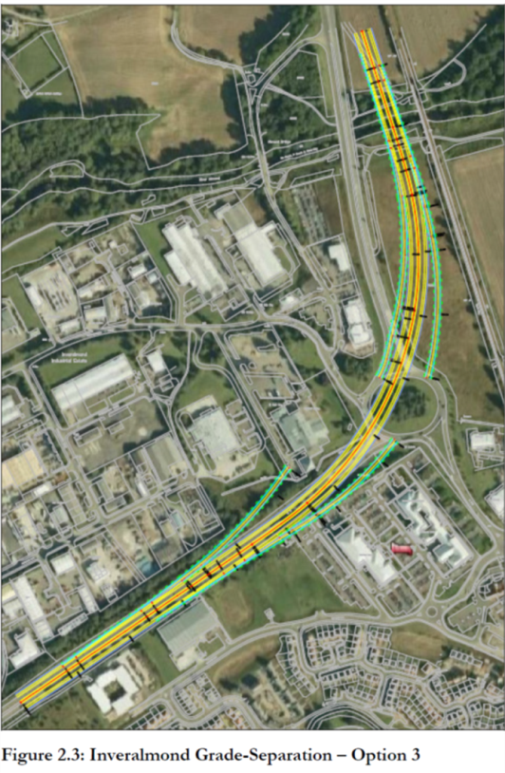
Inveralmond Junction
25 ha economic development land
Transport Scotland Project – Grade Separation
No timescale
Prohibitively expensive
(CH2MHill estimate £127M)
Relocation of several business
CTLR reduces pressure on Inveralmond Roundabout
At grade solution works and much more affordable
New cycle / pedestrian bridge
Almond Valley -1500 houses
6 ha opportunity site
Development along A85 Corridor

Slide 23
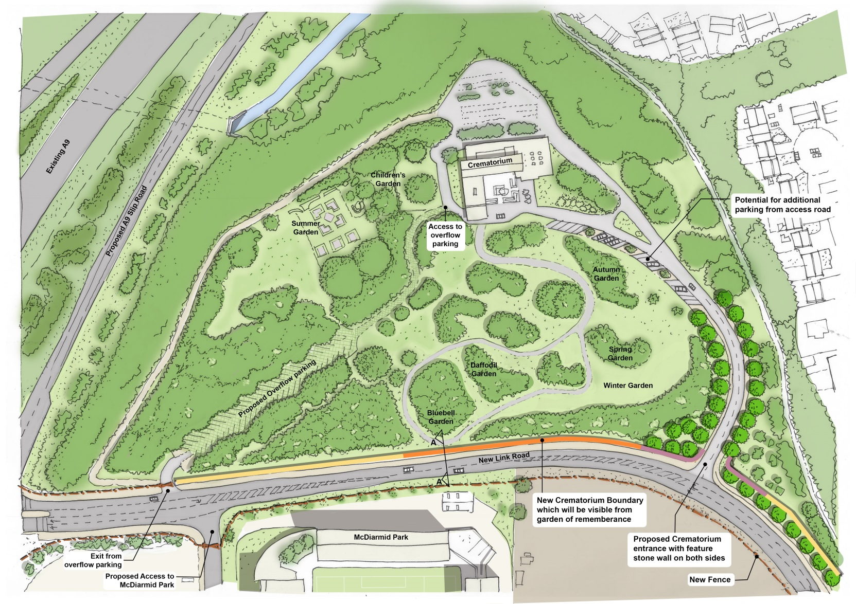
Perth Crematorium
25 ha economic development land
New cycle / pedestrian bridge
Almond Valley -1500 houses
Approximate Crematorium Boundary - - -
6 ha opportunity site
Development along A85 Corridor

Slide 24
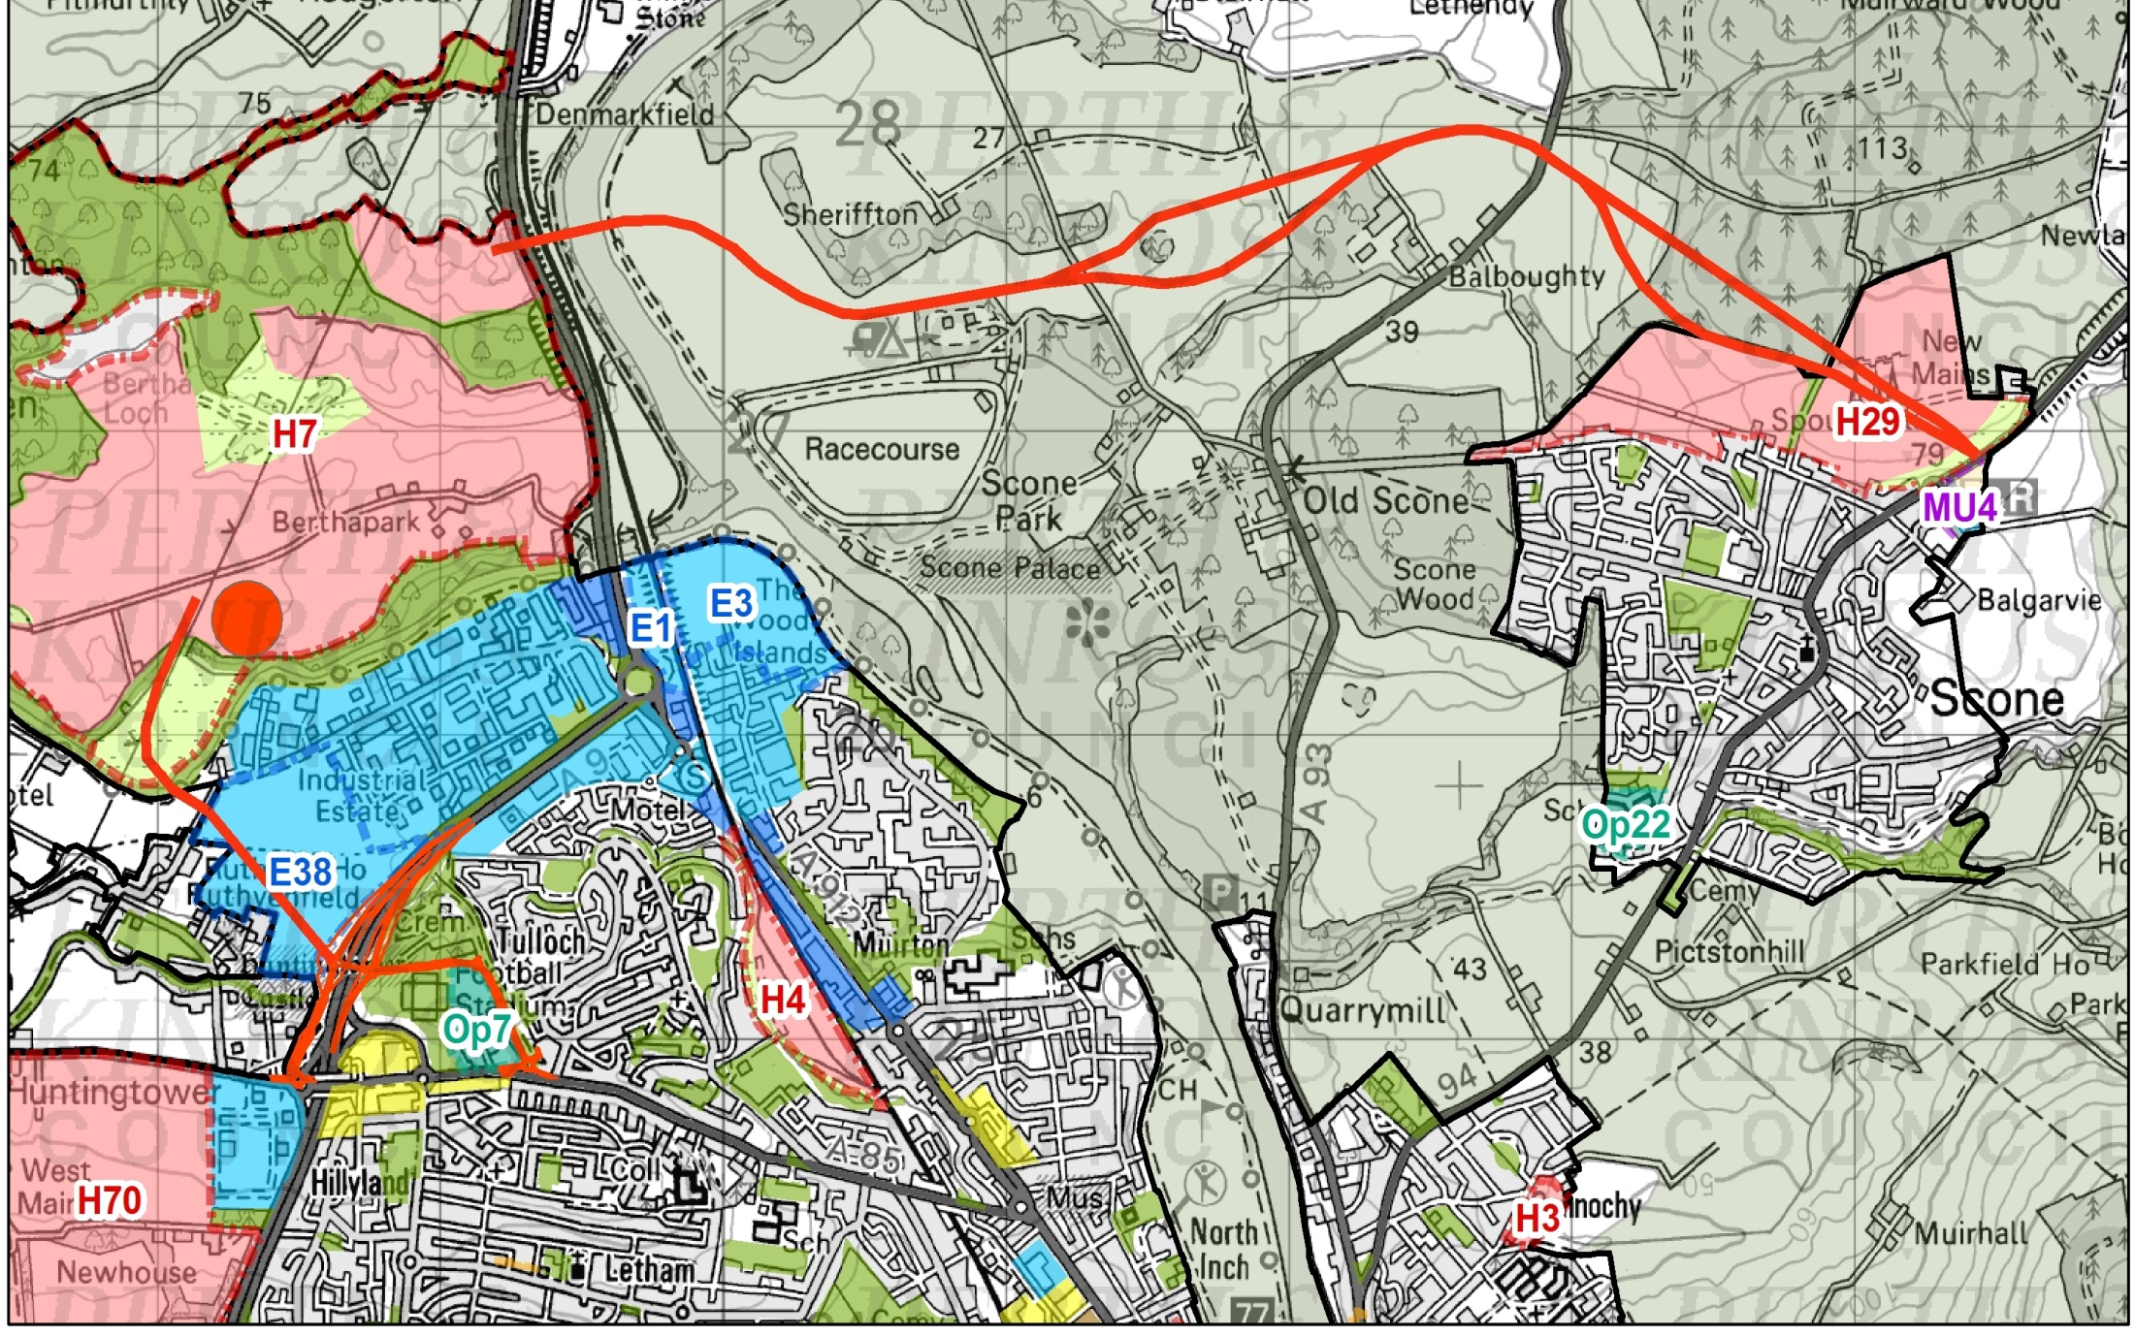
Phase 2 – Cross Tay Link Road
Luncarty 500+ houses
Releases development potential east of the Tay
Scone 800+ houses
3000+ houses
Improved events potential at Scone Palace
Relieves traffic pressure from Inveralmond roundabout
1500+ houses
Estimated Cost £88M
Phasing 20-22
3000+ houses
Relieves traffic pressure and air quality on Bridgend and Atholl Street

Slide 25
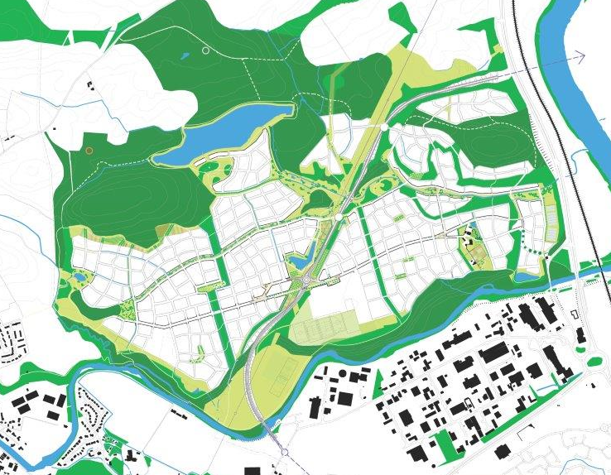
Phase 3 – Bertha Park Link
Draft Bertha Park Master Plan
The final section of the link is the connection from the A9 through Bertha Park. This will be built out as the development proceeds
The final section optimises the flexibility of the system
Phasing: beyond 2020

Slide 26
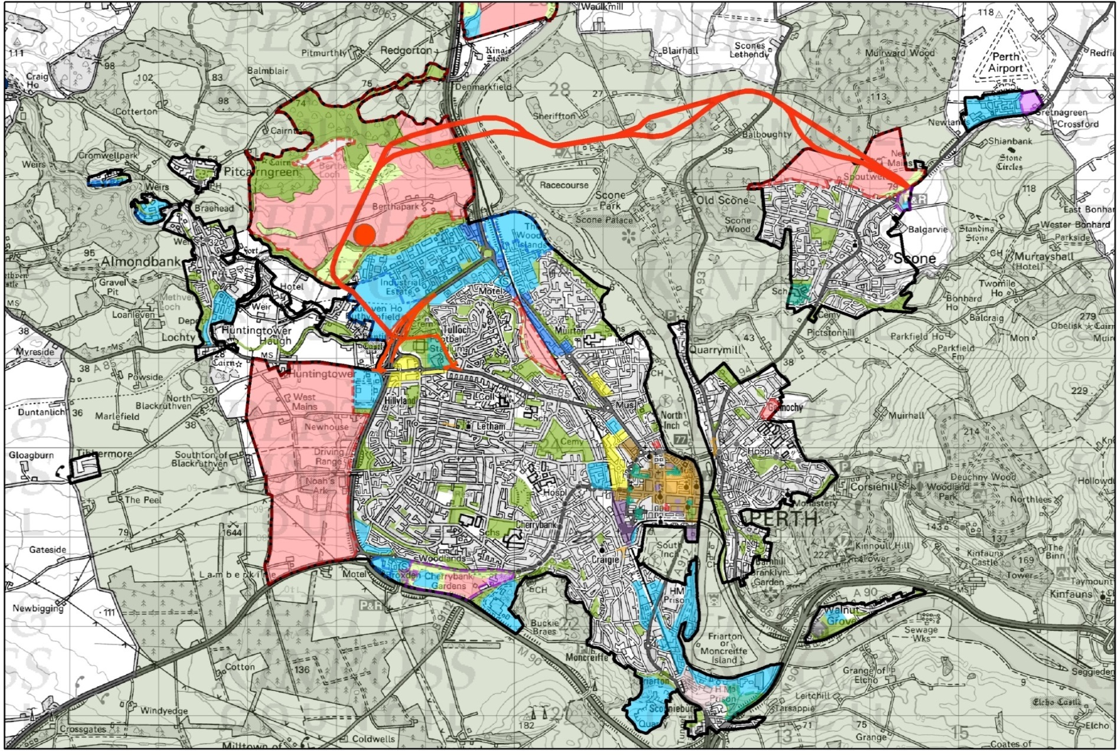
Phase 4 – Citywide Improvements
New Park and Ride
Junction improvements
Phase 4 is a £25M package of measures to improve traffic flows in central Perth and enhance the potential of public transport and walking and cycling.
Some projects are already implemented and phasing of these measures will extend beyond 2020.
Bus lanes
Friarton Link Road
New Park and Ride

Slide 27
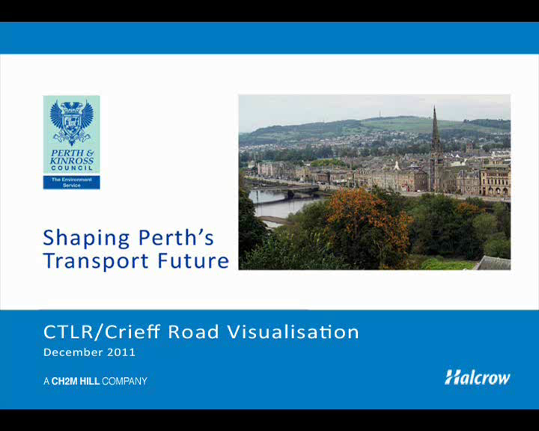
Visualisation

Slide 28
Next Steps
Phase 1a/1b A9/A85 Crieff Road to Bertha Park
June 2015 CPO Inquiry (Critical Risk if Inquiry date delayed)
August 2015 CPO Confirmed by Scottish Ministers
Jan 2016 Contract awarded
Feb 2018 Completion
Phase 2 Cross Tay Link Road
Mid 2015 DMRB 2
Mid 2016 Planning Application (Critical risk Aecom A9 Studies)
2016 CPO progressed
2017 DMRB 3
2020 Contract awarded
2022 Opening
Phase 3
Planning Application as part of Bertha Park June 2015
Completion to be aligned with Phase 2 completion

Slide 29
Funding
A9/A85 junction Phases 1a and 1b requires borrowing of up to £39million and the Council approved this in May 2014.
A85(T) Corridor – Transport Scotland upgrading traffic signal junctions at Tesco and Auction Mart and undertaking resurfacing works. Upgrade of junction at Newhouse Road from a roundabout to traffic signals is critical but remains unfunded.
Supplementary Guidance on Developer Contributions towards transport infrastructure in operation anticipated to bring in £40million over 30 year period.
The Cross Tay Link Road cannot be funded by developer contributions alone and will require a new funding model such as a City Deal and/or a significant contribution from Transport Scotland. Discussions ongoing.

Slide 30
Summary
Perth Transport Futures Project is vital to the sustainable economic growth of the City over the next 30 years
The Project allowed the LDP to identify a series of 5 Strategic Development Opportunities including
  Approximately 9,000 houses
  80ha of Employment Land
  1 Secondary School
  5 Primary Schools
Provisional estimate of investment
  Investment £2.5 Billion
  Jobs in excess of 5,000

Slide 31
Summary
Critical Success Factors
  A Council that embraces growth and accepting risk
  Integration of Transport and Land Use Planning
  Robust traffic modelling
  Fundamental shift to PKC front funding infrastructure
  Developer Contributions policy in place

