Slide 1
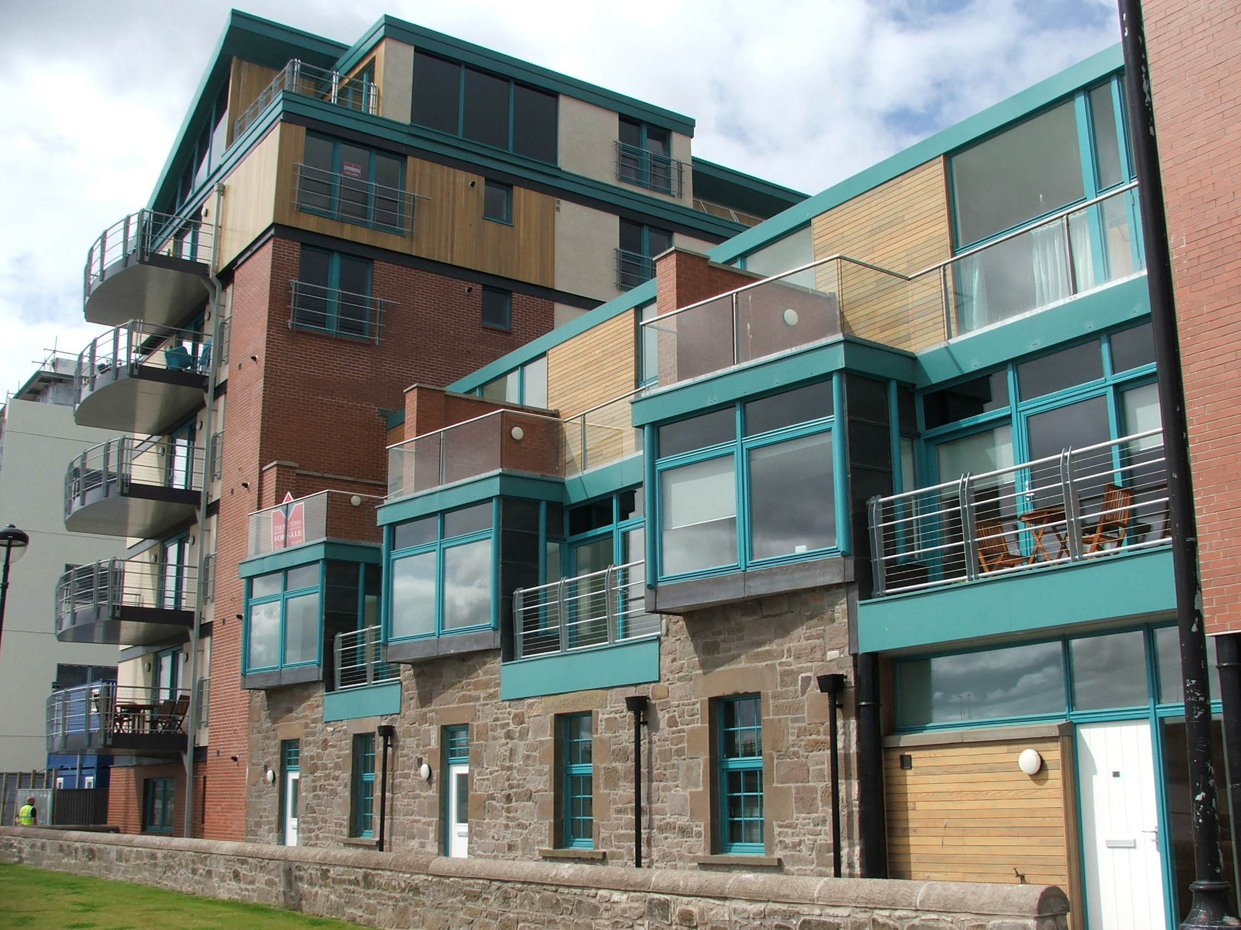
Enabling growth through housing
Pam Ewen
TAYplan SDPA Manager
RTPI Scotland Convenor

Slide 2


Slide 3
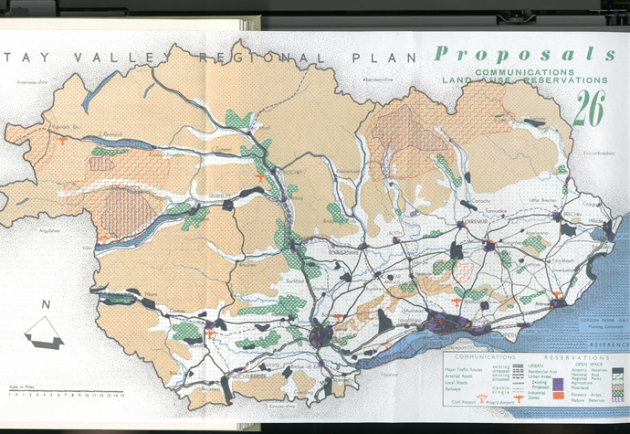
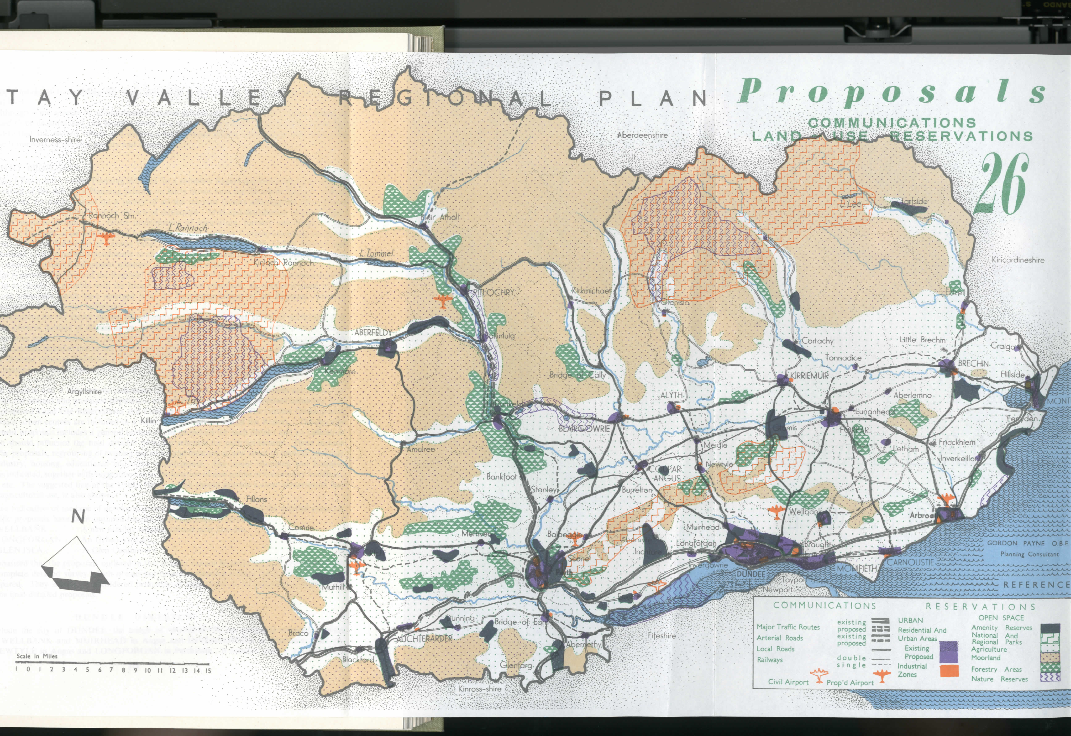

Slide 4
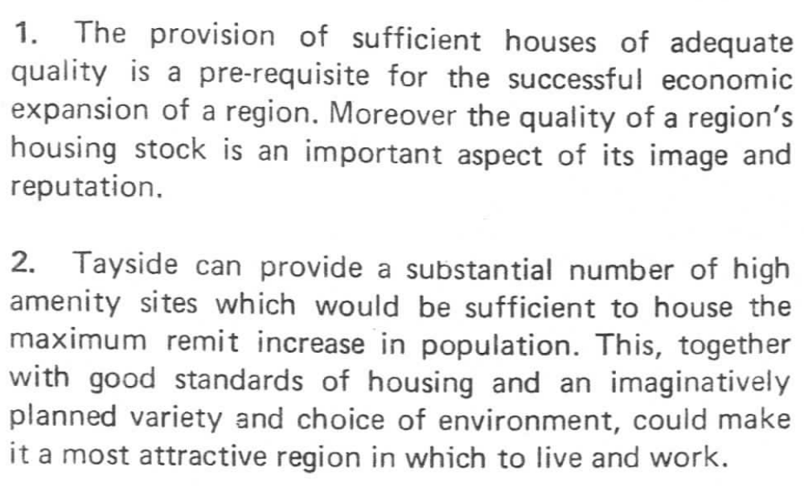
Extract from ‘Tayside – Potential for Development, 1970’

Slide 5
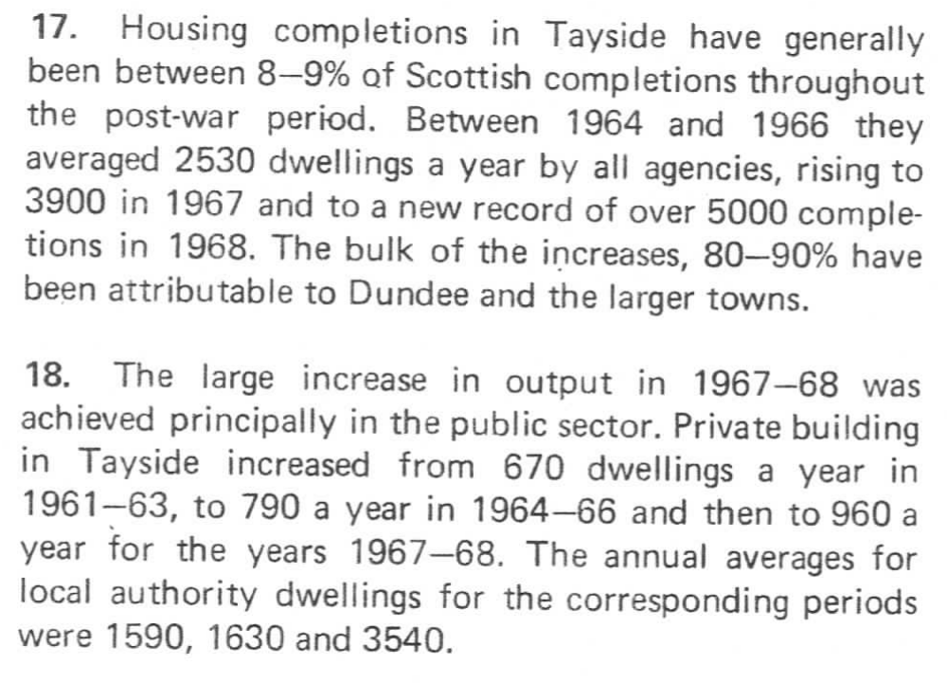

Slide 6
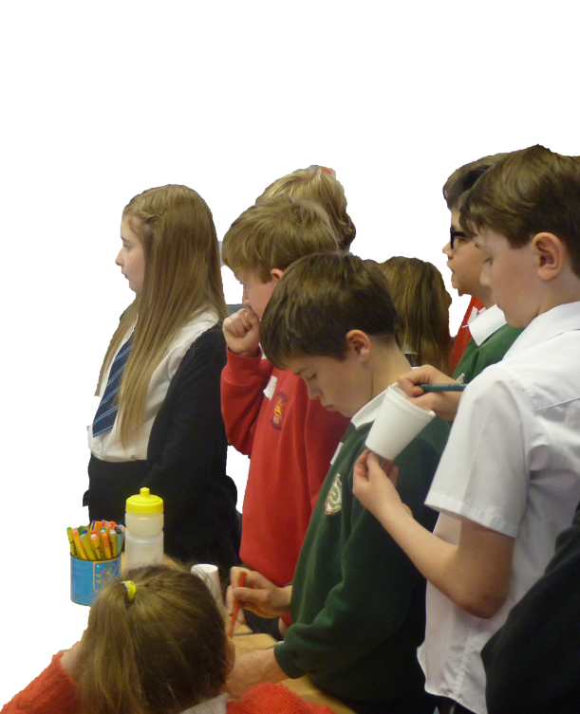

TAYplan: Engaging with young people
“Make new housing attractive: no white harling or toy like”
“Need to care for elderly and affordable housing for young people”
“Houses have to be built so they are comfortable for families”
“Safe & comfortable homes”

Slide 7
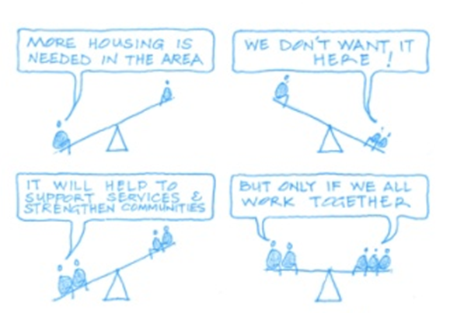

Slide 8

Community Engagement
Land
Infrastructure
Finance
Leadership

Slide 9
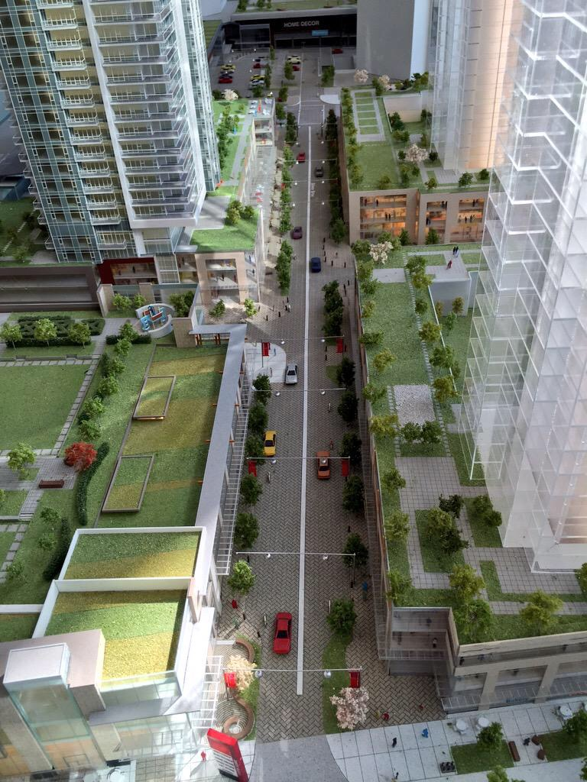

International glimpses:
pubic sector enabling growth & new homes
Burnaby

Slide 10
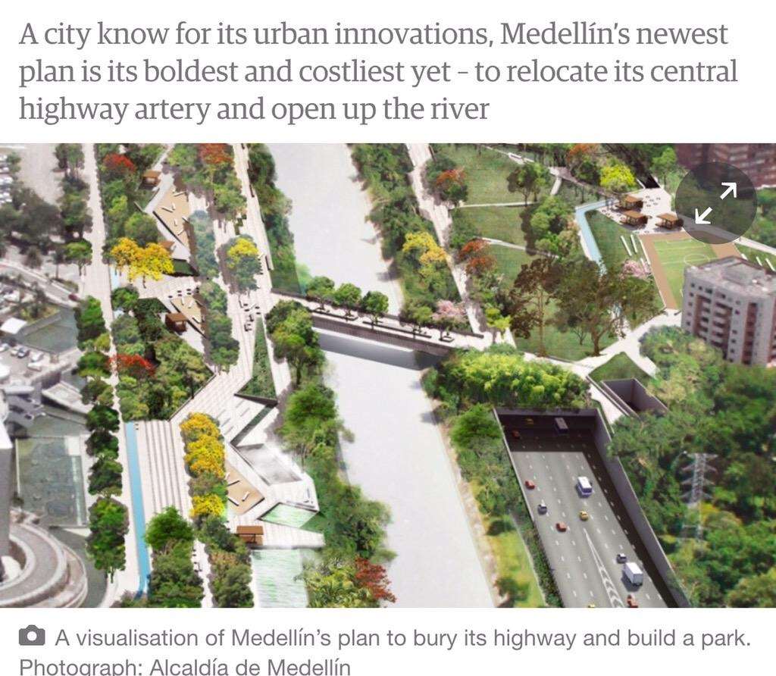

Slide 11
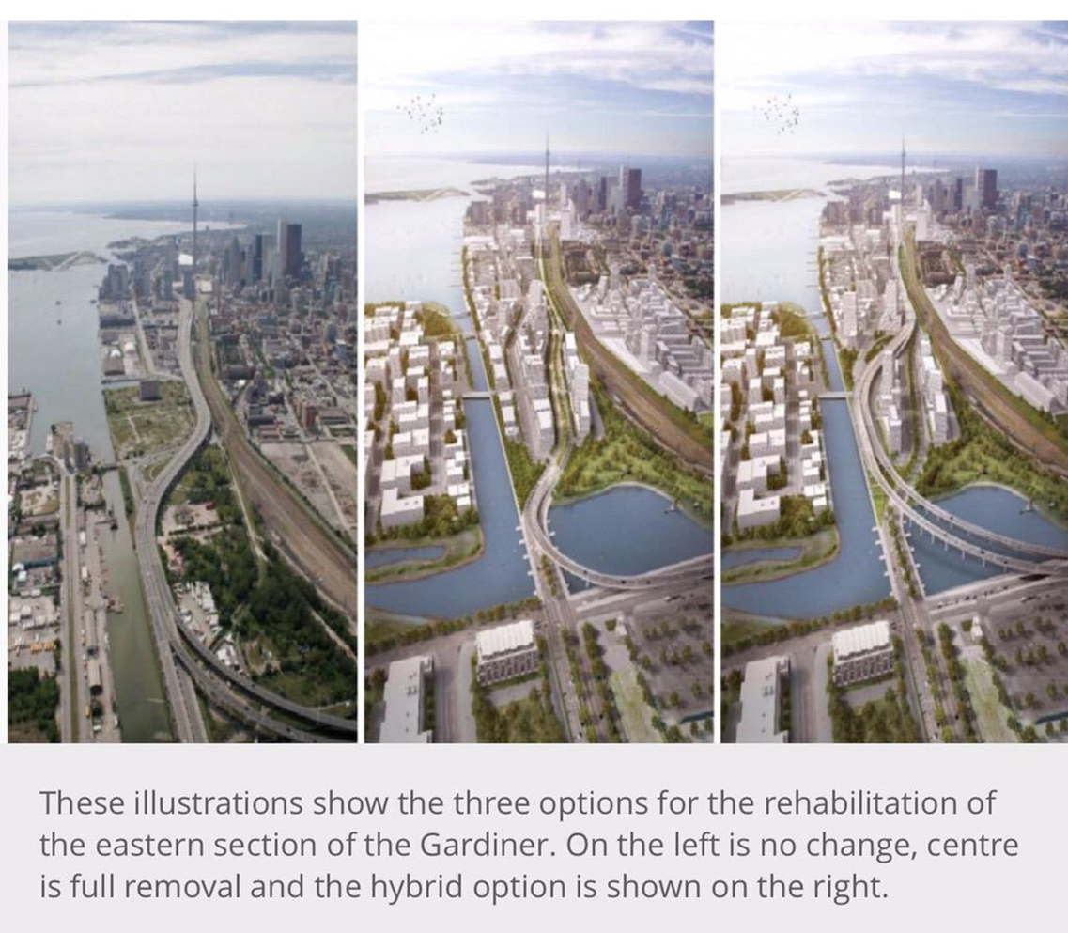
Toronto

Slide 12
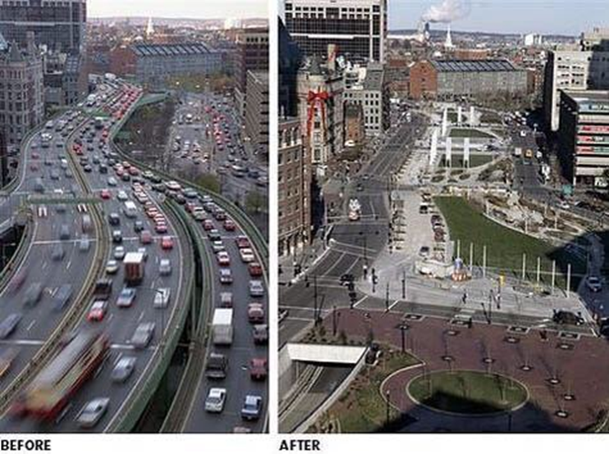
Boston

Slide 13
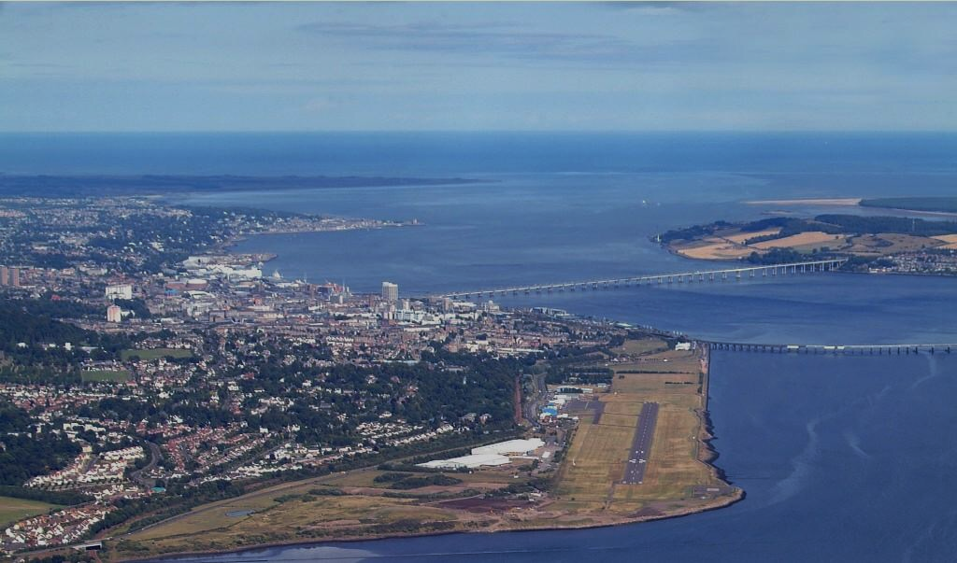
#gamechangers

Slide 14


Emerging lines
Accept need for planned, sustainable growth
Role of planning as enabler
Need to link vision to delivery
Need to better link development and infrastructure

Slide 15
Challenges
  Planning being seen as a barrier
  Effective land supply debate
  NIMBYism
  3rd Party Rights of Appeal
  Resources and performance
  Public service reform

Slide 16
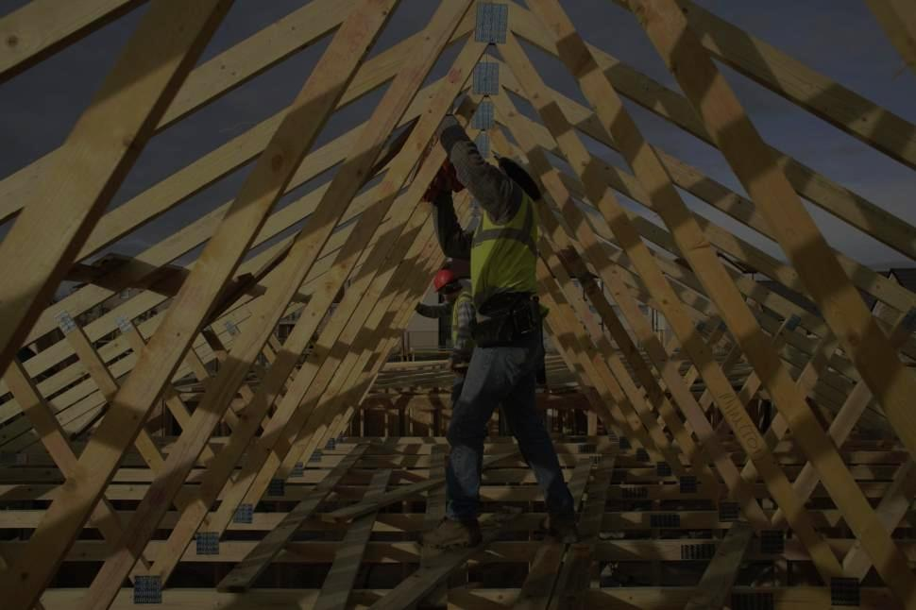
Delivering
Homes

Slide 17
Upfront funding, infrastructure and land assembly
More proactive role for NPF on development and infrastructure
Promote private Rented Sector through planning

Slide 18

Effective Planning Processes
Effective Planning Processes
Effective Planning Processes

Slide 19
Remove penalty clause and replace with incentive system
Declutter planning processes and procedures
Upstream community engagement

Slide 20
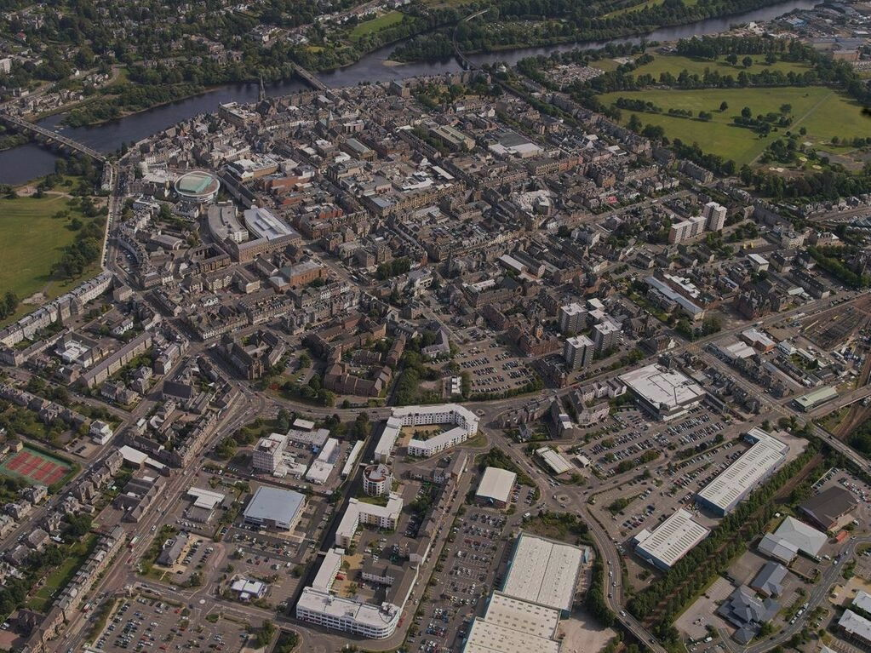
Importance of Place

Slide 21
Planning and community planning link, planning as corporate service and preventative spend
Cabinet Secretary for Places

Slide 22
Additional personal thoughts….
Evidencing whether a site is effective and when it is deliverable could be a requirement on the site/land promoter – not the Planning Authority
Let’s have a discussion on whether Housing Supply Targets could be set in the NPF at Local Authority level - explore the benefits and risks
Re-think Housing Needs & Demand Assessments (HNDAs)
The public sector need to start building more homes, better aligning land and property assets
Greater leadership and visioning to create great places

Slide 23

RTPI, Planning Horizons Paper: Thinking Spatially, 2014

Slide 24
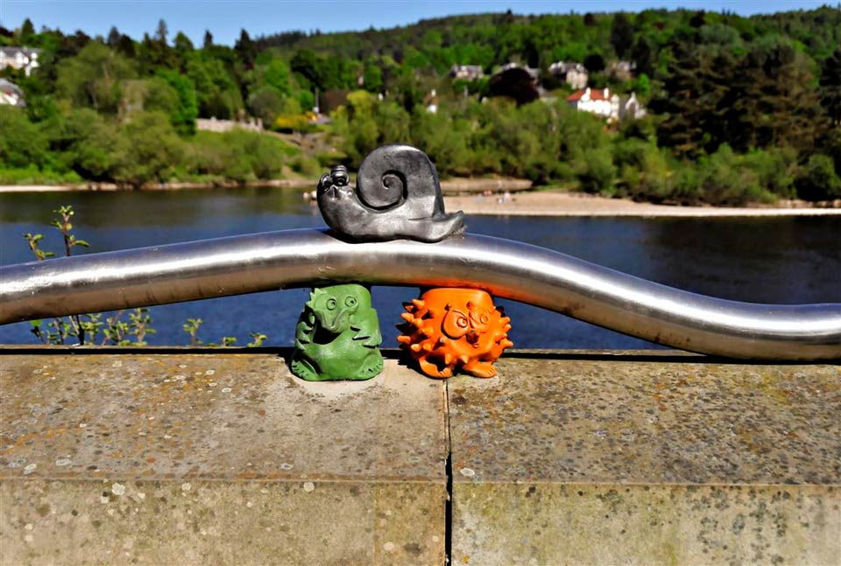
I’m alright, I have my self-built home
Chill...the heads of planning are just along in The George working it all out
Hey, Greeney, where will we get a home?
@tayplan @convenorRTPIs

