Slide 1
ENABLING GROWTH THROUGH HOUSING
June 2015

Slide 2
Homes for
Scotland
Nicola Barclay
Director of Planning

Slide 3
Housing Completions

Slide 4


Slide 5




Slide 6

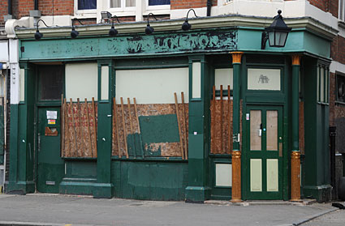
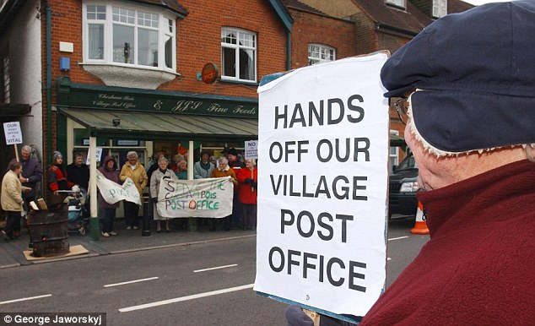

Slide 7


Slide 8



First Occupation Expenditure
£5,000 per house
£125 million EACH YEAR

Slide 9
CERTAINTY
How many houses can we build?
Where will those houses be?
When will we be able to deliver them?
  How much will it cost?
Sites allocated will be delivered?
Sites allocated CAN be delivered?
Sites are allocated where people want to live?
Why is the current system not delivering this growth?

Slide 10
CERTAINTY
How many houses are required?
Where should they be built?
When will they be available?
- and what’s it going to cost us?

Slide 11
How many houses are required?
Agree figure pre-MIR stage
Removes the debate from the process
Consider sustainable annual growth targets of 5% year on year
– certainly for the City regions

Slide 12
Where should they be built?
Allocated sites not coming forward
- too expensive
- poor market area
Suggestion of increasing generosity allowance to 100%

Slide 13


Slide 14
When will they be available?
Streamline consenting process
Increase delegated powers for allocated sites
Processing Agreements – include S75, RCC

Slide 15
And what’s it going to cost us?
Infrastructure delivery
Strategic Infrastructure Investment

Slide 16
And what’s it going to cost us?
Certainty
    Know upfront what the costs are
    Quicker decision making
    Smoother planning process
Proportionate and economically viable

Slide 17

The time has come for this new conversation.
Are you ready?

Slide 18
“ Good housing is important for individuals and families but also for wider society.
It can support economic growth, promote strong, resilient communities and improve health.
Links between housing and other policy areas at both national and local level should be stronger, to help improve the impact that good housing can make to our communities”
(John Baillie, Chair of the Accounts Commission, July 2013)

