Slide 1
Enabling growth through housing
Heads of Planning in Scotland
Annual Conference , 11/12 June 2015
Keith Anderson
CEO Port of Leith Housing Association, and
Chair of Chartered Institute of Housing in Scotland
19th March 2015

Slide 2
Overview
Scotlands’ housing strategy
Recent performance on new supply
The housing “system” we have and the one we need
The new Joint Housing Delivery Plan for Scotland
A few conclusions

Slide 3

Housing Strategy/Policy in Scotland
4 main strands over past 4 years

Slide 4

Reviews and critiques

Slide 5
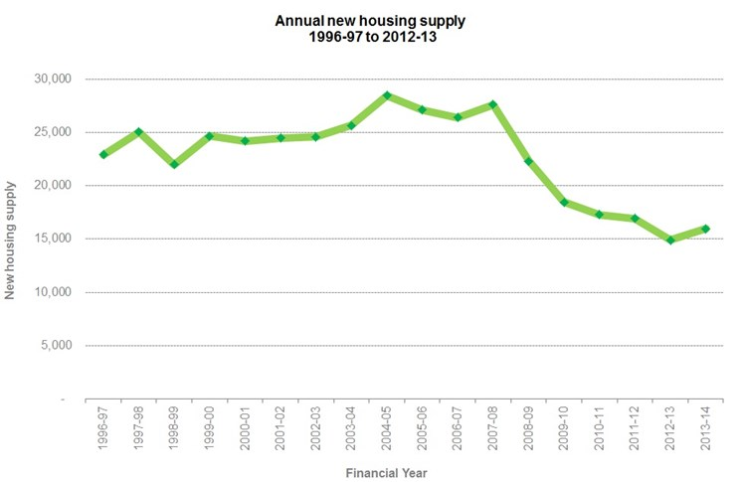
National performance – purpose target
“Increase the number of new homes”

Slide 6
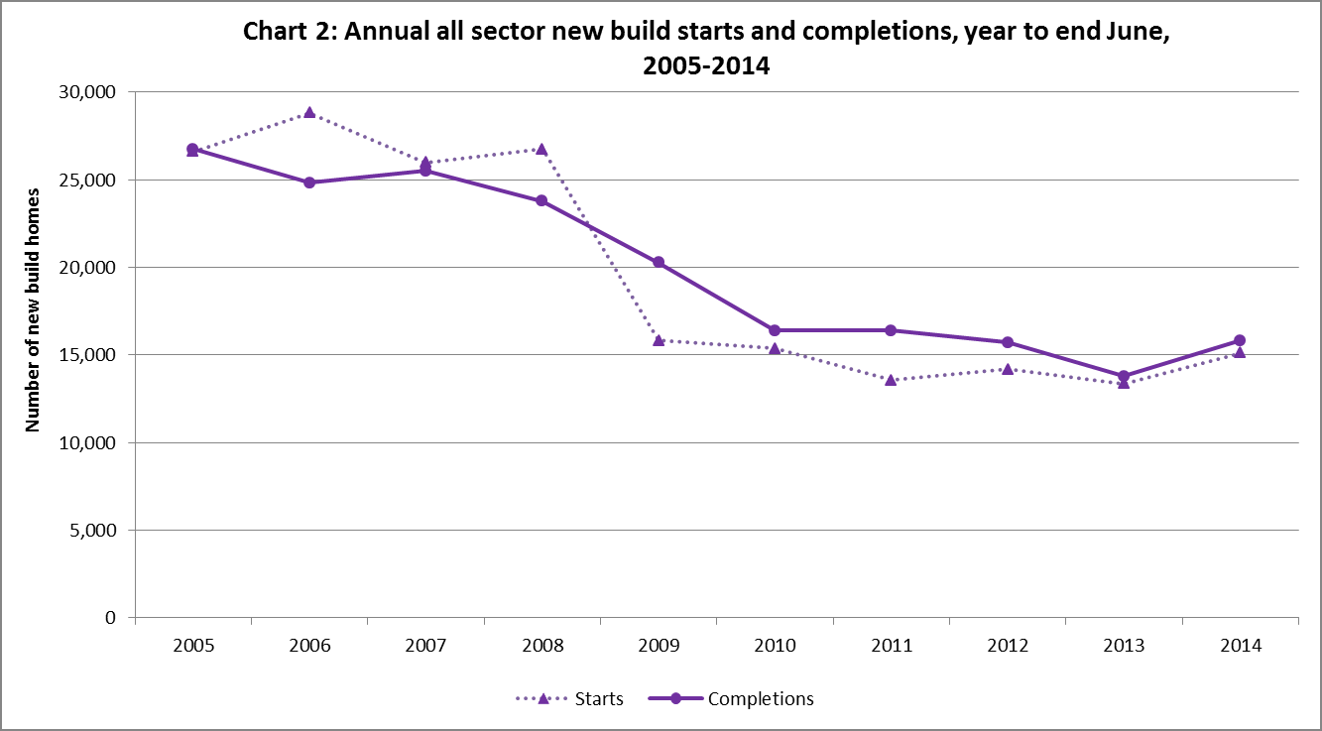
New supply (all sector) performance

Slide 7
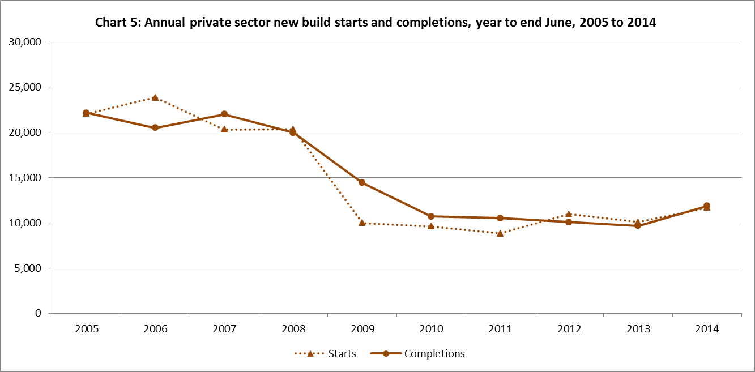
New supply (private sector) performance

Slide 8
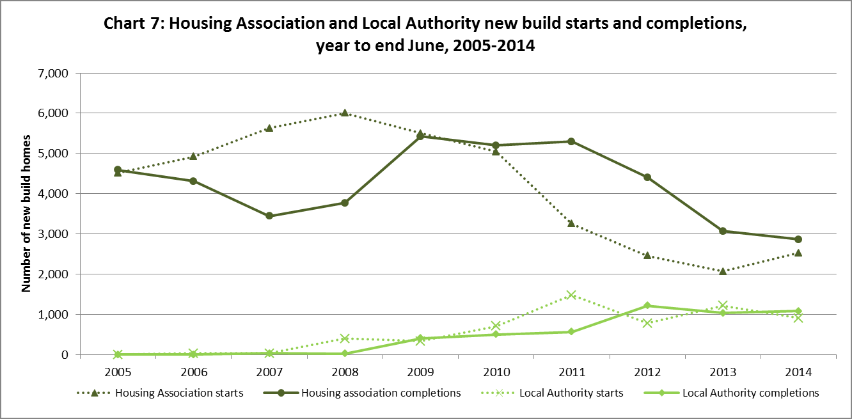
New supply (RSL/LA) performance

Slide 9
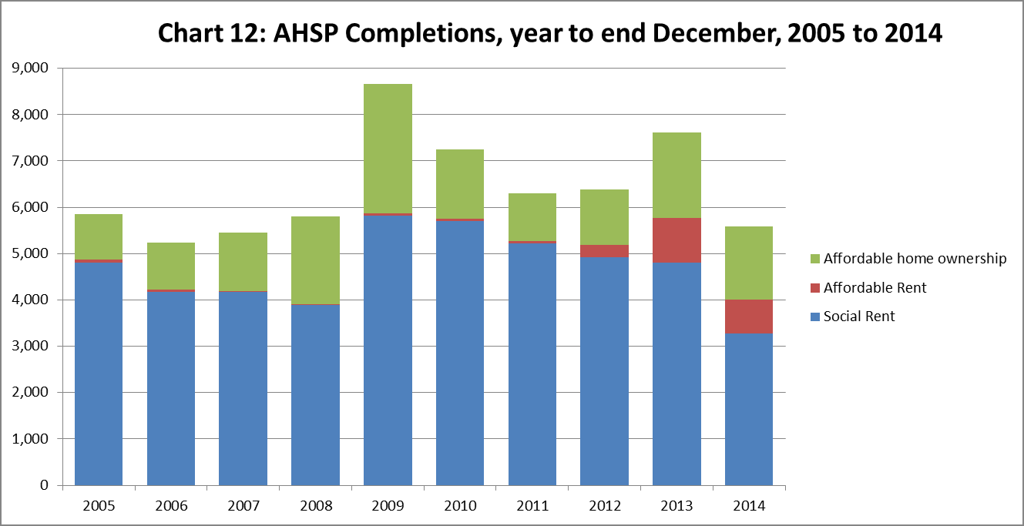
Outturn new affordable housing supply

Slide 10
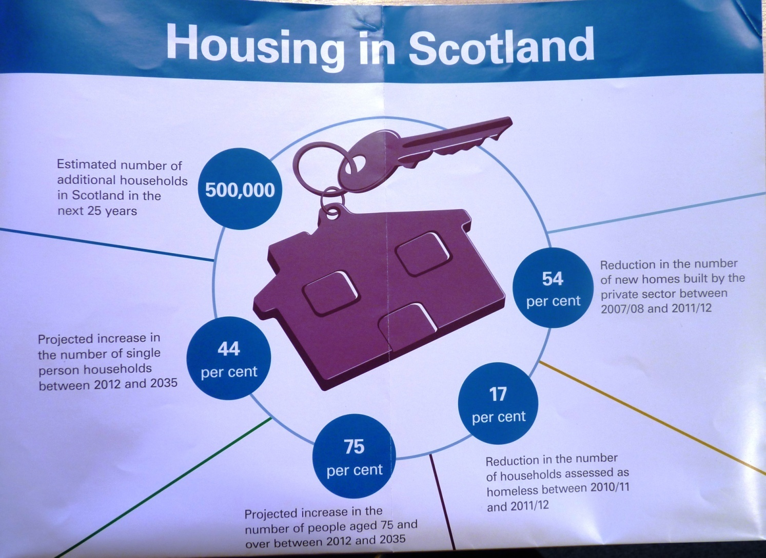
Audit Scotland (2014) – need and complexity

Slide 11
Current housing “system” wide issues to address
Works for some (private owners/social renters) but crisis for large growing numbers (many private renters/many young people/homeless/waiting list) .
Planners are gatekeepers of the market – the cost of restricting housing supply is higher prices felt by ALL.
House prices vary by up to 80% for the same house depending on where it is built = disparity interferes with peoples ability to access the job market = wrong outcome for sustainable development and social justice!
An effective, flexible housing system reduces the volatility of house prices to buy and rent.
The price of land and its supply is the key variable.
Land Reform Review Group report (Part 5) is required reading.
Kate Barker, “Housing – where is the plan?” - another must read.

Slide 12
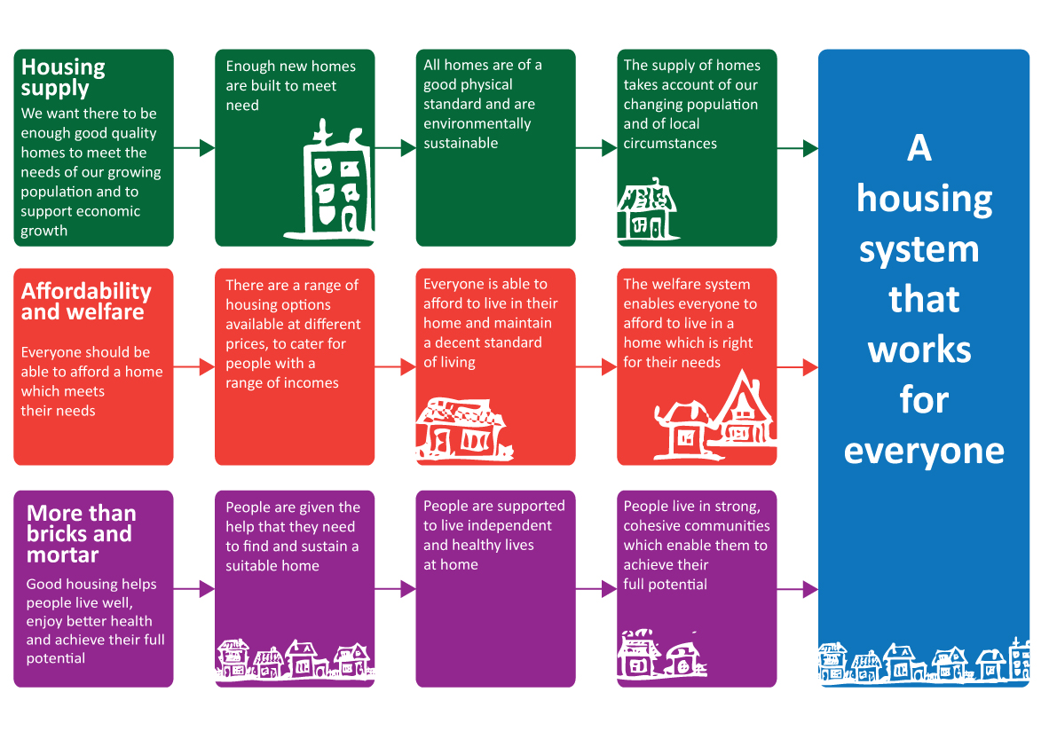
The housing “system” we need
= one that works for everyone

Slide 13
Housing need and demand for the next generation
330,000 new households forming over next 25 years = new supply of c30,000 homes per year for a sustained period including 1/3 affordable for below average income households
c 40% households in Scotland experiencing fuel poverty = renewed focus needed to tackle disrepair in private sector and drive up standards.
Growth of 75+ yr olds from 13% now to 20% of total population in 20 years time = new and different ways to support independent living to prevent and reduce public spending on acute/emergency services.

Slide 14
Joint Housing Delivery Plan for Scotland 2015-2020
“We require behaviour change, better collaboration and information, and better use of resources”
Focus on where there is systemic failure and blockages to progress in order to secure improved outcomes.
Published on 3rd June 2015
2 Main themes;
Home and Place – 20 actions which focus on supply, investment and planning (13), sustainability (3) and place making(4) .
Housing Journey and Support – 14 actions which focus on independent living (5), housing options (4), and the private rented sector (5).

Slide 15
2 actions for Heads of Planning to take lead on
Action 4 – recommend improvements in communication and joint planning between infrastructure agencies at a local level, including a mutual understanding of capacities, thresholds and investment timescales – by end 2015
Desired outcome = increase pace of housing supply through infrastructure investment which supports housing development.
Action 11 – improve understanding of the planning process through support in the pre application process and raising the quality of applications – guidance and training done by 2016
Desired outcome = more homes delivered by SME builders.

Slide 16
3 actions for Heads of Planning to support delivery
Identified partner to support delivery with ;
Action 7 – pilot and share a range of approaches for development plans using mapping techniques to support and encourage more engagement by communities – pilot authority identified by Summer 2015.
Desired outcome = more public support for housing development and buy in to long term visions for communities and places
Action 9 – Agree and promote the use of more robust, realistic and consistent definition of effectiveness – joint understanding agreed by Summer 2015.
Desired outcome = public and private sector agreement on a definition of effective land supply and more housing projects proceeding with better information
Action 10 – Feed into report and recommendations following up Land Reform Review report and RICS report on CPOs and land assembly – scope recommendations and alternatives by Summer 2015.
Desired outcome = recoms. re use of CPOs and Land assembly measures which can then be used to further facilitate housing development and regeneration.

Slide 17
Conclusion – reasonable progress but...
Inadequate investment in enabling and supporting infrastructure.
Poor/limited effective land assembly mechanisms being applied to address the generational effort needed to meet housing need and demand.
Lack of financial capacity within many providers of affordable housing in operating context of ongoing subsidy constraint and higher cost of finance.
Lack of players – attitude and behaviours of some large developers may have short term economic logic but not in the wider public interest.

Slide 18
Thank you for listening
Contact
keith.anderson@polha.co.uk

